Slide 1
Team Osan Townhall
August 2024
School Liaison,
Child & Youth Programs

Slide 2
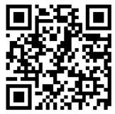
Open Forum Q&A
Scan the QR code to submit questions in advance for the Q&A Portion at the end of the Town Hall

Slide 3
School Liaison Program
DoDEA & Base
School Advisory Committee (4x SY)
Installation Advisory Committee (4x SY)
School Meal Program
Transitions for your students
Anchored4Life at OES
Ambassador Program at OMHS
School Liaison to host Army bases & DoDEA October 2024
Transportation
Godeok – DoDEA & BEK
Pre-K | CDC support

Slide 4
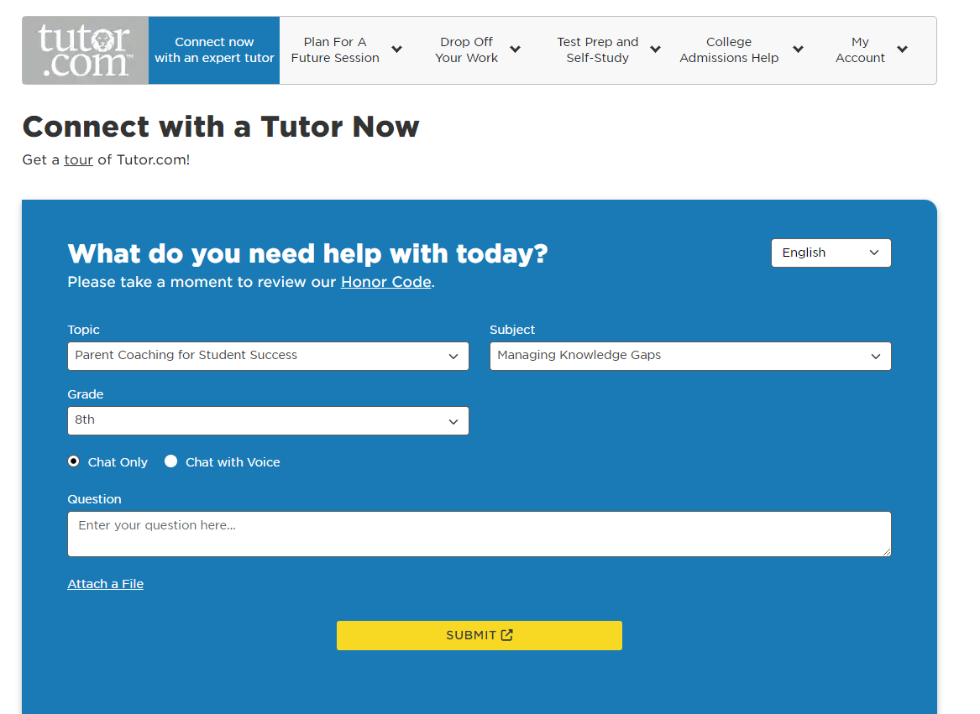
School Liaison Program
Non-Command Sponsored Families
Off Base Tuition options
Homeschool options
Space Available options
Homeschool
Follow your state laws
Home School Legal Defense Association HSLDA.org
Facebook Page: Osan Homeschoolers
Leaders: Kelli Howell and Julieann Dietz
Kick off event: September 6 | 1000 Ice Cream Social
Osan Library: Wednesdays, 1300 Homeschool Group
Resources on Osan School Liaison Office website
Tutor.com

Slide 5
School Liaison Program
Social Emotional Workshop with EFMP & MFLC
September 5 | 1100-1200 - School Liaison Office
Professional Development Center (next to Chilis) | Room 22
Youth MFLCs 101 Workshop
August 15 | 1030 - School Liaison Office
Homeschooling & DoDEA
October 8 | 1400 - School Liaison Office
Sips with the SLO (School Liaison Office)
October 8 | 0900-1000 - Café Bene (SED)
Guest Speaker from Youth and Teen Center

Slide 6
2024 Universal Pre-K Transportation
Purpose: Transport children who are signed up for CDC services and are registered for Universal Pre-K.
Start Date: 03 September 2024
Times:
AM Run (Mon - Fri) Leaves CDC for OES at 0720
PM Run (Mon, Wed - Fri) Leaves OES for CDC at 1440
PM Run (Tue) Leaves OES for CDC at 1325

Slide 7
Military & Family Life Counseling
Parental Consent Form

Slide 8
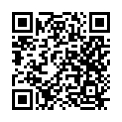
DoDEA District
Pre-Registration (New and Existing Students)
To register to attend a DoDEA School the following age requirements must be met.
A child must be:
- four years old by September 1 to attend Pre-Kindergarten.
- five years old by September 1 to enroll in Kindergarten.
- six years old by September 1 to attend First Grade.
DoDEA Online Registration Portal https://dodeasis.myfollett.com/aspen to register new students.
Existing students contact the School Registrar to update student information.
PTSO Enrollment
Osan Elementary School – PTSO President: Denise Mejia contactusoespto@gmail.com
Osan Middle/High School – PTSO President: Elizabeth Williams OsanmiddlehighPTSO@gmail.com
Sports & Extra Curricular Activities
Information will be provided to your student throughout the school year.
School Drop Off and Pick Up Times
Osan Elementary School Drop Off: 0730-0800 (Mon-Fri)
Pick up: Car Riders 1420 (Mon, Wed-Fri) & 1310 (Tues), All other students 1430 (Mon, Wed-Fri) 1420 (Tues)
Osan Middle/High School Drop Off: 0815-0825 hours
Pick up: 1510 (Mon, Wed-Fri) 1410 (Tues)
**********SCHOOLS NEED VOLUNTEERS*********
**Schools Need Substitute Teachers**
https://www.usajobs.gov/GetJob/ViewDetails/604921500
DoDEA Pacific West
Information Site
https://www.dodea.edu/pacific/pac-west/osan-ab-schools

Slide 9
Osan Middle High School
Student Orientation(s):
Thursday, August 15
New Student Orientation/Gr. 6 Session for Success @ 1530-1700
Friday, August 16
Cougar Corral - All Student Orientation @ 1500-1700
First Day of School:
Monday, August 19
Breakfast will be Served (8:00 a.m.)
Doors open daily at 8:25 a.m.
Locker Distribution Begins 3rd Week of School (Doors Open Daily 8:15 a.m.)
School Year is Inclusive of Additional Recess Days:
Friday, Oct 11
Wednesday, Nov 27
Friday, Feb 14
Friday, May 23

Slide 10
Osan Elementary School
Communications
Multiple Paths
From the School
Grade/Classroom Level
Individual Contacts
Meet & Greet/Mustang Monitor/Facebook Live/Mustang Minute
From You to the School
Reach out to Teachers
Reach out to Administrators
Phone number 505-784-5368
Webpage https://osanes.dodea.edu/

Slide 11
Osan Elementary School
Upcoming Events
New Student Orientation
Meet & Greet
Friday, August 16, 2024, 2:00 - 4:00 PM (1400-1600)
First Day of Classes and Welcome Back
Please park at the commissary garage.
7:30 AM at the North (bus) entrance and 7:40 AM at the Main entrance
Talk-to-Us-Tuesday, Facebook Live
Open House

Slide 12
Osan Elementary School
Involvement Opportunities
SAC
POC - TBD osanes.sac@gmail.com
Meetings
Goals
PTO
POC - Mrs. Denise Mejia ContactusOESpto@gmail.com
Activities
Volunteers
POC - Mr. William Castro, Administrative Officer OES & OMHS
Weekly or intermittent

Slide 13
Osan Elementary School
Substitute Applications
Work without a full-time commitment
Teaching or working as an aide with younger students or special needs learners
USAJobs
Process
DoDEA Hiring Workshop
October 7 | 1000 – M&FRC

Slide 14
Osan Elementary School
Pre-K Information
Eligibility
Home Visits
First Day of Classes
Family Style Dining
Mini-Mustang Doors

Slide 15
Force Support Updates
Child Development Center Director – Dr. Kelsey Linville, kelsey.linville@us.af.mil
Located in Bldg. 738 Contact Info: DSN: 784-1125
Request for Care
Militarychildcare.com
Plans
Transportation for UPK to and from center provided for CDC enrolled children
Hiring for new building
CDC Upcoming
NAEYC accreditation visit window
Unannounced HHQ Inspection
CDC Contact Info: DSN 784-4966 Email: 51FSS.FSYC.CDC@us.af.mil

Slide 16
Force Support Updates
School Age Care
Registration for Before/After School Care ongoing through Militarychildcare.com
(Age 5 *and has started Kindergarten – Age 12)
Art Auction – 27 SEP
“Lights On” Afterschool Event – 24 OCT
Contact Info: DSN 784-6830 Email: 51FSS.FSYY.SchoolAgeCare@us.af.mil
Youth/Teen Center
Sign up for monthly membership by registering for a CYPBMS account (Ages 9-18)
Keystone/Torch – Teen/Youth leadership club that offers various volunteer hours and community improvement opportunities
Military Youth of the Year – Leadership opportunity that offers scholarships and monetary prizes through Boys and Girls Club of America
Registration for Field Trips, Events, Clubs, and Membership all through CYPBMS
Contact Info: DSN 784-1492 Email: 51FSS.FSYY.YouthCenter@us.af.mil

Slide 17
Force Support Updates
Youth Sports
Registration for Baseball / Softball closed 1 AUG.
Currently working on creating teams, assigning coaches, and ensuring all required documents are submitted and uploaded on CYPMS.
Parent Orientation (mandatory to complete annually): 15 AUG at 1800 and 21 AUG at 1100.
Flag Football / Cheerleading Season – Registration is from 5 - 30 AUG.
Volleyball Season – Registration is from 19 AUG - 20 SEP.
POCs:
Mari Kosaka (Youth Director) & Edan Ulukivaiola (Youth Sports Rec Assistant)
51fss.fsyy.youthcenter@us.af.mil

Slide 18
Force Support Updates
Family Child Care
Become a certified Family Child Care Provider in the comfort of your own home on the installation.
Choose your own days, hours of operation, and age group.
Gain access to extra benefits and resources from the Air Force Agency.
Check out quality materials for your home from our Lending/Resource Library to set up and maintain enriched environments.
Contact Info: DSN: 784-4694 Email: 51FSS.FSYC.FamilyChildCare@us.af.mil

Slide 19
Force Support Updates

Slide 20
Communication Action Plan
Mustang One-Stop Updates (https://51fss.com/mustang-one-stop/)
CDC Guidelines for Pets going CONUS (PCSing your Pets)
Departing Osan Section now live!
CONUS/OCONUS
Retirements & Separations (coming soon)

Slide 21
Housing Update

Slide 22
Open Forum Q&A
Subject Matter Experts
FW Leadership
Public Affairs
Force Support Squadron
Upcoming Events
Military & Family Readiness Center (M&FRC)
Civil Engineer Squadron
Housing
Base Improvements
Medical Group
School Liaison Program Manager (SLPM)
Support Agencies
Legal
Equal Opportunity
SAPR
Victim’s Counsel
You can also scan the QR code to ask a question

Slide 23
Join Us Next Time!
September Town Hall
Theme: Installation Housing
Date: 11 September 2024
Location: O-Club
Time: 1700
Social Media
51st Fighter Wing
Facebook: @51stFW
Instagram: @51stfw
AF Connect App: 51st Fighter Wing
51st FSS
Facebook: @51fss
Instagram: @osan_air_base_fss

