Slide 1
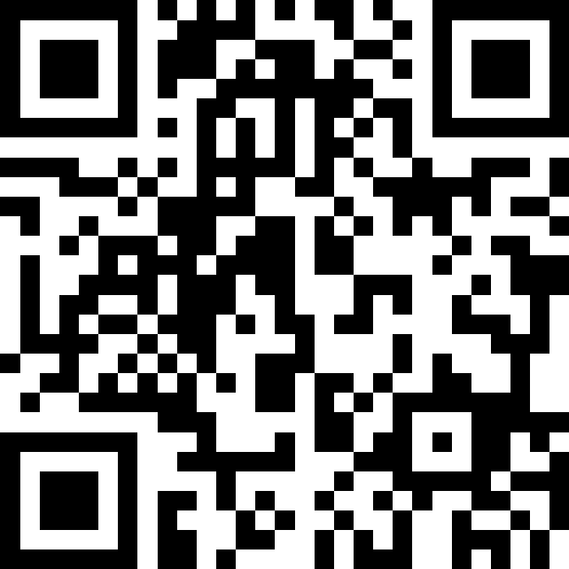
Q&A QR Code
Scan the QR code to submit questions in advance for the Q&A Portion at the end of the Town Hall

Slide 2
Military Family Housing
Quarterly Town Hall
11 September 2024
Hosted by 51 CES

Slide 3

Agenda
Housing Update: Progress Since Last Town Hall
Maintenance & Repair Project Updates
Upcoming Events
Policy Changes
FSS Update
Mustang One-Stop Update
Questions & Discussion

Slide 4
Housing Update: Progress
Since Last Town Hall (Q&A)
Can spouses be added to the email distribution list?
  Currently, our system only supports one email address (service member). MHO is exploring options to add spouses to the housing email distribution list.
What is the recommended way to install the ACs
  Instruction are located on the AF Connect App.
Who is responsible for testing and addressing airflow issues in the vents?
  Maintenance Contractor - Residents are encouraged to submit a work order for any vents with little-to-no airflow to the Maintenance Service Desk (0505-784-2376) or through the AF Connect App
What is being done to address the mold on the ceiling tiles of Seoraksan tower?
  All moldy ceiling tile have been replaced (28 Aug 2024)
  Please report any other mold concerns promptly via a work order and/or contacting the Housing Office

Slide 5
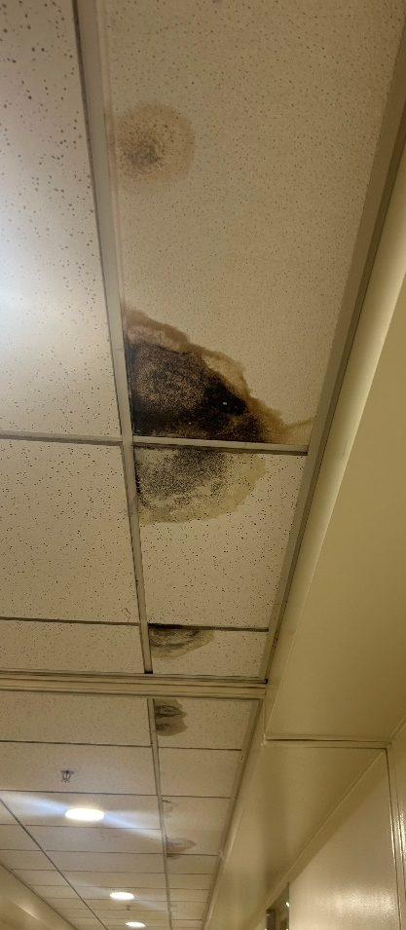
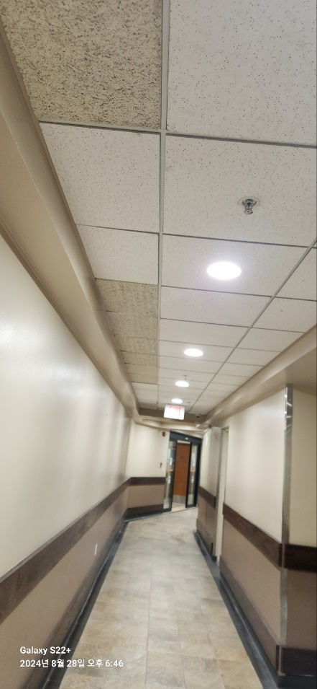
HVAC Update
Seoraksan Moldy Ceiling Tiles
BEFORE
AFTER

Slide 6
Housing Update: Progress
Since Last Town Hall (Q&A)
Do Military Housing dorm/housing residents have similar rights and regulations as those published in the Tenant Bill of Rights for Privatized Military Housing?
  While military housing does not have a formal Tenant Bill of Rights, we strive to meet similar standards. Please elevate any concerns to the Housing Office.
Are Housing & Dorm inspection reports published publicly? If so, where?
  Housing and dorm inspection reports are not published publicly. However, residents can request specific information for their housing unit only, from the Housing Office.
What is being done to ensure the master code for the tower doors is not being given out to new residents?
  We have implemented strict protocols where master codes are only accessible by authorized personnel. MHO has rekeyed master codes for MFH Towers, SOQs, & GOQs. (6 Aug 2024)

Slide 7
Housing Update: Progress
Since Last Town Hall (Q&A)
Can housing install a pet clean up station in the lobby with basic supplies for responsible pet owners to clean up accidents from their pets?
  Yes, we will investigate the possibility of installing pet cleaning stations in the tower lobbies.
When will the Hallasan elevator be back up and running?
  This is a custom manufactured door and current timeline is 2 – 3 months.
Full size, more functional, spacious dog park?
  A project is actively being awarded to expand & update Seoraksan Dog park! Projecting early 2025 for construction start date.

Slide 8
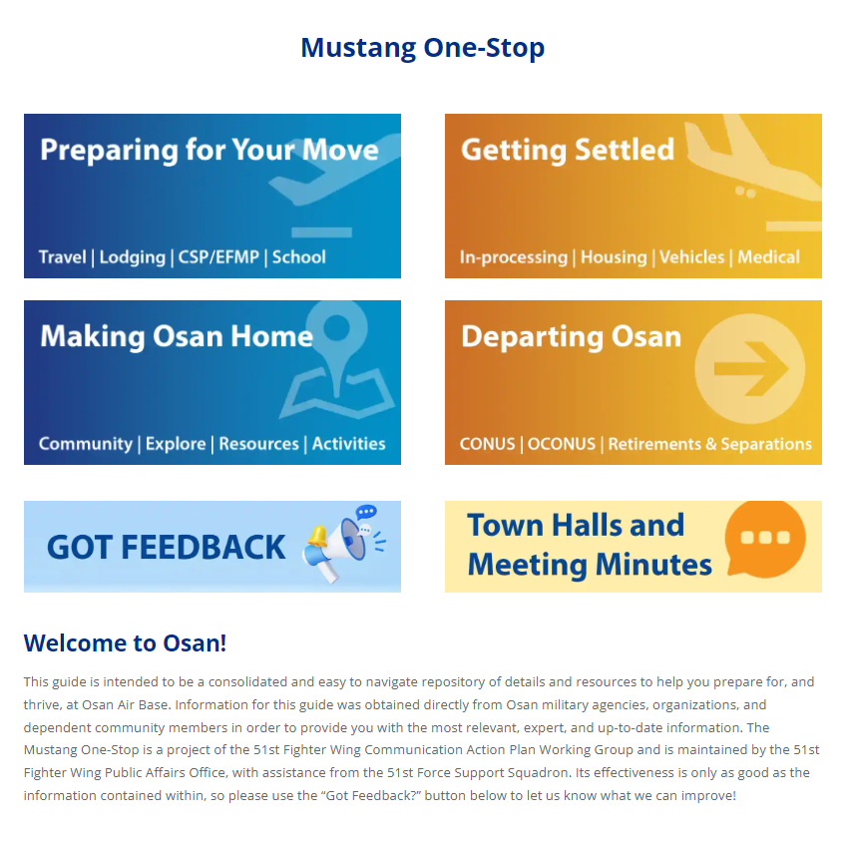
Housing Update: Progress
Since Last Town Hall (Q&A)
Townhall Meeting Minutes Location
  Once posted, Housing will push a message via email & AF Connect App
https://51fss.com/mustang-one-stop/#

Slide 9
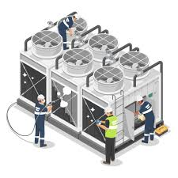
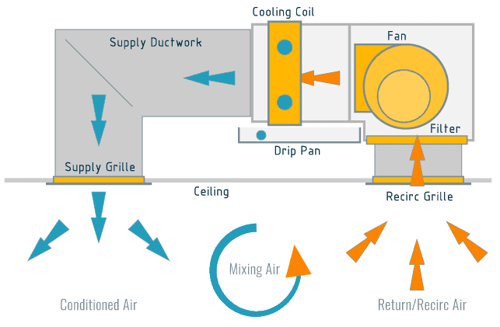
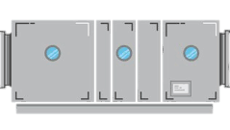

HVAC Update
Chiller

Slide 10
HVAC Update
Chiller
Air Handling Unit

Slide 11
HVAC Update
Chiller
Hallway
Air Handling Unit

Slide 12
HVAC Update
Chiller
Heat Recovery Unit
Hallway
Air Handling Unit

Slide 13
HVAC Update
Chiller
Heat Recovery Unit
Hallway
Air Handling Unit

Slide 14
HVAC Update
Chiller

Slide 15
HVAC Update
Fan Coil Unit
Chiller

Slide 16
HVAC Update
Fan Coil Unit
Chiller
Residence

Slide 17
HVAC Update
Fan Coil Unit
Chiller
Residence
Heat Recovery Unit
Hallway
Air Handling Unit

Slide 18
HVAC Update
REPLACED AIR FILTERS (96 UNITS)
PM ON FAN COIL UNITS (63 UNITS)
CONTRACTOR WORK HOURS (300)
72 WORK ORDERS / 55 ROOMS
PERFORMED DUCT MOLD INSPECTIONS
UPDATING CONTRACT
PM ON ALL 6 CHILLERS
CREATED WORK TASK TRACKER
UPDATING QA PLAN
ORDERED 30 CAPACITORS & 13 FAN MOTORS
ISSUED PORTABLE AC UNITS (51)
AUGMENTED HVAC SUPPORT
As of 5 Sep 2024

Slide 19
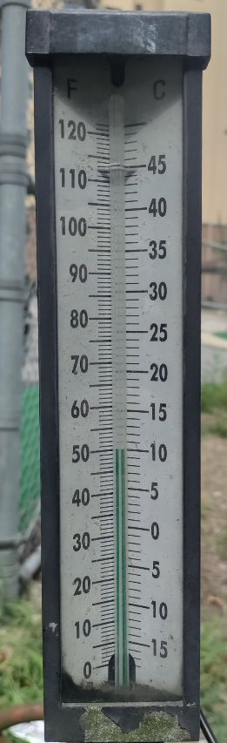
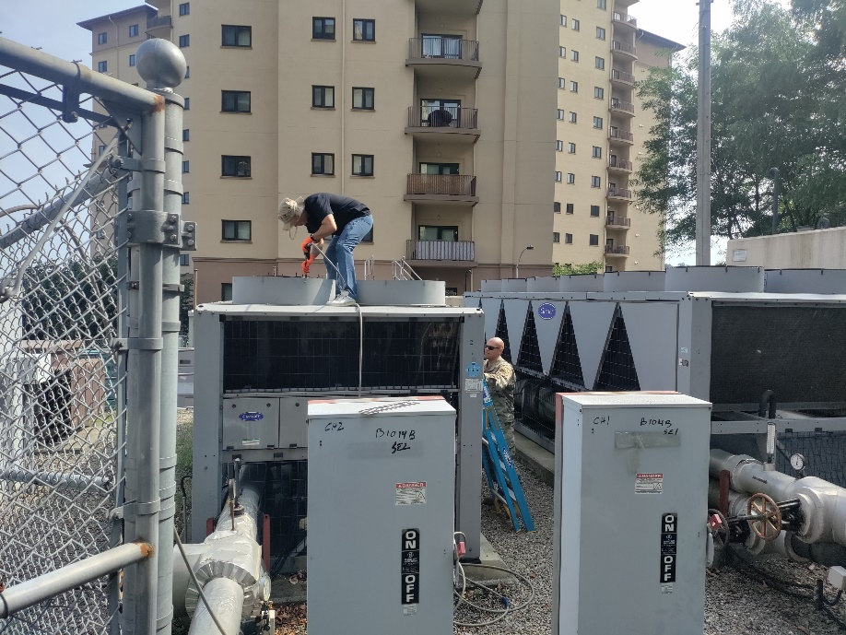
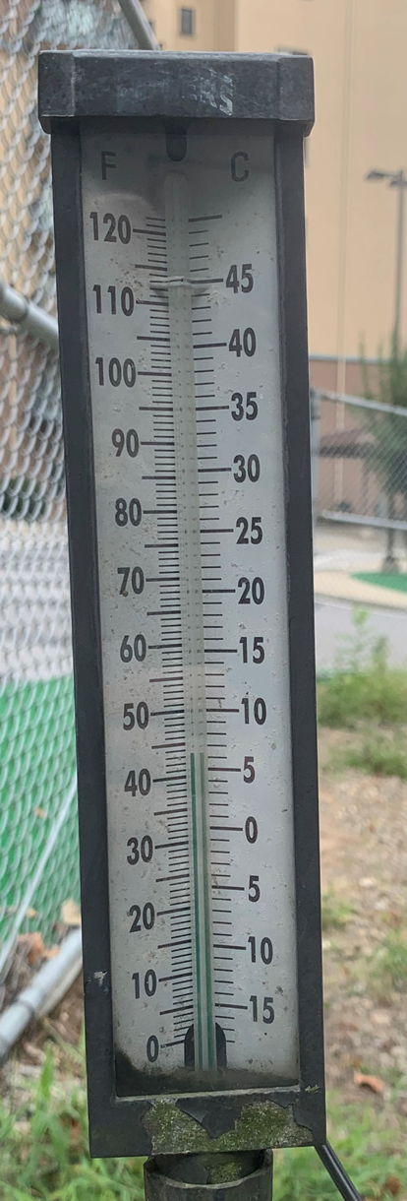
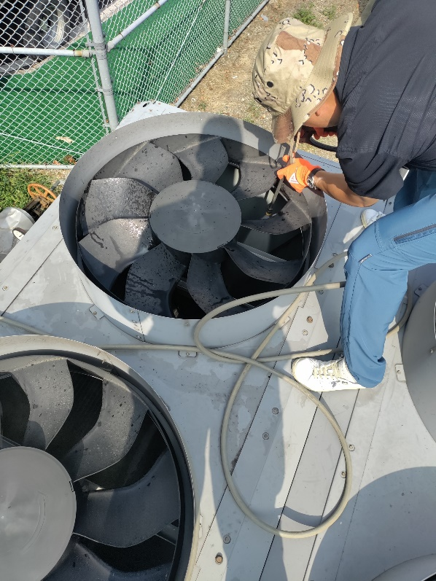
HVAC Update
Jirisan Chiller PM—CE Team
AFTER
BEFORE

Slide 20
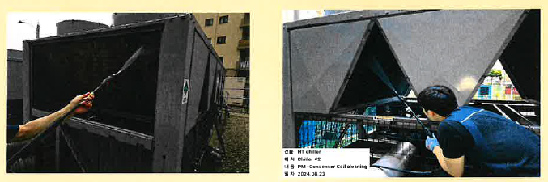
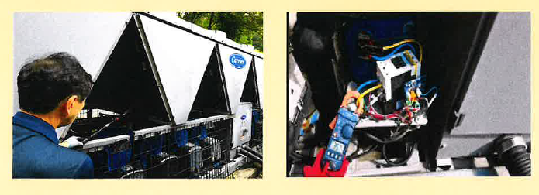
HVAC Update
Contractor Chiller PM

Slide 21
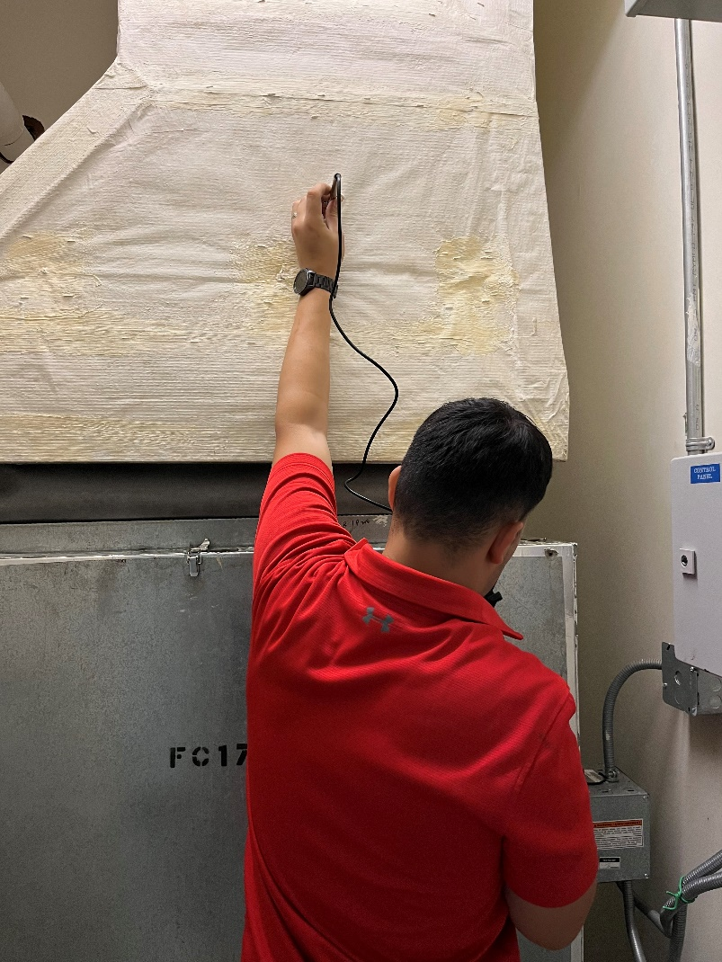
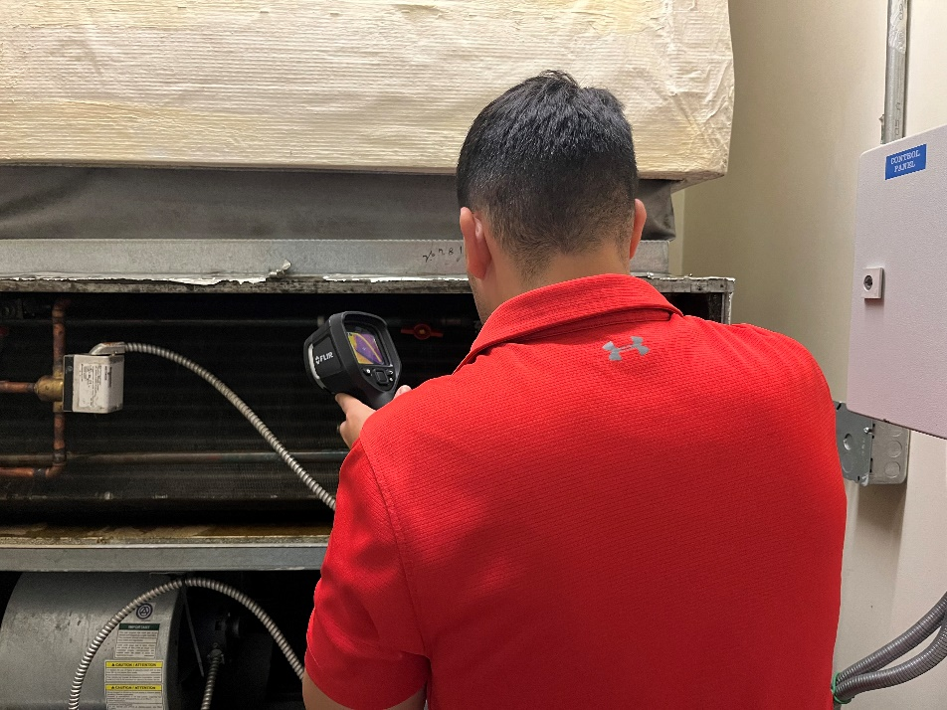
HVAC Update
Fan Coil Unit PM—CE HVAC

Slide 22
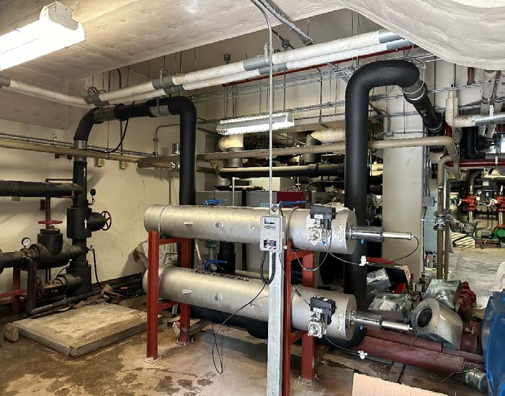
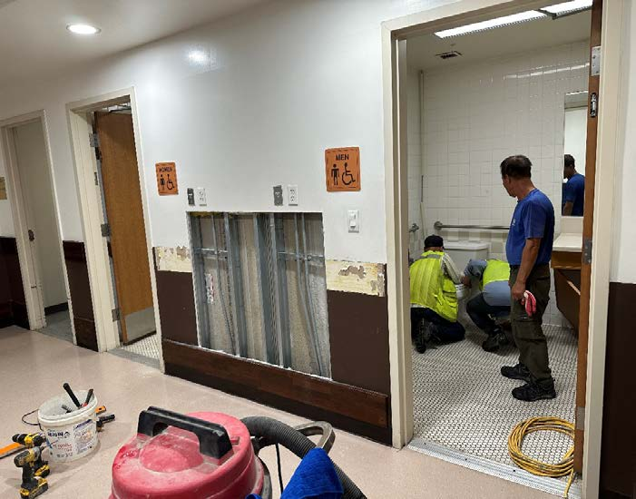
Maintenance &
Repair Projects
  MFH Water Filtration Project Completed 27 Aug 2024
Notes:
Dinosaur Park
Not started. 30% design completed
Tower Playgrounds
Any discrepancies, please report to the Maintenance Office at Hallasan
Exchange Play Area
Taken down, with a new play area open inside Checkertails

Slide 23
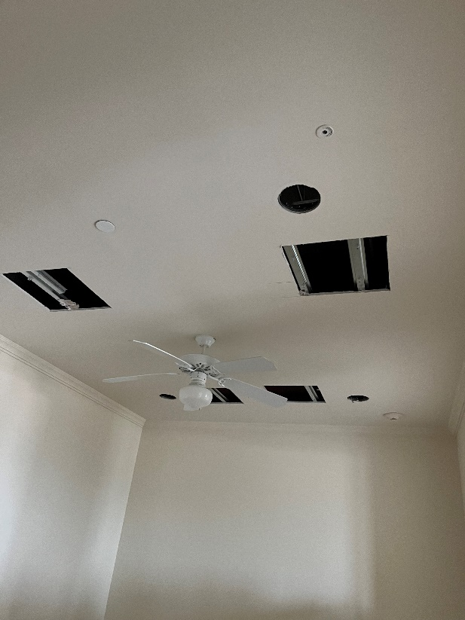
Maintenance &
Repair Projects
  LED Lighting Upgrade In Progress
    Replace Lighting w/LED MFH Seoraksan, Jirisan, Hallasan Tower
    Total : 328, Done : 131, 39% completed CCD July 26
Notes:
Dinosaur Park
Not started. 30% design completed
Tower Playgrounds
Any discrepancies, please report to the Maintenance Office at Hallasan
Exchange Play Area
Taken down, with a new play area open inside Checkertails

Slide 24
Maintenance &
Repair Projects
  Exterior Door installation—SOQ residents Completed 3 Sep 2024
  Parking Garage Refresh On Pause
    1st Floor: Pursuing a warranty call—determining timeline for fix
    2nd & 3rd Floor: Repaint floors with assigned numbers & hang reflective signs
    Repaint each stairwell
    *2nd Floor work delayed due to expired materials—awaiting updated schedule from contractor*
Notes:
Dinosaur Park
Not started. 30% design completed
Tower Playgrounds
Any discrepancies, please report to the Maintenance Office at Hallasan
Exchange Play Area
Taken down, with a new play area open inside Checkertails

Slide 25
Maintenance &
Repair Projects
ADA Ramp from Seoraksan to Commissary In Progress
  Replace existing stairs with an ADA ramp & new staircase
  ECD: Jan 25
Cordless Blinds Installation On Pause – Restarting Soon
  Seoraksan: 14-24 Oct
  Jirisan: 25 Oct – 07 Nov
  Hallasan: 08-28 Nov
  Need 3ft working space in front of all windows to install
Future Initiatives:
  Dinosaur Park Upgrade
  Future MFH Park & Playground

Slide 26
Maintenance &
Repair Projects
  MFH Improvement project # 23F0104, ESD Sep 24
    Repair/Repaint Wall and Railings to B211 trash room
    Prepare/Repaint Guard Railings for the B211 and B1014.
    Paint permanent Lines to Replace Temporary Markings B1014, B1015 (common area bike storage)
    Repaint Stop Sign Pole and Seoraksan Sign Frame, B211
    Establish Sidewalk Approach Ramps to support B1015, B1065, B1078 and B1080
    Re-stain Wooden Fence, B1078
    Repaint Metal Components of Deck and Concrete Wall, B1065
Notes:
Dinosaur Park
Not started. 30% design completed
Tower Playgrounds
Any discrepancies, please report to the Maintenance Office at Hallasan
Exchange Play Area
Taken down, with a new play area open inside Checkertails

Slide 27
Upcoming Events
Osan Housing Neighborhood Mayor Program ESD 3 Oct
Osan Housing is sponsoring a Mayors Program to review and discuss community matters. Each neighborhood is represented by a volunteer Mayor who meets with MHO (Military Housing Office), and installation representatives every month.
Mayors provide a variety of functions including
Assisting in communication efforts.
Relaying resident comments and suggestions to MHO.
Identifying common area maintenance issues.
Providing resources and guidance to residents.
Assisting in directing project initiatives

Slide 28
Upcoming Events
“Cool-To-Heat” Transition
16 Oct.
Heating Option Available
1 Dec.
Cooling System Shut-Off
Cooling
Only
Resident’s
Choice
Heating
Only

Slide 29
Policy Changes
Maintenance Work Orders:
  Work Order Signatures: Residents are no longer required to sign maintenance work orders for work validation. Interactions between maintenance technicians and residents should be minimal.
    Work Order Feedback Survey coming soon!
  Quality Control: All major repairs will be quality-checked by contracted quality control inspector (QCI) and contracting officer (COR).
  Language Requirements: Maintenance technicians are not required to speak English. Only the contracting receptionist or maintenance receptionist and the contract manager are required to speak English.
  Reporting Issues: Any issues with the execution of a work order should be relayed to the maintenance desk for resolution. If a residents feels he or she is not getting the assistance need please elevate the issue to the housing office.

Slide 30
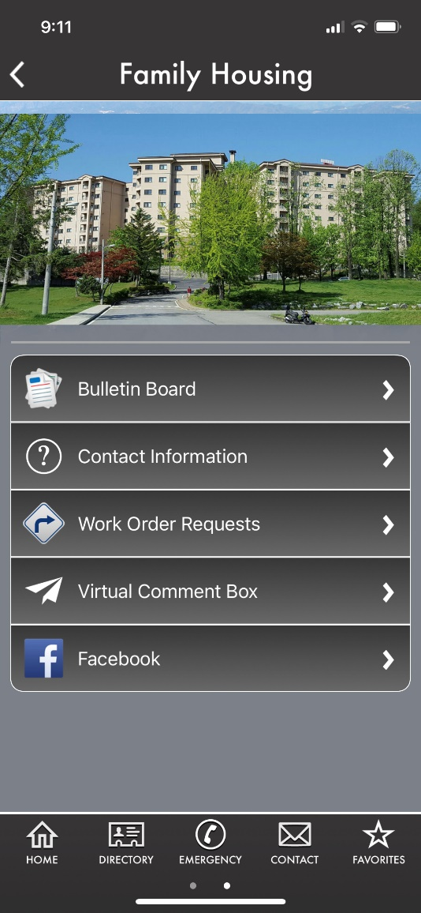
Contact Information
Housing Office: Bldg 600, Room 101
DSN: 784-1840; Comm: 0505-784-1840
51ces.ceihh.housing@us.af.mil
FB: Osan Air Base Housing & Dorm Office
Monday - Friday, 0800 - 1530
Closed every 3rd Thursday: 1200-1530
Closed all US & KN Holidays

Slide 31
Communication Action Plan
Mustang One-Stop Updates (https://51fss.com/mustang-one-stop/)
  Retirements & Separations
    48 month to 1 day timeline and appropriate actions

Slide 32


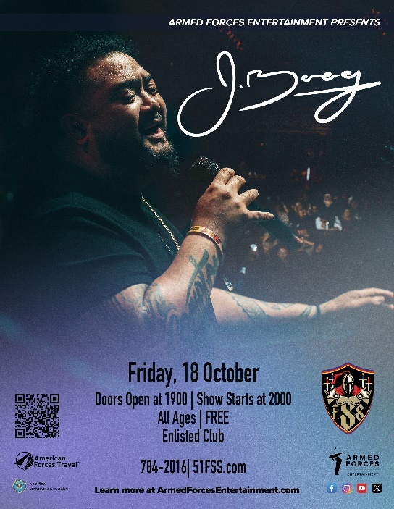

51st FSS Highlights
AFE Brings the Laughs Comedy Show
14 Sept at 7 pm
Enlisted Club
OKTOBERFEST
20 Sept at 5:30 pm
Bldg 918 & Officers’ Club
Trunk or Treat
25 Oct at 4 pm
Bldg 918 & Officers’ Club
AFE J Boog Concert
18 Oct at 8 pm
Enlisted Club

Slide 33
Open Session Q&A
Available Subject Matter Experts:
  Wing Leadership
  Mission Support Group
    Housing / Civil Engineering
    Force Support Squadron
  School Liaison
  Public Affairs
You can also scan the QR code to submit a question online

Slide 34
Join Us Next Time!
October Town Hall
Theme: 51 FW Update & Hot Topics
Date: 9 October 2024
Location: Officers’ Club
Live Stream at www.Facebook.com/51stFW
Time: 1700

