Slide 1

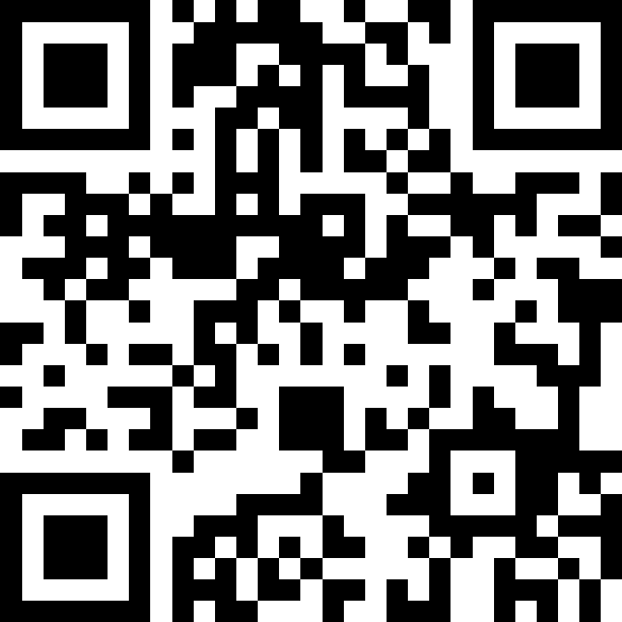
Q&A QR Code
Scan the QR code to submit questions in advance for the Q&A Portion at the end of the Town Hall
D e f e n d , E x e c u t e , S u s t a i n - F i g h t T o n i g h t !
1

Slide 2

51st Fighter Wing
D e f e n d , E x e c u t e , S u s t a i n - Fi g h t T o n i g h t !
DoDEA Schools Child & Youth Program
Quarterly Town Hall 13 November 2024 Hosted by 51 FW
Featuring:
7 AF Leadership!

Slide 3
Agenda
Seventh Air Force Commander’s Comments
OCOLA Living Survey – Nov 15 Closeout!
Changes to OHA
DoDEA Schools Update
Child & Youth Programs
FSS Upcoming Events
Off Base Community Update
Q&A

Slide 4


Seventh Air Force
Seventh Air Force
Commander’s Comments

Slide 5

OCONUS Cost-of-Living Allowance Survey
Living Pattern Survey will be available Oct 15 – Nov 15 (last week!)
  Distributed using email addresses in MyPay
  However, available online or mobile device!
The survey is voluntary and confidential
  Approx. 20-30 min to complete
Survey results directly impact your pay!
  Current COLA rates are based on results from the 2016 survey
Ensures servicemembers receive appropriate compensation considering cost of living in their assigned areas or locations
OCOLA calculated with Camp Humphreys Inputs (Co-Located)
D e f e n d , E x e c u t e , S u s t a i n - F i g h t T o n i g h t !
4

Slide 6
Changes to OHA
Osan - Camp Humphreys Locality Merge
Effective 16 Nov, Osan AB and Camp Humphreys will merge OHA and OCOLA index rates – raising Camp Humphreys OCOLA cost index
Proximity of the two installations warranted a “geographically proximate” identification, therefore considered ‘1-location’
Service members may see an increase in OHA this month
Osan AB (incl Camp Humphreys):
Supported by last rental review, raising Camp Humphreys OCOLA index from 104 to 110.
D e f e n d , E x e c u t e , S u s t a i n - F i g h t T o n i g h t !

Slide 7
51st Fighter Wing
D e f e n d , E x e c u t e , S u s t a i n - Fi g h t T o n i g h t !
Child and Youth| DoDEA Team Osan Town Hall November 2024

Slide 8
51st Fighter Wing
D e f e n d , E x e c u t e , S u s t a i n - Fi g h t T o n i g h t !
Child and Youth | Force Support
Team Osan Town Hall November 2024

Slide 9
CDC Director Information
Child Development Center Director DSN: 784-1125
Building 738
Dr. Kelsey Linville, Email: kelsey.linville@us.af.mil
Request for Care
Militarychildcare.com
CDC Contact Info: DSN 784-4966 Email: 51FSS.FSYC.CDC@us.af.mil

Slide 10
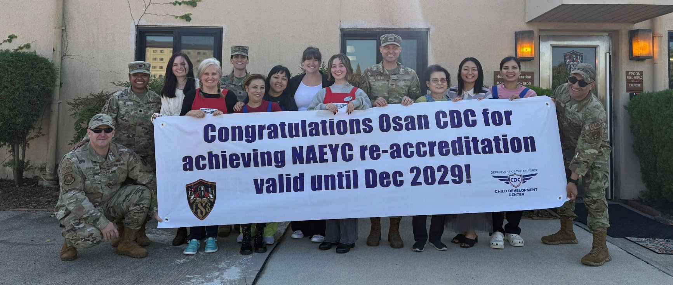
CDC Re-accreditation
Osan Child Development Center achieved NAEYC Re-accreditation valid until December 2029

Slide 11
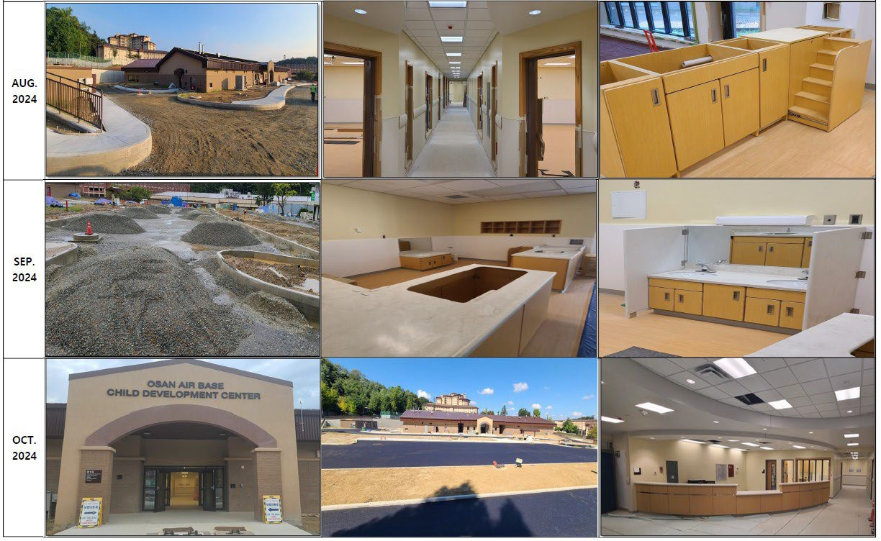
Update – New CDC

Slide 12






New CDC POAM
Osan’s New Child Development Center/School Age Care Timeline
COMPLETED
GRAND OPENING – SPRING 2025
MILESTONE
AFSVC TEAM ARRIVES TO STAGE CLASSROOMS – JAN-FEB 2025
FINAL ORDERS RECEIVED & FINAL TOUCHES – JAN-FEB 2025
TENTATIVE SELECTION, HIRING & PLACEMENT OF NEW EMPLOYEES – JAN-FEB 2025
COLLABORATION WITH ORDERING FF&E WITH AFSVC – OCT-DEC 2024
GROUNDBREAKING/CONSTRUCTION STARTS – MAY 2022 CONTRACT AWARDED – MAY 2022

Slide 13
SAC / Youth & Teen
School Age Care
Registration for Before/After School Care ongoing through Militarychildcare.com (age 5 *and has started Kindergarten – age 12)
Upcoming Mini-Military Youth of the Year Competition (in-house) December 20th
Contact Info: DSN 784-6830 Email: 51FSS.FSYY.SchoolAgeCare@us.af.mil
Youth/Teen Center
Sign-up for monthly membership by registering for a CYPBMS account (ages 9-18)
Keystone/Torch – Teen/Youth leadership club that offers various volunteer hours and community improvement opportunities
Military Youth of the Year – Leadership opportunity that offers scholarships and monetary prizes through Boys and Girls Club of America. Upcoming competition date – January 24th
Registration for Field Trips, Events, Clubs, and Membership all through CYPBMS
Contact Info: DSN 784-1492 email: 51FSS.FSYY.YouthCenter@us.af.mil

Slide 14
Youth Sports
Youth Sports
Registration for Basketball and Winter Cheer open now until November 29th
Upcoming Parent Orientation (mandatory to complete annually): December 11th at 1800, December 16th at 1100, and January 7th at 1800.
Upcoming Soccer Registration: February 3rd until February 28th
Looking for Basketball, Cheer, and Soccer Coaches. If interested, please email our org box to get started on all required training and background investigation.
Surveys are now given at the end of each Sports Season to evaluate program.
Contact: DSN 784-1492 email: 51fss.fsyy.youthcenter@us.af.mil

Slide 15

Family Child Care

Slide 16



Force Support Events

Slide 17
FSS Enhancements
Team Osan Community supports FSS Activities
Team Osan community continuous to enjoy new and/or refreshed facilities/events
Revenue is reinvested back into FSS Facilities
FSS Facilities receive improvements and new programming to better serve the community

Slide 18
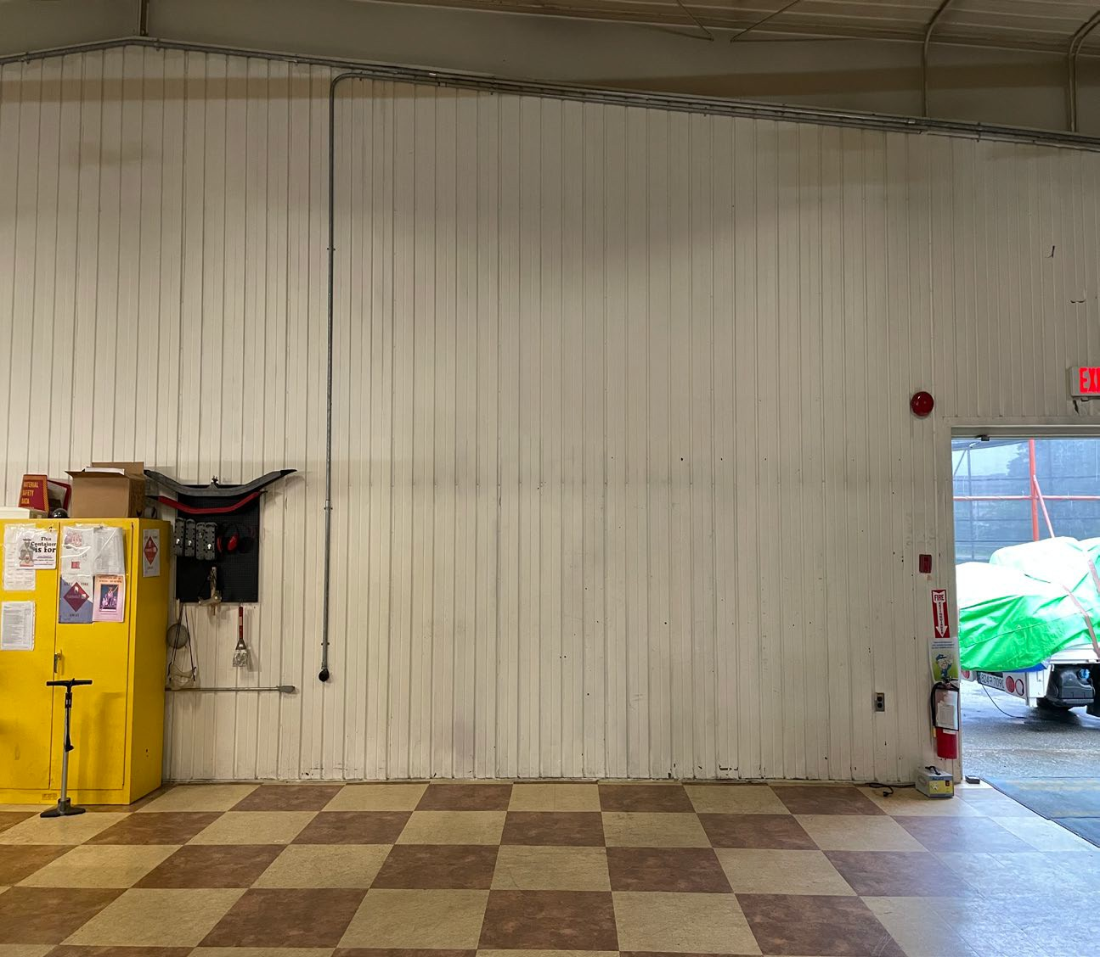
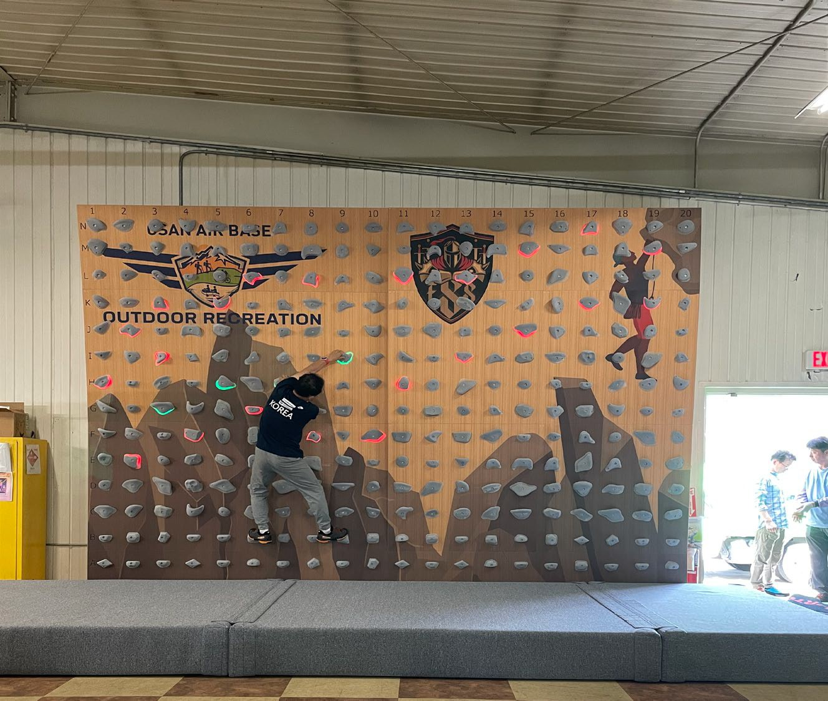
FSS Enhancements Outdoor
Recreation
Indoor Bouldering Wall
Before
After

Slide 19
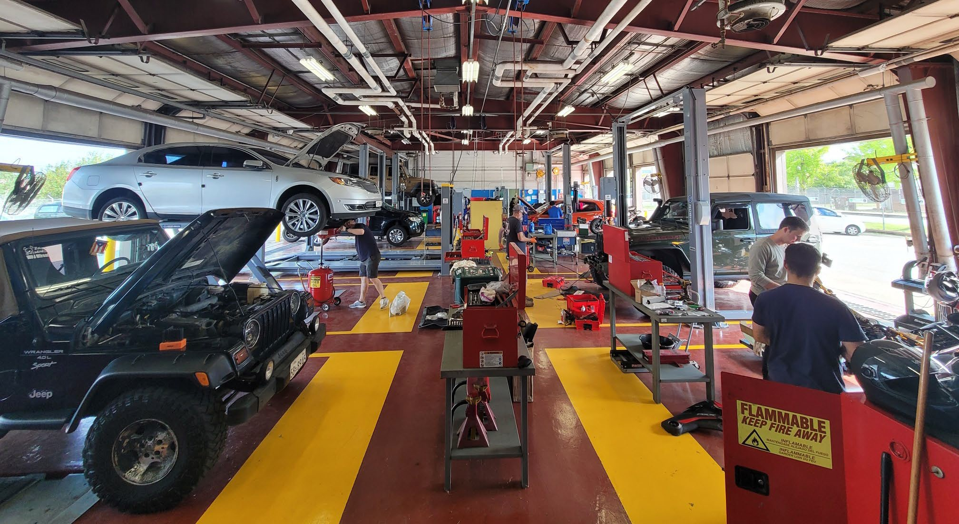
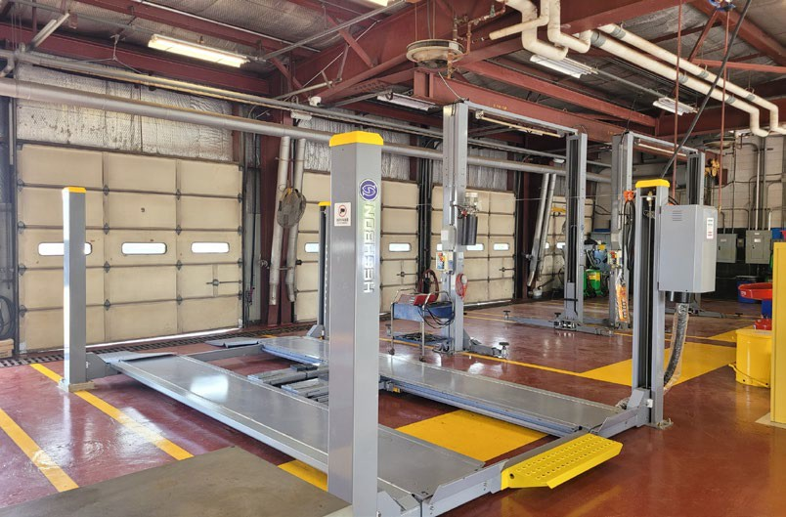
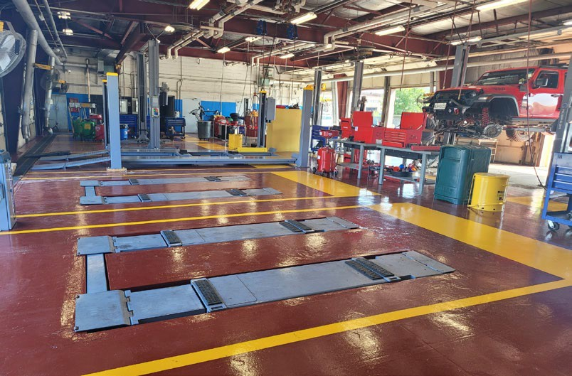
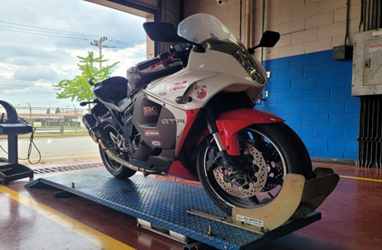
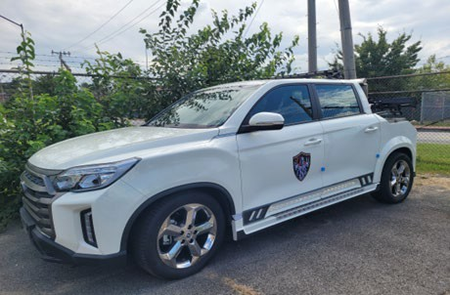
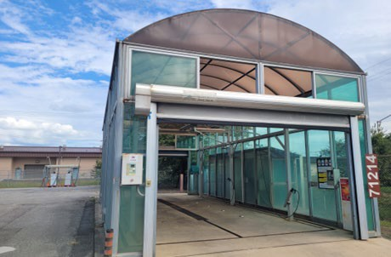
FSS Enhancements Auto Hobby
Work Floor Renovation includes two new lifts
D e f e n d , E x e c u t e , S u s t a i n - F i g h t T o n i g h t !
17

Slide 20
51st Fighter Wing
D e f e n d , E x e c u t e , S u s t a i n - Fi g h t T o n i g h t !
DoDEA
Team Osan Town Hall November 2024

Slide 21
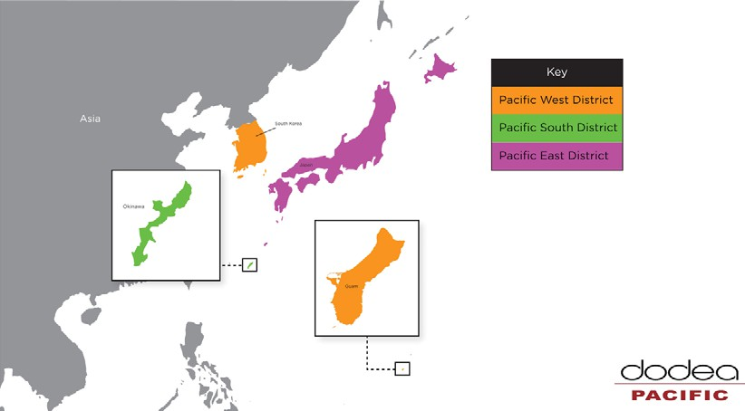



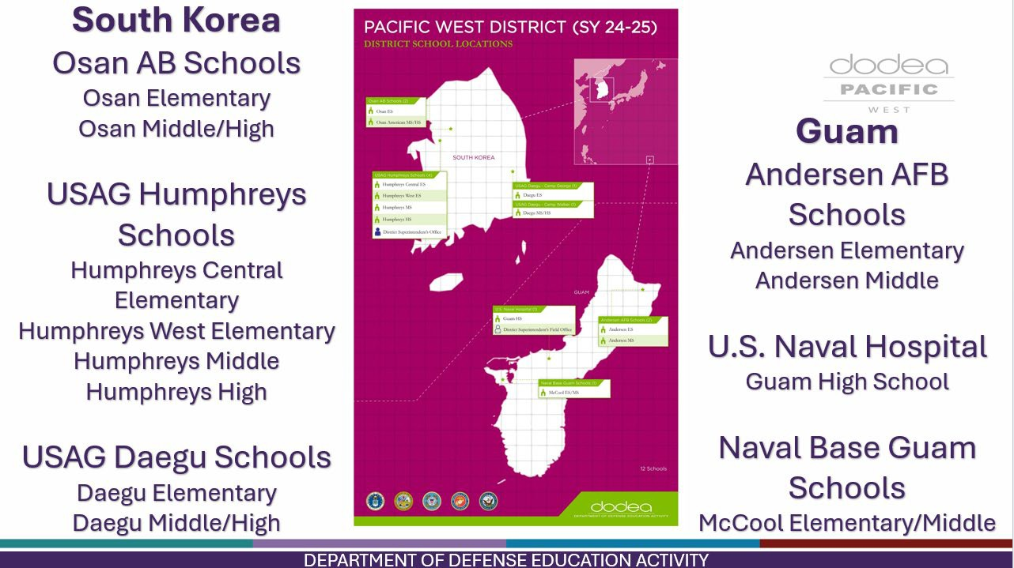



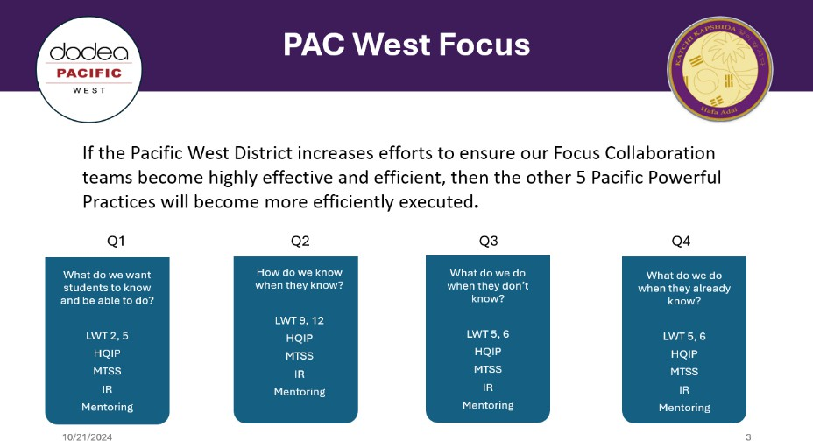
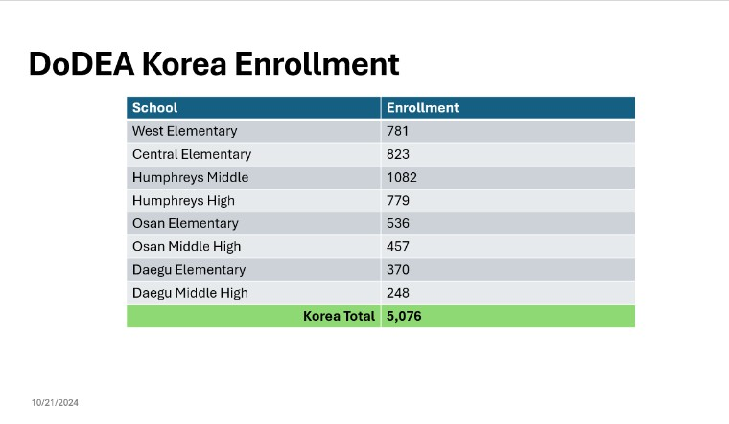

DoDEA District
**Schools Need Substitute Teachers**
https://www.usajobs.gov/GetJob/ ViewDetails/768205000
DoDEA Pacific West Information Site
https://www.dodea.edu/pacifi c/pac-west/osan-ab-schools

Slide 22
Bus Route - 105
Follow-Up: Bus Arrival
Presenters: DoDEA District Logistics Team
Route 105 is not meeting DoDEA standards of service, and the Osan Student Transportation Officer (STO) is responsible for developing a solution for this issue. This solution affects MHS students only. The bus stop for Osan ES students remains unchanged.
This route is arriving at Osan MHS 5-10 minutes before bell time vs. the 10 – 15 minute standard required to allow students sufficient time to prepare and make it to class on-time.
A corrective action plan has been developed for review with our 51 FW mission partners. Once all concerns have been addressed, it will be distributed to affected families to survey for impacts and concerns. Estimate change affective date is 6 January 2025.

Slide 23

Osan Middle High School
Upcoming Events: NOVEMBER
  November 18-21
    Far East JAMM (Hosted at Osan Middle High School)
  November 17
    Choral Collaboration Outreach – String Orchestra, Band and Guitar
  November 21
    Optional ASVAB for 10th-12th Grade Students
  November 28
    Thanksgiving – Federal Holiday
Upcoming Events: DECEMBER
  December 5
    Winter Guitar and Choral Concerts
  December 6
    Accelerated Withdrawal Date (First Semester)
  December 12
    Winter Fine Arts Night
  December 13
    No School for Students (CCRS PL Training Day)
  December 14
    ACT held at OMHS
  December 19
    OMHS Talent Show
  December 23 to January 3
  Winter Recess

Slide 24
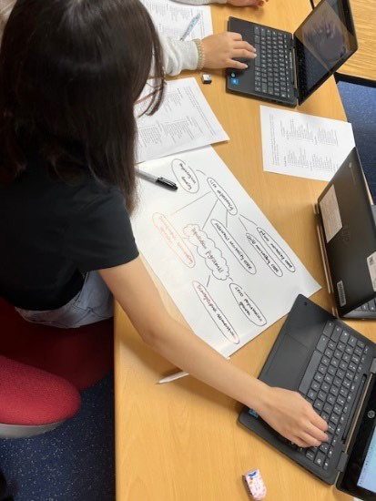
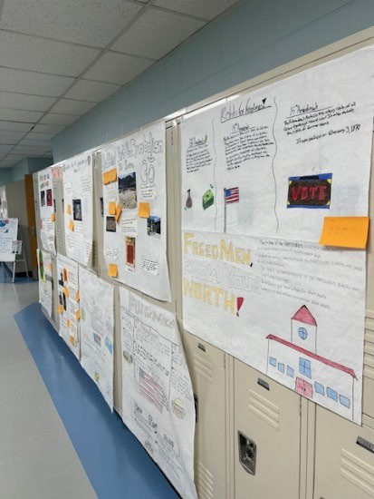
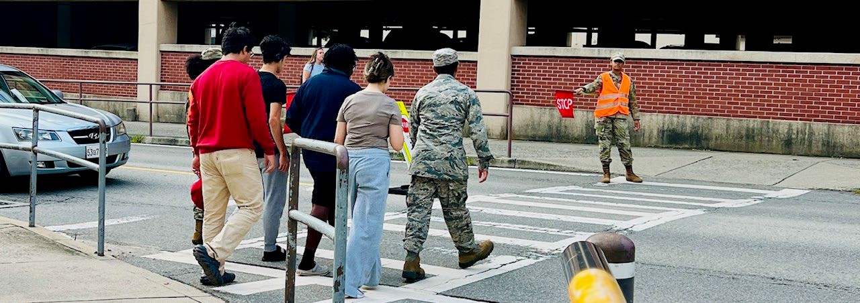
Osan Middle High School
Follow-Up: Bus Arrival
  Presenters: DoDEA Transportation Personnel
Follow-Up: Use of Overpass for Pedestrian Traffic
  Presenters: OMHS Administration
Follow-Up: Tennis Courts
  Presenters: OMHS Administration

Slide 25

Osan Elementary School
Partnerships
  National Emergency Preparedness Month

Slide 26
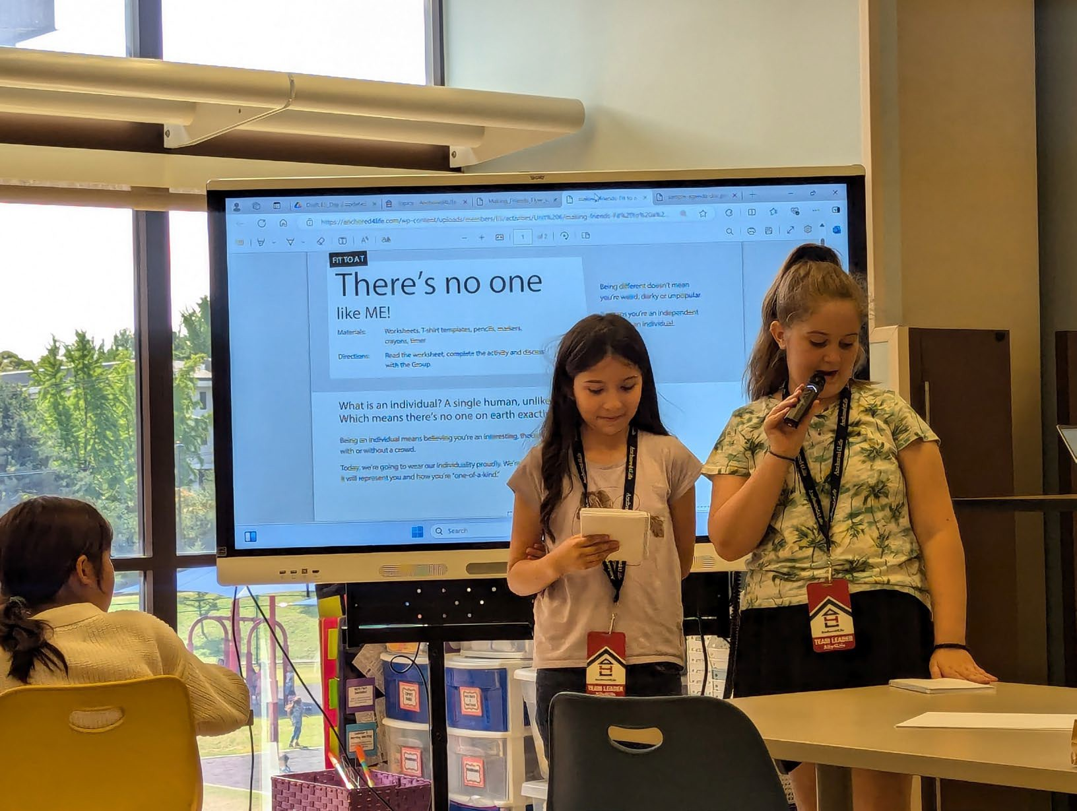
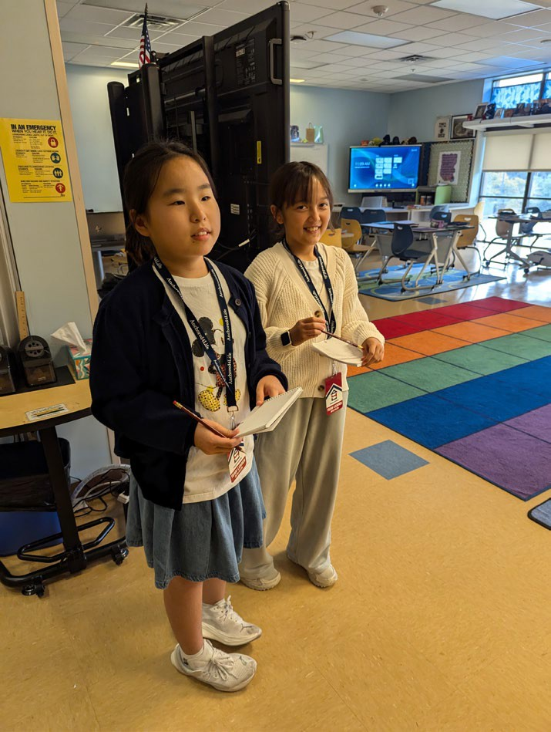
Osan Elementary School
Partnerships
  Anchored4Life
    8- 4/5 graders
    2 days of training
    Deployment/TDY kits
    Moving Kits
    Community Service Project

Slide 27

Osan Elementary School
OES Student Council Swearing In Ceremony
Four Officers
Ten members

Slide 28
51st Fighter Wing
D e f e n d , E x e c u t e , S u s t a i n - Fi g h t T o n i g h t !
Off-Base Community Update
Team Osan Town Hall November 2024

Slide 29
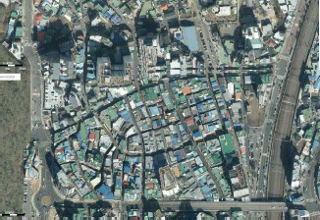
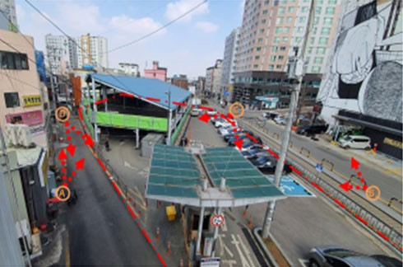
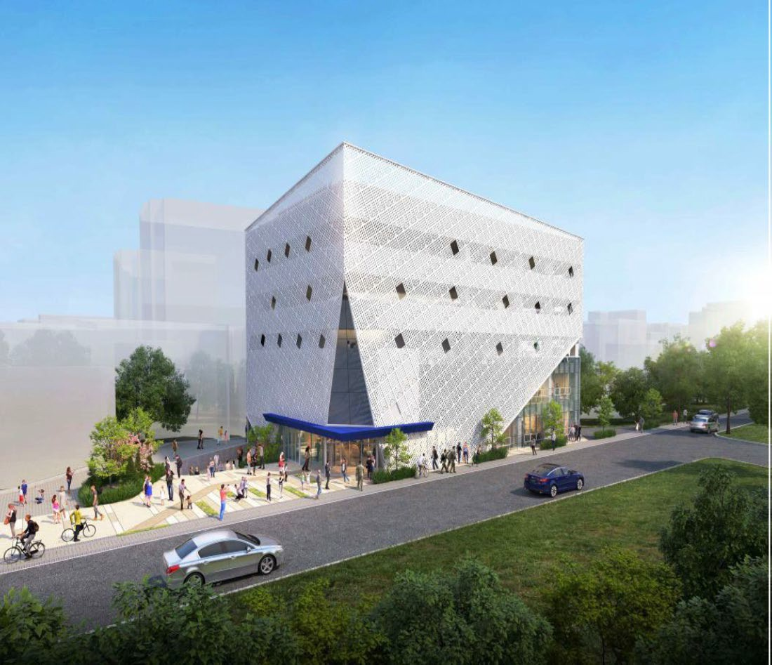
Global Community Center in SED
Map
Current Parking Lot
Community Center
Main Gate
Global Community Center Project
Period: Oct 24- Dec 26
Location: near the railroad in the SED Scale: 1 Underground, 5the Floor
1Basement: Health support center, Multicultural harmony school 1st floor: Book café/Kids Café, Indoor Recreation (rock climbing) 2nd floor: conference room, Seminar room
3rd floor: Frat house, parking lot 4th floor: parking lot
5th floor: parking lot Roof: parking lot
Construction Status
Parking lot traffic control: 14 Oct 24
Construction fence installation: 22 Oct 24
Parking lot demolish: Building construction start: Completion:
Nov 24
Dec 24
Dec 26

Slide 30
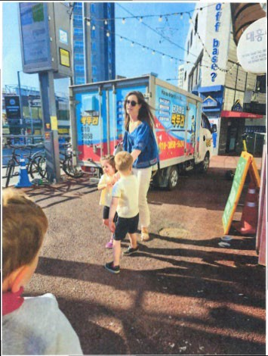
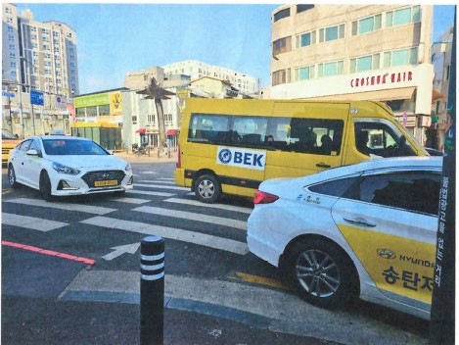
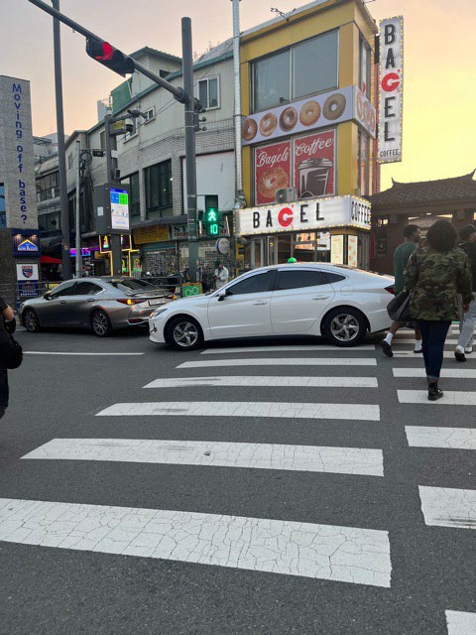
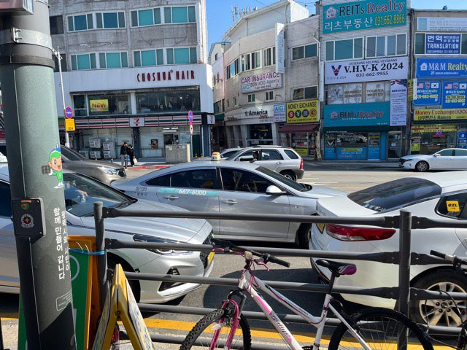
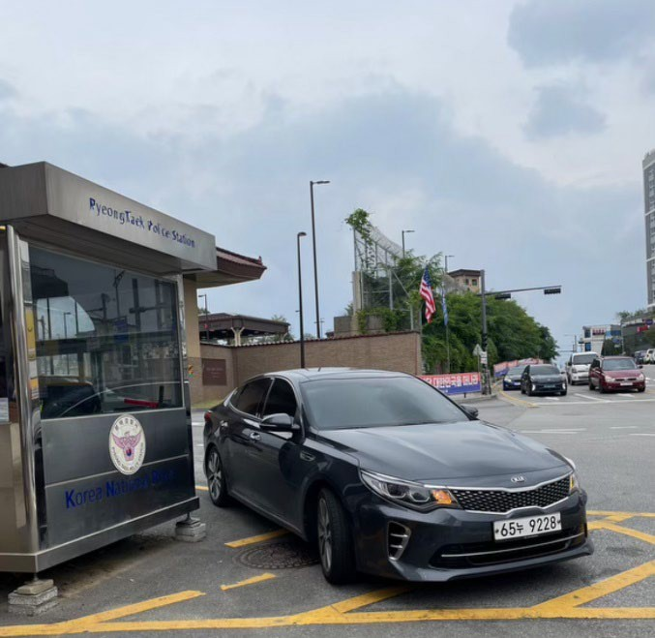
Taxi Stand Concern
Concern: Safety risk associated with off-base/main gate Taxi stand location, Taxis: blocking outbound traffic, cross-walk, and children pick-up/drop-off location for both U.S. and ROKAF personnel

Slide 31
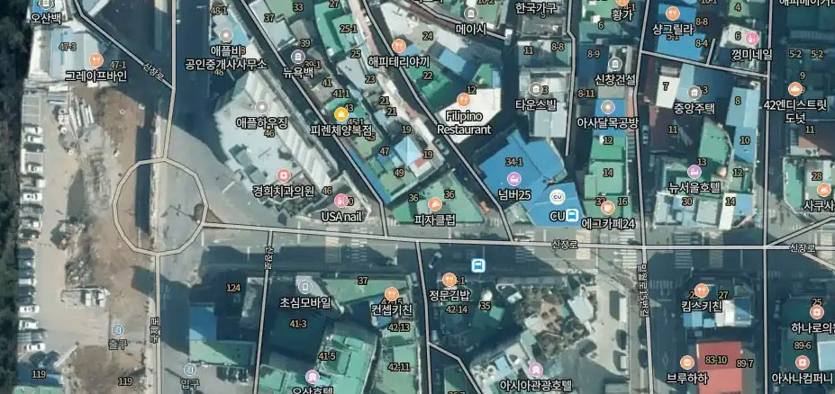
Other Taxi Stand Available
To Main Gate
SONGTAN ENTERTAINMENT DISTRICT (SED)
Round About
To Overpass
TAXI

Slide 32
51st Fighter Wing
D e f e n d , E x e c u t e , S u s t a i n - Fi g h t T o n i g h t !
Community Update DeCA Team Osan Town Hall November 2024

Slide 33





Osan Commissary:
Your Commissary … It's Worth the Trip!
DeCA will Award new contract 15-16 NOV
New contractor will have 30 days to begin performance
High Value Core Items....20% savings.
5NOV: Airlift. Ordered 7-10 days of produce from a contractor in CA
9NOV: Airlift will take place
11NOV: Produce will arrive in stores
DeCA Will keep this in place as a bridge or use DLA as a partial source for those items. DeCA will make initial decision on which options to pursue on or about 7 NOV.

Slide 34
Open Session Q&A
Available Subject Matter Experts:
7th Air Force Leadership
Wing Leadership
Mission Support Group
  Housing / Civil Engineering
  Force Support Squadron
Medical Group
School Liaison / DODEA
Public Affairs
You can also scan the QR code to submit a question online

Slide 35
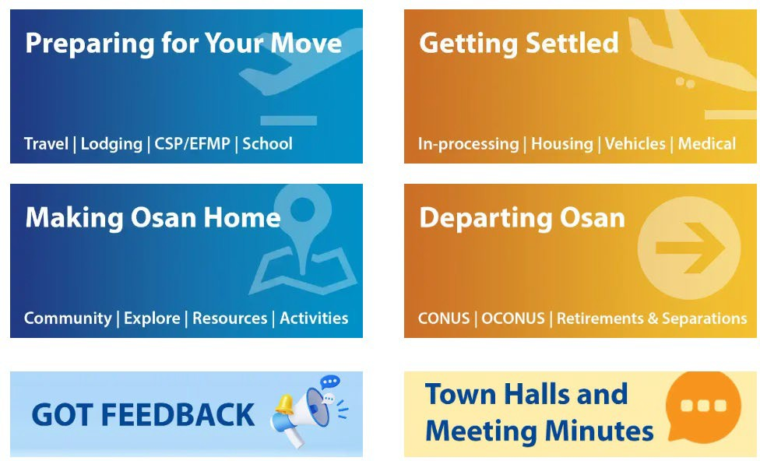
Mustang One Stop
https://51fss.com/mustang-one-stop/
Submit feedback
Review past Town Hall Meeting Minutes/Slides

Slide 36
Join Us Next Time!
December Town Hall Theme: Osan Housing Update Date: 11 December 2024
Location: Osan Air Base Officers’ Club
Live Stream at www.Facebook.com/51stFW
Time: 1700 | 5 p.m. KST

