Slide 1
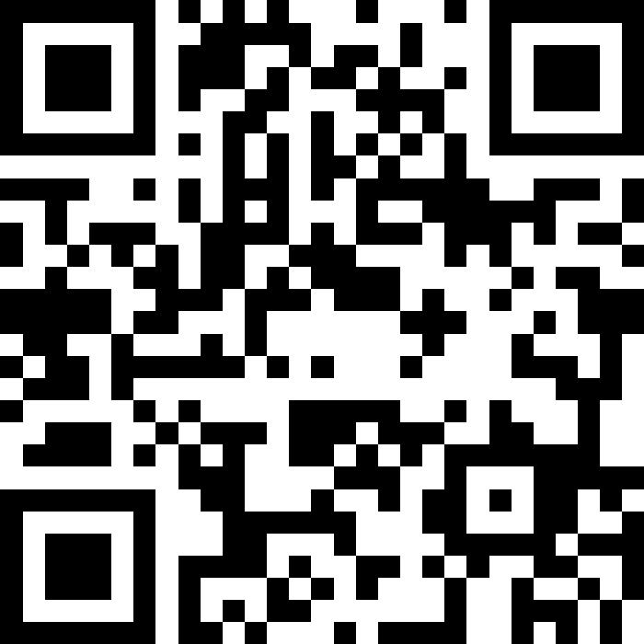
Scan Here to Submit a Question
Scan Here to Submit a Question Online.

Slide 2
51st Medical Group
Osan AB Townhall
June 2025

Slide 3
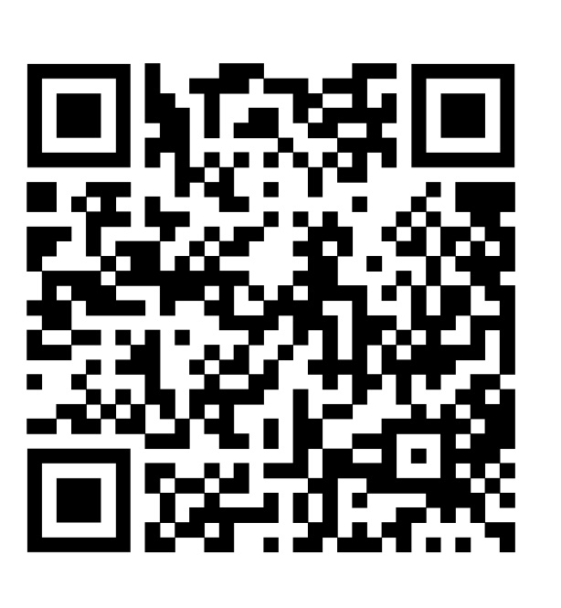

Medical Group QR Codes
51st Medical Group Facebook
MTF hours, events, etc.
ISOS MyCare
Overseas App
Track referrals & appointments
Submit claims, find network providers, etc.

Slide 4
Agenda
General Clinic Information
MHS GENESIS Patient Portal
Booking FAQs
TRICARE In-Processing & International SOS (ISOS)
Referrals
Host Nation Hospitals
EFMP
MDG Capabilities
Access (Primary Care, Specialty Care & Networks)
Mental Health Services
FSS Events
Open Forum Q&A

Slide 5
Medical Care
General Clinic Information
Hours of Operation
Mon - Fri 0700-1700
Appointment Line
Mon - Fri 0700-1600
COMM: 0505-784-DOCS (3627)
DSN: 784-DOCS (3627)
Reoccurring Closures
Clinic closed for medical readiness training on the 3rd Thursday of each month.
Closed for federal holidays and limited services on FW Down Days.

Slide 6
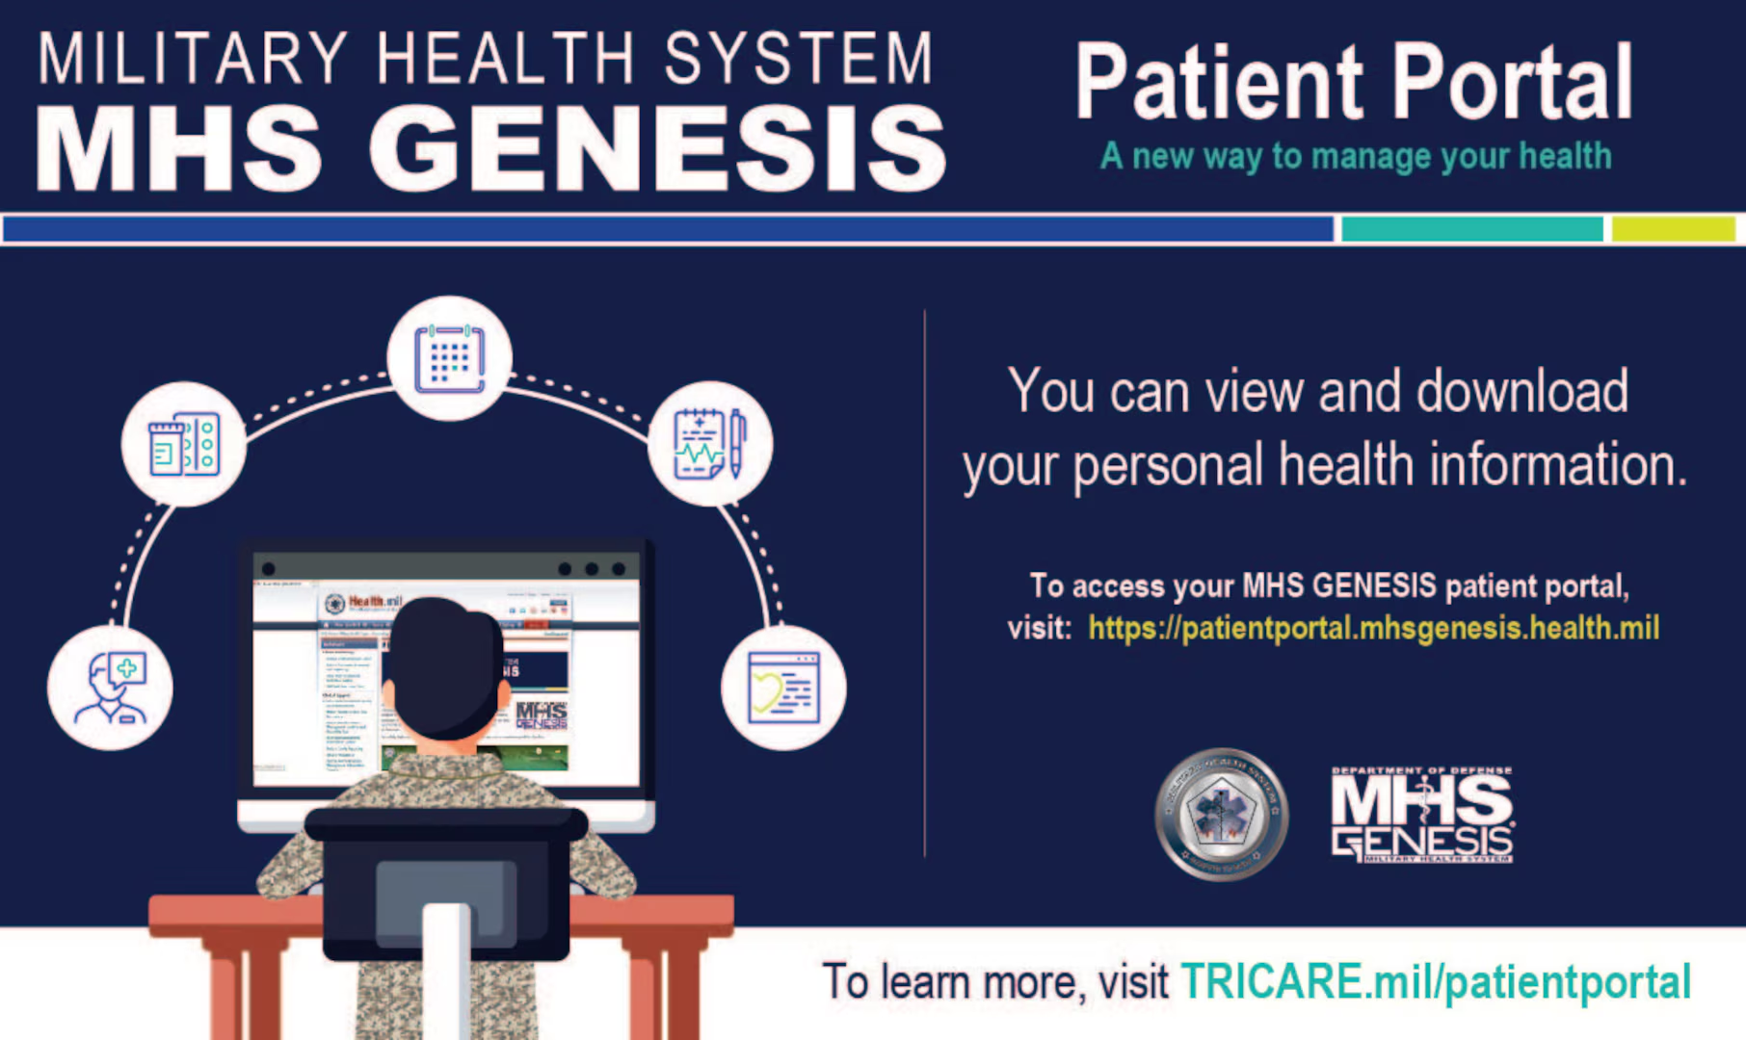
MHS GENESIS Patient Portal
View Health Record
(clinic visits and test results)
Message your PCM Team
Pharmacy Refill Requests
To access the MHS GENESIS
Patient Portal visit:
https://my.mhsgenesis.health.mil

Slide 7
Booking FAQs
When should I book an in-person appt?
Acute symptoms that do not warrant Emergency Room or Urgent Care Center
Initial request for a profile/referral
Emergency Room follow-up
Conditions that require physical assessment (ie blood pressure, musculoskeletal, skin issues)
First Term Airmen PHA
EFMP Clearance for family members
When should I book a virtual appt (phone)?
Medication/Condition follow-up
Referral request for an existing condition (ex. Urology referral for vasectomy)
Profile extension
Lab/Radiology results
Medical clearance
What can be done over messaging my PCM (instead of an appt)?
Medication refill request
Referral renewals
Incidences when a patient sends an attachment (Convalescent leave requests, Urgent Care Center discharge paperwork, radiology reports, med clearance form, etc.,)

Slide 8
TRICARE In-Processing & ISOS
Mandatory TRICARE Briefing for AD Members
Tuesdays, Wednesdays, and Thursdays
(excluding federal holidays & exercise weeks)
From 1300-1400
Mustang Community Center – Ballroom
International SOS (ISOS) is responsible for coordination of medical benefit of the TRICARE Overseas Program
Management of referrals for TRICARE Prime members
International medical claim dispute for ALL TRICARE members
Translation services for TRICARE Prime members stationed overseas
Beneficiary Counseling Org Box
dha.osan.osan-51st-mdg.mbx.bcac-dcao@health.mil

Slide 9
Medical Referrals
TRICARE Prime:
Requires referrals for specialist visits & some diagnostic services
Beneficiaries must get a referral from their Primary Care Manager (PCM) before seeing a specialist
TRICARE Select:
Generally, does not require referrals for most health care services
Out-of-pocket costs (Co-pays)
Beneficiaries can choose any TRICARE-authorized provider without a referral, although some services may require pre-authorizations.

Slide 10
Host Nation Hospital Support
Brian D. Allgood Army Community Hospital (BDAACH) accepts a significant portion of the 51 MDG’s medical referrals.
When BDAACH is unable to accept medical referrals, ISOS sends them to Ajou University Hospital, Pyeongtaek St. Mary’s Hospital, Hallym University Hospital or Yongin Severance Hospital.

Slide 11
Exceptional Family Member Program (EFMP)
Members PCSing with dependents:
You will receive a notification to create an account in MyVector: https://myvector.us.af.mil
You are required to complete an initial travel screening questionnaire. This will populate in MyVector within 15 days of receiving your RIP and no sooner than within 8 months of your RNLTD. (PCSing to an OCONUS location will require an additional family member travel screening)
For all dependents currently seeing a specialist and/or having any open referrals to a specialist.
Finalize ALL outstanding medical, dental, or educational referrals and ensure that records are provided to the losing base SNC (Special Needs Coordinator) at your local EFMP-Medical office
Report changes to any previously identified condition(s) to your local EFMP-Medical office immediately.
For family members receiving care at a civilian clinic/hospital, obtain medical records and/or complete AF 2870/Release of Medical Records in MyVector for all dependents.
Ensure that all dependents have a physical documented within the last 24 months and it is on file.
EFMP Email: usaf.osan.51-mdg.mbx.osan-efmpm@health.mil
EFMP Number: 784-5241

Slide 12





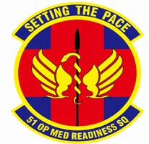







51 MDG Capability
Group Staff Ed & Training
Group Practice Mgt Health Care Integration Quality/Risk/Safety Mgt Disease/Case Mgt
Clinical Oversight 607 MMS IDMT Daegu
694 ISRG Medics 25/36 Fighter Sqs Clinics
5 Recon Sq Clinic
Healthcare Ops
Operational Medical Readiness
Medical Support
Urgent Care Center Family Practice Internal Medicine Immunizations
Multi-Service Inpatient Pediatrics Radiology
Surgical Suite
-- General
-- Orthopedics Women’s Health
Bio Env Engineering Operational Support Tm Dentistry (General) Dental Lab
Flight Medicine Health Promotion Warrior AD Clinic Mental Health Optometry
Oral Maxillo-Facial Physical Therapy Public Health
Diagnostic Laboratory Facility Management Information Systems Logistics
Medical Readiness Nutritional Medicine Pharmacy Resource Mgmt
TRICARE Operations & Patient Admin
War Reserve Material
Operating AF’s most permanent forward deployed 11-bed hospital for 24K joint beneficiaries
9

Slide 13
Clinic Access
Dependent Care (Family Medicine, Internal Medicine, Pediatrics, Women’s Health)
Non Command-sponsored patients can be seen on a Space Available appointment. Call the Appointment Line after 0900 to make a same-day Space Available appointment.

Slide 14
Mental Health
The Mental Health Clinic (MH) comprises of 3 different services:
MH (0700-1700, 1600-1700 are walk-ins only)
Offers individual counseling & therapy services from licensed psychologists/social workers in addition to medication management by a psychiatrist
AD only
Alcohol & Drug Abuse Prevention & Treatment (ADAPT) (0700-1700)
Provides substance abuse education, assessments, and outpatient rehabilitation
AD only
Family Advocacy Program (FAP) (0700-1700)
Develops & provides programs/services to prevent, halt & treat child/spouse maltreatment.
AD & Family Members

Slide 15



FSS Events

Slide 16


FSS Events

Slide 17
Summary
General Clinic Information
MHS GENESIS Patient Portal
Booking FAQs
TRICARE In-Processing & International SOS (ISOS)
Referrals
Host Nation Hospitals
EFMP
MDG Capabilities
Access (Primary Care, Specialty Care & Networks)
Mental Health Services
FSS Events
Open Forum Q&A

Slide 18
Open Forum Q&A
Subject Matter Experts
MDG Leadership
Public Affairs
Force Support Squadron
Civil Engineer Squadron
School Liaison Program Manager (SLPM)
Support Agencies
Scan Here to Submit a Question Online.

Slide 19
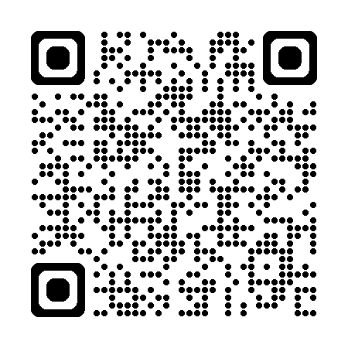
Join Us Next Time!
July Team Osan Town Hall
Date: 16 July
Time: 1700
Location: Officers’ Club
Topic: Housing
View Previous Town Hall Minutes:
https://51fss.com/mustang-one-stop/

