Slide 1
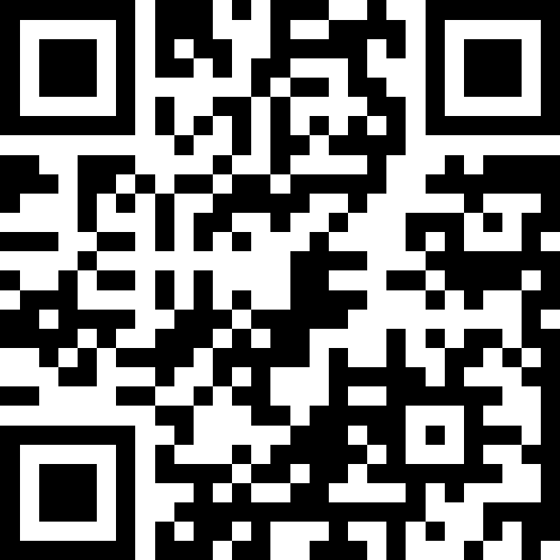
Scan Here to Submit a Question
Scan Here to Submit a Question Online.

Slide 2
Supporting Military- Connected Students
Osan AB Townhall
13 August 2025

Slide 3
Agenda
General Information
School Liaison Program
Exceptional Family Member Program
Educational & Developmental Intervention Services
Military & Family Life Counselors
AAFES- School Meal Program
Child & Youth Programs
51 LRS
DoDEA Crosswalk update
PacWest District
Osan Elementary School
OES PTO / SAC
Osan Middle High School
OMHS PTSO / SAC
51 FSS Upcoming Events
Open Forum Q&A

Slide 4

School Liaison Program
About Us
Department of the Air Force School Liaisons (SLs) are the central point of contact for commanders, military families, and school districts on Preschool–12th grade school matters.
Our Mission
The School Liaison Program is committed to outreach, advocacy, and partnership initiatives that generate real-time solutions for military-connected students as they face global educational challenges and transitions.
Who We Serve
Active Duty | DOD Civilians | Retirees | Guard and Reserve
Eligible family members to include contractors assigned to the installation
Program Support Areas
Education Community Partnerships
Local School Navigation
Special Education Navigation
Deployment Support
College, Career and Military Readiness
Grants and Scholarships
Professional Development
Transition Support

Slide 5

School Liaison Events
August
Transition Talk: Supporting your Child through Change with MFLC:
  11 Aug | 1330 | PDC, Rm 15
September
Homeschool Curriculum Showcase and Exchange:
  3 Sept | 1830 | PDC, Rm 15
Sips with the SLO (School Liaison Office) with FAP:
  15 Sept | 1130 | Café Bene
October
Choices and Challenges:
Social Emotional Game Night with MFLC and IRO
  23 Oct | 1800 | PDC, Rm 15
November
Dual Enrollment 101 with UMGC:
  20 November | 0900 | Zoom

Slide 6
School Liaison Program
Office Hours of Operation
Mon - Fri 0800-1700
Contact
DSN: 784-0290
COMM: 0505-784-0290
Cell Call/Text: 010-3386-0051
Email: April.Kersey@us.af.mil
Location
Professional Development Building
Building 788, Room 22
Between Chilis and The Education Center
Information
https://51fss.com/school-liaison-office/
https://www.facebook.com/osanslo/

Slide 7
Military and Family Life Counselors
Child Youth Behavioral MFLCS:
  What: CYB MFLCS offer non-medical counseling, consultations, outreach & presentations.
  Who: Must be an active service member or retired in last 6 months or dependent of one. Can meet with child and parent individually or as a family.
  How: Provide signed parent acknowledgement form if ages 17 or younger.
  OMHS: Joshua Chak
  OES: Chante Coley
  CYP/Homeschool/ Base-wide: Felicia McRae

Slide 8
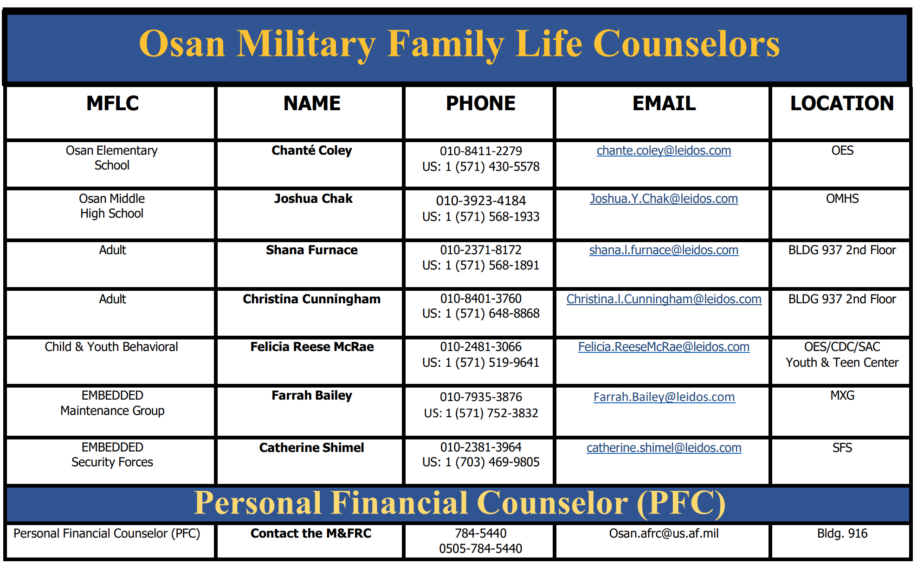
MFLC Contacts

Slide 9
M&FRC EFMP Family Support (FS) Coordinator
Key Responsibilities:
Information and Referral:
Providing information about military and community resources, including healthcare, education, and support programs.
Non-Clinical Case Management:
Assisting families with navigating systems of care, developing family service plans, and connecting them with appropriate providers.
Outreach and Education:
Offering workshops, training, and educational materials to help families understand EFMP and available resources.
Coordination with Other Agencies:
Working with military and community organizations to ensure families receive comprehensive support.
Assistance with Enrollment:
Helping families enroll in the EFMP and ensuring their special needs are documented.
Support During PCS:
Assisting families with the challenges of Permanent Change of Station moves, including finding appropriate medical and educational services at the new location.

Slide 10
M&FRC Exceptional Family Member Program (EFMP) Family Support
Office Hours of Operation
Mon - Fri 0800-1600
Contact
DSN: 783-4636
COMM: 0505-784-4636
Alternate COMM:0505-784-5440
Email: harold.owens.4@us.af.mil
Location
McPherson Center
Building 916, Room Labeled EFMP
Located Between Library and The Enlisted Club
Information
51FSS.FSH.EFMP@us.af.mil

Slide 11
EDIS- Educational and Developmental Intervention Services
EDIS Mission:
  To help eligible children achieve their developmental and educational potential by providing quality family-centered services, consultation, and support in the home, school, and community. Services include developmental screenings and evaluations, intervention and rehabilitation services.
  EDIS is composed of two age-specific programs; Early Intervention Services (EIS) ages birth to 2 and Related Services (RS) ages 3-21.
What is Early Intervention:
  Early Intervention Program provides developmental screenings, evaluations, and intervention services for children birth to 3 years of age who may be at risk of developmental delay, suspected delayed, or present with medical (biological) conditions that impact the child’s functioning.
What is Related Services:
  Related Services are specific services provided to special education students to help them become successful in their education programs. EDIS providers help students achieve functional independence and participation in the school environment with their peers.
Referrals:
  Medical professional of family (for EI)
  From the school for RS services
Contact information:
  DSN: 737-1300
  Commercial: 0503-337-1300
  Like and follow us on Facebook- www.facebook.com/EDISkorea

Slide 12

School Meal Program
**NEW!!** for School Year 2025-2026
UNIVERSAL PRE-K/ SURE START
If you have a student enrolled in Universal Pre-K
(UPK or PK),
your student will be charged full meal price daily, unless you are eligible for and apply for free or reduced meals.
  New SMP System: LINQ connect
  Students will be in LINQ connect once registered in DoDEA school
    Current students' funds will be imported
    Negative Account Balances
  A LINQ connect parent account is required to monitor student’s spending account
    Need Student’s ID# to link to parent acct
    Monitor accounts, make payments
    Apply for Free and reduced meals
  Only one application required per household
  Mandatory for all Sure Start students
  Refunds: Send Request to SMPCustsvc@aafes.com for those who have PCS’d

Slide 13
Child & Youth Services
CDC – bldg. 213
Registration for Care: ongoing through Militarychildcare.com
(age 6 weeks to age 5)
Hours of Operation: Monday-Friday 0700-1800
DSN: 0505-784-4966/5454 Email: 51FSS/FSYC.CDC@us.af.mil
SAC – bldg. 213
Registration for Care: ongoing through Militarychildcare.com
(age 5 – in kindergarten to age 12)
Hours of Operation: Monday-Friday 0700-1800
DSN: 0505-784-6830 Email: 51FSS/FSYC.Schoolagecare@us.af.mil

Slide 14

Child & Youth Services
Family Child Care – bldg. 213
Register for care and find provider information on militarychildcare.com
Benefits:
Providers set their own hours & business model
Major financial incentives
Currently available only for those living on base
Contact Info: Jenny Iverson, Community Child Care Coordinator
DSN 315-784-4694 or jennifer.Iverson.1@us.af.mil / 51fss.fsyc.familychildcare@us.af.mil

Slide 15
Child & Youth Services
Youth Center – bldg. 433
Open to youth ages 9-12
Membership – monthly or annually
DSN: 0505-784-1492 Email: 51FSS/FSYY.youthcenter@us.af.mil
Youth Sports– bldg. 433
Volunteer Coaches always needed
DSN: 0505-784-1492 Email: 51FSS/FSYY.youthcenter@us.af.mil
Teen Center – bldg. 738
DSN: 0505-784-4668 Email: 51FSS/FSYY.youthcenter@us.af.mil

Slide 16
2025 Universal Pre-K Transportation
Purpose: Transport children who are signed up for CDC services and are registered for Universal Pre-K.
Start Date: 02 September 2025
Times:
AM Run (Mon – Fri) Leaves CDC for OES at 0720
PM Run (Mon, Wed - Fri) Leaves OES for CDC at 1400
PM Run (Tue) Leaves OES for CDC at 1325

Slide 17
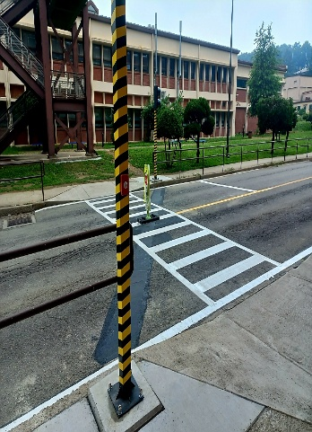
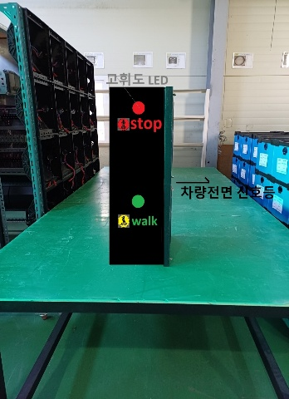
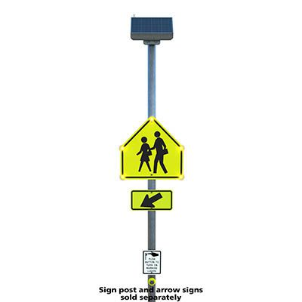
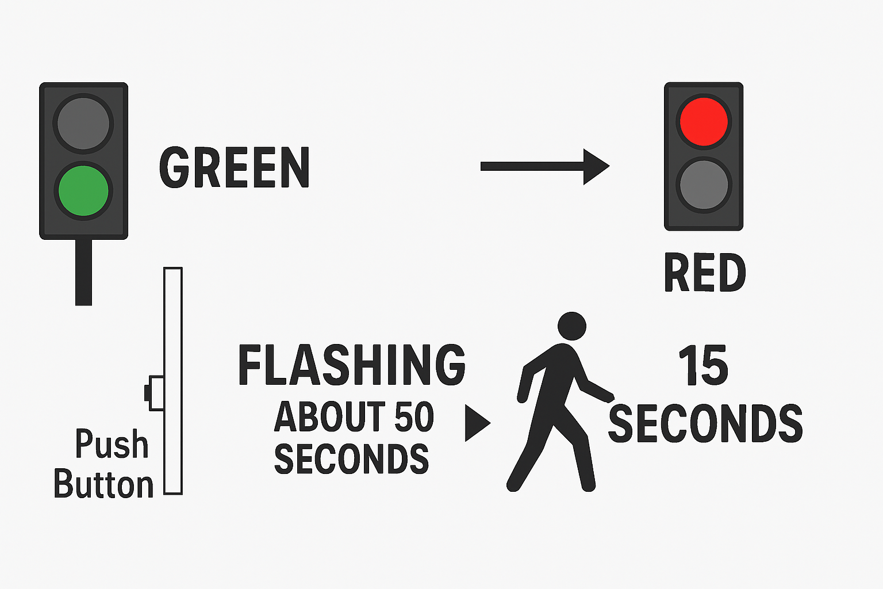
Crosswalk Update
OMHS Vehicle Stoplight & Pedestrian Streetlight Operation
The vehicle traffic light remains green until a pedestrian activates the system using the push button.
Once activated, the traffic light will flash for about 50 seconds to alert drivers that it will soon change, and they must prepare to stop.
Pedestrians have approximately 15 seconds to cross the street safely after pressing the button.
After the crossing cycle, the vehicle traffic light returns to green, allowing traffic to resume until the next pedestrian activation.
Push/activation buttons are installed on both streetlight poles for convenient access from either side of the street.

Slide 18
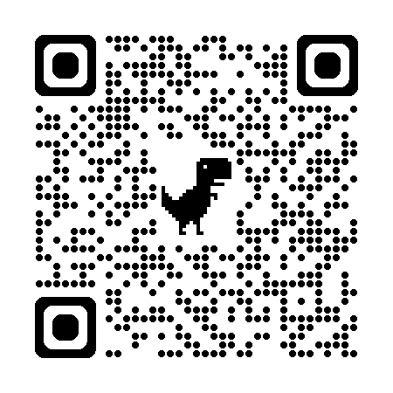
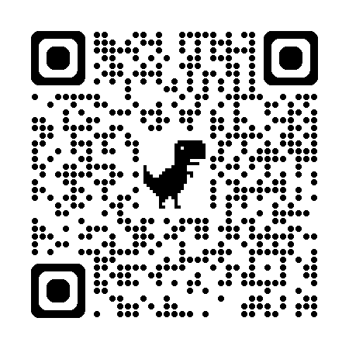

DoDEA PacWest
Registration
To register to attend a DoDEA School the following age requirements must be met.
  A child must be:
  four years old by September 1 to attend Pre-Kindergarten.
  five years old by September 1 to enroll in kindergarten.
  six years old by September 1 to attend first grade.
Schools Need
Substitute Teachers
Pre-registration for new students: Visit DoDEA Online Registration Portal https://dodeasis.myfollett.com/aspen
Final Registration: Please contact the school registrar to finalize the registration once you arrive in Korea.
Existing students: Contact the School Registrar to update student information.
https://www.usajobs.gov/job/834518600
DoDEA Pacific West
Information Site
PTSO Enrollment
Osan Elementary School – PTSO President: Ayla Roy contactusoespto@gmail.com
Osan Middle/High School – PTSO President: Farrah Williams osanmiddlehighptso@gmail.com
Sports, Extra Curricular Activities
Information will be provided to your student throughout the school year.
https://www.dodea.edu/pacific/pac-west
School Drop Off and Pick Up Times
Osan Elementary School
    Drop Off: 0735-0800 (School Begins 0800)
    Pick up: 1430 (Mon, Wed-Fri) 1315 (Tues)
Osan Middle/High School
    Drop Off: 0815-0830 (Breakfast 0800, School Begins 0830)
    Pick up: 1510 (Mon, Wed-Fri) 1410 (Tues)
**Schools Need
Volunteers**

Slide 19
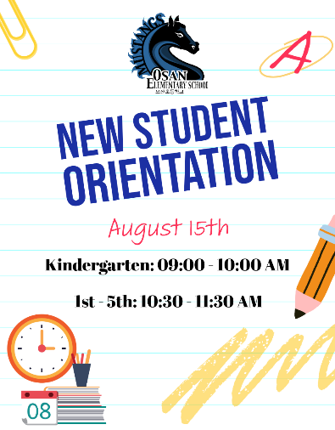



OES
Upcoming Events
15 August: New Student Orientation
Kindergarten: 09:00 am – 10:00 am
Grades 1 – 5: 10:30 am – 11:30 am
15 August: Teacher Meet & Greet
2:00 pm – 4:00 pm
18 August: First Day of School for Kindergarten – 5th Grade
25 August – 29 August: Prekindergarten Home Visits
Dates & times will be sent out by the classroom teacher once class assignments are made
2 September: First Day of School for Pre-Kindergarten
2 September: OES Open House
4:00 pm – 6:00 pm

Slide 20


OES
PTO & SAC
🏫 How your OES PTO Supports Osan Elementary School
The Osan Elementary PTO actively strengthens the school’s mission by fostering collaboration, enhancing student success, and building community connections. We're far more than popcorn and parades—we're dedicated partners in every child's journey. Membership is open to all, and we’d love for you to join us! Follow us on Facebook for updates or email us at ContactUsOESPTO@gmail.com
President Ayla Roy, Vice President Lauren Surridge, Treasurer Jillian Rodriguez, and Secretary Brianna James
OES PTO Facebook
🎓 School Advisory Committee (SAC)
Osan Elementary SAC includes parents, educators, and stakeholders working together to:
Advise school leadership
Strengthen communication
Collaborate on concerns via proper channels
Meetings are public & all parents are welcome!
📧 Contact: osanes.sac@gmail.com
OES School Advisory Committee

Slide 21
OMHS
Student Orientation(s):
  Thursday, August 14
    New Student Orientation/Gr. 6 Session for Success @ 1530-1700
  Friday, August 15
    Cougar Corral - All Returning Student Orientation @ 1500-1700
First Day of School:
  Monday, August 18
  Breakfast will be Served (8:00 a.m.)
  Doors open at 8:25 a.m.
  Cellphone – Free during school hours
  Lunch Period Schedule
Locker Distribution for All Students Begins 1st Week of School (Doors Open Daily 8:15 a.m.)
School Calendar Highlights:
  Open House – Sept 4
  School Picture Day – Sept 29-30
  End of 1st Quarter – Oct 23

Slide 22
OMHS
  2 Lunch Period Schedule Overview
🅰️ A-Days (Regular Days: Monday, Wednesday, Thursday, Friday)
Middle School Lunch: 11:30 AM – 12:05 PM
High School Lunch: 12:10 PM – 12:45 PM
🅱️ B-Days (Regular Days: Monday, Wednesday, Thursday, Friday)
High School Lunch: 11:30 AM – 12:05 PM
Middle School Lunch: 12:10 PM – 12:45 PM
Early Release Tuesdays
  A-Days:
    Middle School Lunch: 11:00 AM – 11:35 AM
  High School Lunch: 12:15 PM – 12:50 PM
  B-Days:
  High School Lunch: 11:00 AM – 11:35 AM
  Middle School Lunch: 12:15 PM – 12:50 PM

Slide 23
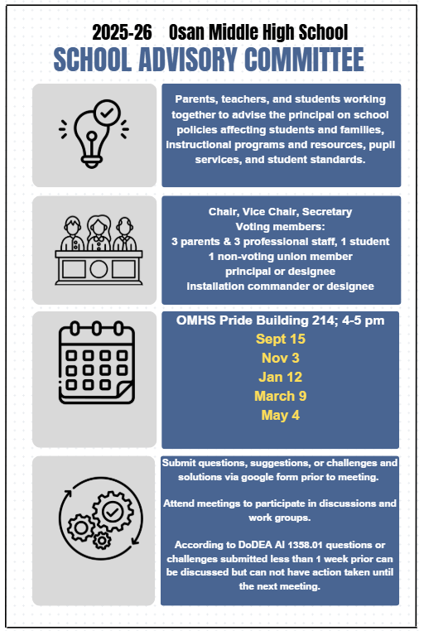

OMHS
SAC

Slide 24


OMHS
PTSO
PTSO Purpose:
Assist OMHS in meeting student needs, improving academic and extra-curricular programs, and provide interface between parents, students, faculty, and DODEA.
Communicate between parents, students, teachers, and administrators in student support and school activities.
We are a private organization, not a part of the DOD or any of its components, and have no governmental status.
Open Positions:
Membership Chair
Publicity/Social Media
Student & Staff Appreciation
Scholarships

Slide 25



51 FSS Upcoming Events

Slide 26



51 FSS Upcoming Events

Slide 27
Open Forum Q&A
Subject Matter Experts
  MSG Leadership
  Public Affairs
  School Liaison Program Manager (SLPM)
  MFLCs
  EFMP – Family Support
  EDIS
  AAFES
  LRS
  CYP
  DoDEA PacWest
  OES and OMHS Administration
  OES PTO
  OES PTSO
  OMHS PTSO
  OMHS SAC
Scan Here to Submit a Question Online.

Slide 28

Join Us Next Time!
September Team Osan Town Hall
Date: 10 September
Time: 1700 | 5 pm KST
Location: Officers’ Club
Topic: 51st Fighter Wing Hot Topics
View Previous Town Hall Minutes:
https://51fss.com/mustang-one-stop/

