Slide 1
DoDEA/CYP
Osan AB Townhall
12 November 2025

Slide 2
Agenda
School Liaison Program
Military and Family Life Counselor
DoDEA PacWest
Osan Elementary School
Osan Middle High School

Slide 3

School Liaison Program
About Us
Department of the Air Force School Liaisons (SLs) are the central point of contact for commanders, military families, and school districts on Preschool–12th grade school matters.
Our Mission
The School Liaison Program is committed to outreach, advocacy, and partnership initiatives that generate real-time solutions for military-connected students as they face global educational challenges and transitions.
Who We Serve
Active Duty | DOD Civilians | Retirees | Guard and Reserve
Eligible family members to include contractors assigned to the installation
Program Support Areas
Education Community Partnerships
Local School Navigation
Special Education Navigation
Deployment Support
College, Career and Military Readiness
Grants and Scholarships
Professional Development
Transition Support

Slide 4
School Liaison Program
Office Hours of Operation
Mon - Fri 0800-1700
Contact
DSN: 784-0290
COMM: 0505-784-0290
Cell Call/Text: 010-3386-0051
Email: April.Kersey@us.af.mil
Location
Professional Development Building
Building 788, Room 22
Between Chilis and The Education Center
Information
https://51fss.com/school-liaison-office/
https://www.facebook.com/osanslo/

Slide 5
Military and Family Life Counselors
Child Youth Behavioral MFLCS:
  What: CYB MFLCS offer non-medical counseling, consultations, outreach & presentations.
  Who: Must be an active service member or retired in last 6 months or dependent of one. Can meet with child and parent individually or as a family.
  How: Provide signed parent acknowledgement form if ages 17 or younger.
  OMHS: Joshua Chak
  OES: Chante Coley
  CYP/Homeschool/ Base-wide: Felicia McRae

Slide 6
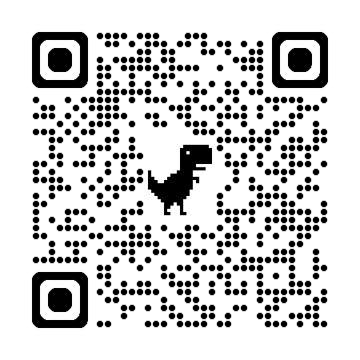
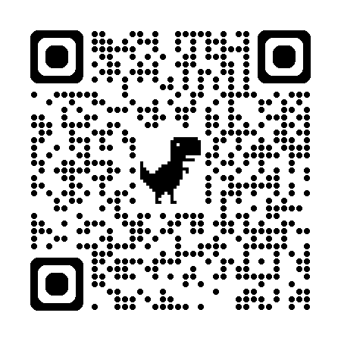
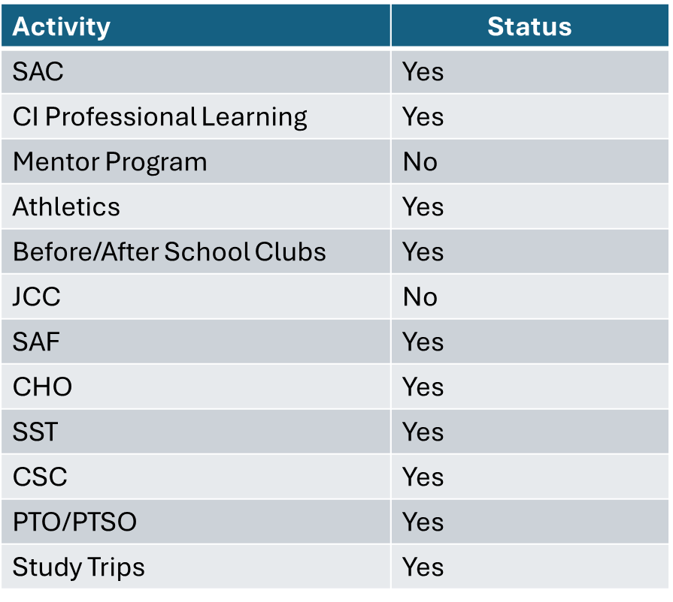
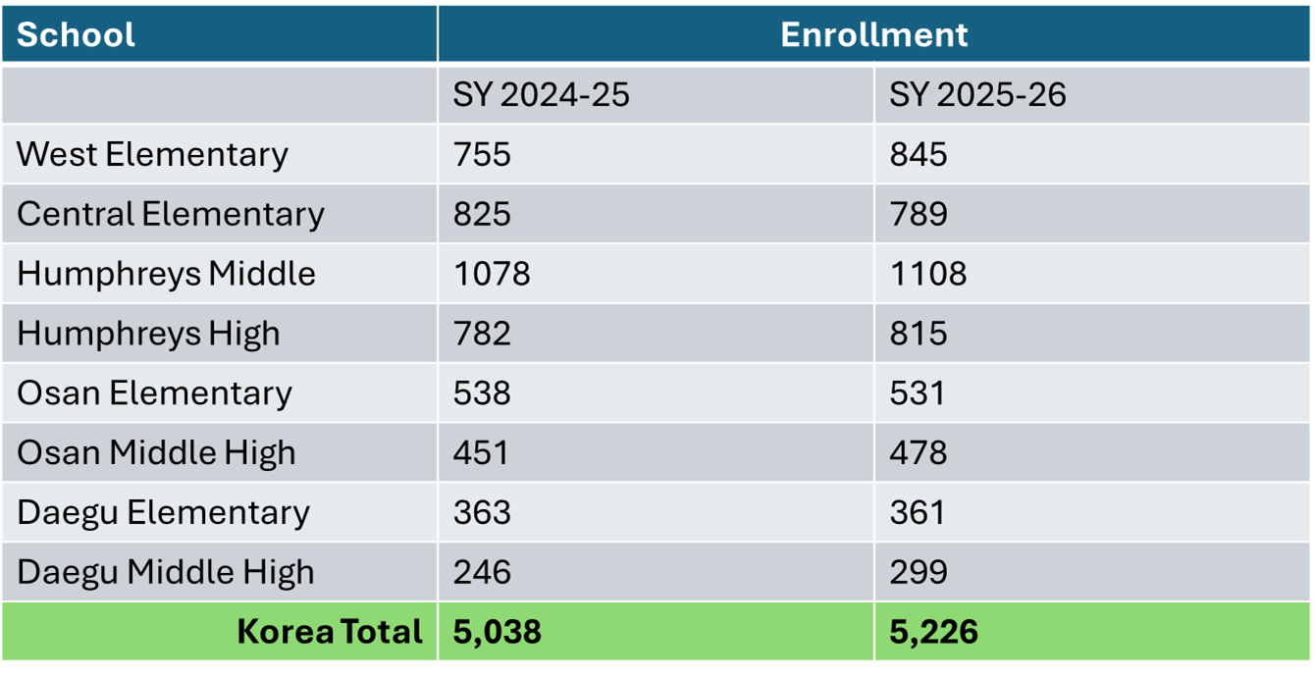
DoDEA PacWest
Schools Need
Substitute Teachers
Registration
To register to attend a DoDEA School the following age requirements must be met.
  A child must be:
  four years old by September 1 to attend Pre-Kindergarten.
  five years old by September 1 to enroll in kindergarten.
  six years old by September 1 to attend first grade.
Pre-registration for new students: Visit DoDEA Online Registration Portal https://dodeasis.myfollett.com/aspen
Final Registration: Please contact the school registrar to finalize the registration once you arrive in Korea.
Existing students: Contact the School Registrar to update student information.
https://www.usajobs.gov/job/834518600
DoDEA Pacific West
Information Site
Shutdown Status
Enrollment Numbers
https://www.dodea.edu/pacific/pac-west
**Schools Need
Volunteers**

Slide 7
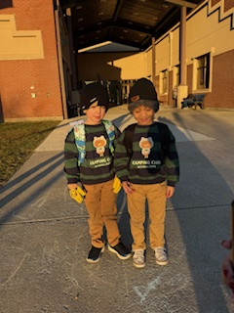
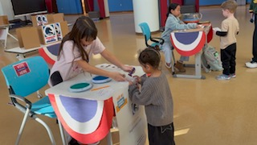
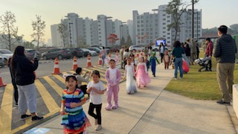
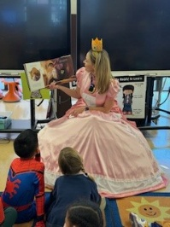
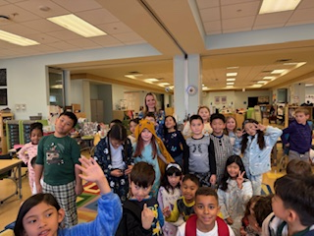
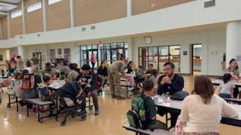
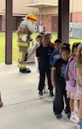
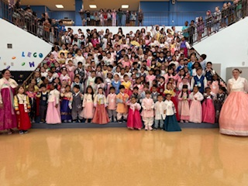

OES
Past Events
  OES New Student Breakfast
  Celebrated Chuseok
  Fire Prevention Presentation
  Student Council Elections
  Red Ribbon Week – Character Parade
  Parent Teacher Conferences – Updated Student Data Sheet for Parents
  Started WIN time in all Grades
  Partnered with Hospital for Vision Screening
  Cheer for Books, Touchdown for Reading by OMHS Students
Upcoming Events
  Student Council Induction Ceremony, Nov. 14 @ 8:30 am
  Parent University, Nov. 18 from 11:30 am -12:30 pm
  SAC Meeting, Nov. 19 @ 3:00 pm
  Thanksgiving Break, No School, Nov. 26-28
  Jingle Jam, Dec. 5, 4:30-6:30 pm

Slide 8


OES
PTO & SAC
🏫 How your OES PTO Supports Osan Elementary School
The Osan Elementary PTO actively strengthens the school’s mission by fostering collaboration, enhancing student success, and building community connections. We're far more than popcorn and parades—we're dedicated partners in every child's journey. Membership is open to all, and we’d love for you to join us! Follow us on Facebook for updates or email us at ContactUsOESPTO@gmail.com
President Ayla Roy, Vice President Lauren Surridge, Treasurer Jillian Rodriguez, and Secretary Brianna James
OES PTO Facebook
🎓 School Advisory Committee (SAC)
Osan Elementary SAC includes parents, educators, and stakeholders working together to:
Advise school leadership
Strengthen communication
Collaborate on concerns via proper channels
Meetings are public & all parents are welcome!
📧 Contact: osanes.sac@gmail.com
OES School Advisory Committee

Slide 9
OMHS
Upcoming Events: NOVEMBER
  November 13
    Fall Drama Performance
  November 17-20
    Far East JAMM (Hosted at Osan Middle High School)
  November 20
    Optional ASVAB for 10th-12th Grade Students
  November 26-28
    Thanksgiving Recess – No School for Students/Teachers
Upcoming Events: DECEMBER
  December 5
    Accelerated Withdrawal Date (First Semester)
  December 6
    SAT held at OMHS
  December 11
    Winter Guitar and Choral Concerts
  December 13
    ACT held at OMHS
  December 18
    OMHS Talent Show
  December 18
    Winter Fine Arts Night
  December 22 to January 2
    Winter Recess

Slide 10
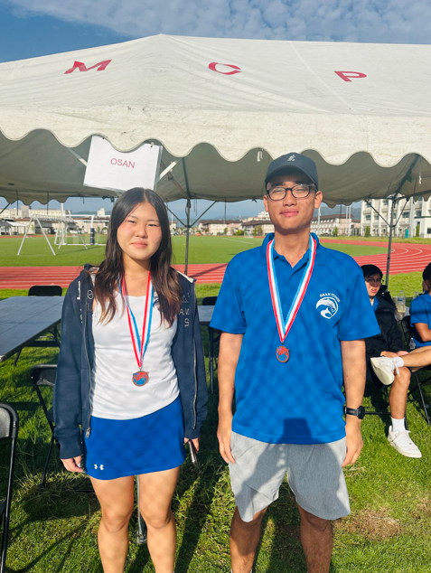
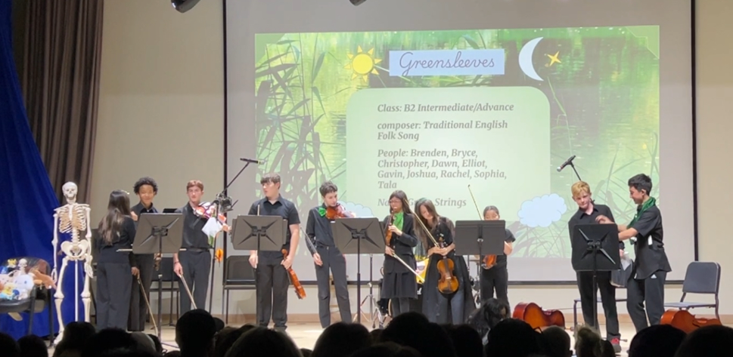
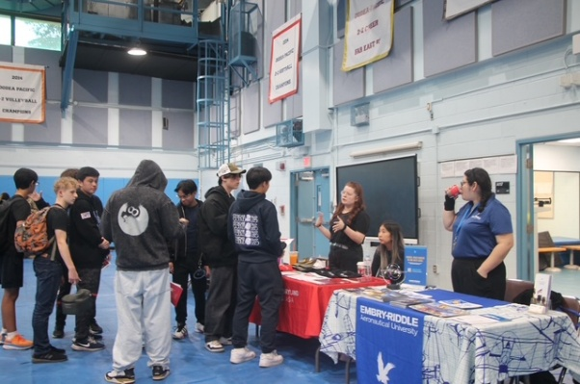

OMHS
Girls Volleyball took 3rd place in KAIAC
Boys Volleyball bought home Sportsmanship Award
Tennis Captains (Boys and Girls) took 3rd place in Far East Singles Matches
Cross Country Team completed a successful season with personal best time
Wonderful Performances: Concerts & Recitals
Spring into the Future: College & Career Fair
  Osan Middle High School hosted a college and career fair connecting students and families with colleges, career organizations, and alumni to promote-secondary planning and community collaboration.
Cheer for Books! Touchdown for Reading!
  The OMHS football team wore their jerseys, and the OMHS cheerleaders wore their uniforms as they visited classrooms to read to OES students, promoting books and literacy in celebration of National Book Month.

Slide 11
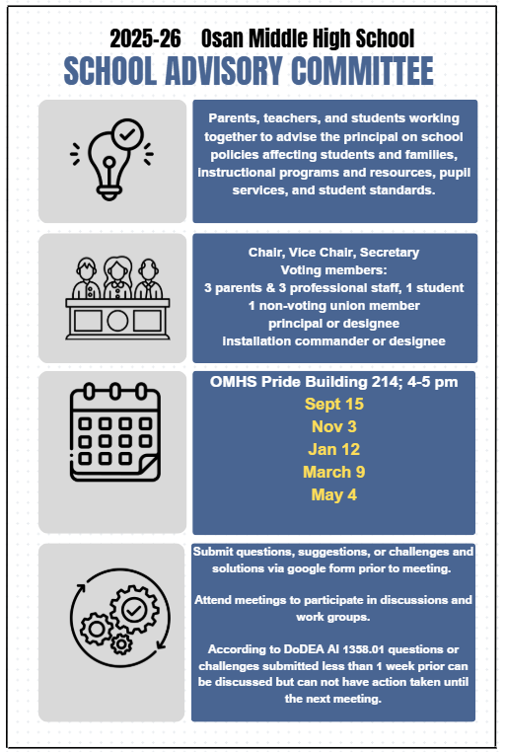

OMHS
SAC

Slide 12
Child & Youth Programs
Child Development Center (CDC)
CDC/SAC moved into new building 213 as of April 2025
Registration for Care ongoing through Militarychildcare.com (age 6 weeks to age 5)
Ongoing job opportunities on usajobs.gov & www.osan.af.mil/Resources/Military-Spouse-Direct-Hire-Program
Upcoming Events
  Parent Advisory Board Sponsored Art Auction: November 17th – 20th
  Family Luncheon: November 21st
  Holiday Cookie Decorating: December 19th
  Contact Information: 51FSS.FSYC.CDC@us.af.mil / DSN: 784-4966

Slide 13
Child & Youth Programs
School Age Care
Registration for Before and/or After School Care, militarychildcare.com (age 5*and has started Kindergarten)
Upcoming Events:
  SAC Autumn Festival: November 21st
  SAC Annual Mini Military Youth of the Year Competition: December 19th
  BGCA Annual Fine Arts Exhibit: January 9th
Contact Information: 51FSS.FSYY.SchoolAgeCare@us.af.mil / DSN: 784-6830

Slide 14
Child & Youth Programs
  Youth Center
  Sign up for monthly membership, field trips, and events by registering for a CYPBMS account (ages 9-12)
  Torch Club– Empowering youth through leadership development and impactful community service projects.
    Actively collecting Toy Drive donations for a Seoul Orphanage. Collecting donations until 3 December. Drop-Off location is BLDG 433.
  Facility Updates: Gym construction has been completed. Activity space is now available for use during Open Rec hours.
  Upcoming Events:
    18 Nov 25: Torch Club Fall Festival, open for Youth Center members
    19 Nov 25: Home Alone Training, Ages 9-18,
    10 Dec 25: Christmas Cookie Decorating. Ages 9-12
    16 Dec 25: 2025-2026 Osan Jr Military Youth of the Year Competition, Ages 10-13
    9 Jan 26: Annual BGCA Fine Arts Exhibit
  Contact Info:
    DSN 784-1492 | Email: 51FSS.FSYY.YouthCenter@us.af.mil

Slide 15
Child & Youth Programs
  Teen Center
  Sign up for monthly membership, events, and field trips by registering for a CYPBMS account (ages 13-18)
  Keystone Venture– Spots available for teen leadership club that offers volunteer hours and community improvement opportunities
  Weekly Clubs- Food Club, Drama Club, Tabletop Games, Military Youth of the Year Preparation Club
  Facility Updates- New Outdoor Arena & Music Recording Studio
  Upcoming Events:
  Holiday Overnight Lock-In: Dec 12th-13th
  Military Youth of the Year Competition: Jan 9th
  Yonsei University Field Trip: Jan 16th
  Contact Info:
    DSN 784-4668 | Email: 51FSS.FSYY.YouthCenter@us.af.mil

Slide 16

CYP Family Child Care
Families looking for care 2 providers Register for care and find provider information on militarychildcare.com Dependents looking for a meaningful career
In-demand, highly portable, reliable Client list with immediate needs Licensed and open within 60 days DAF pays for training, resources, and materials Caregiver sets hours and business model Incentives Currently available only for those living on base Join a caring and collaborative team

Slide 17


Upcoming FSS Events

Slide 18


Upcoming FSS Events

Slide 19
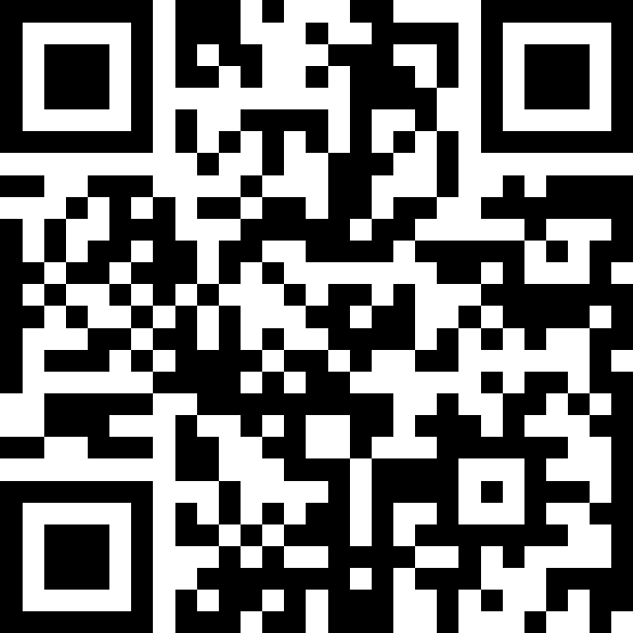
Open Forum Q&A
Subject Matter Experts
  51st Fighter Wing Leadership
  MSG Leadership
  Civil Engineering Squadron
  Force Support Squadron
  DoDEA
  51st Medical Group
Scan Here to Submit a Question Online.

Slide 20
Join Us Next Time!
December Team Osan Town Hall
Date: January
Time: 1700
Location: O’Club
Topic: 51 FW Updates

