Slide 1
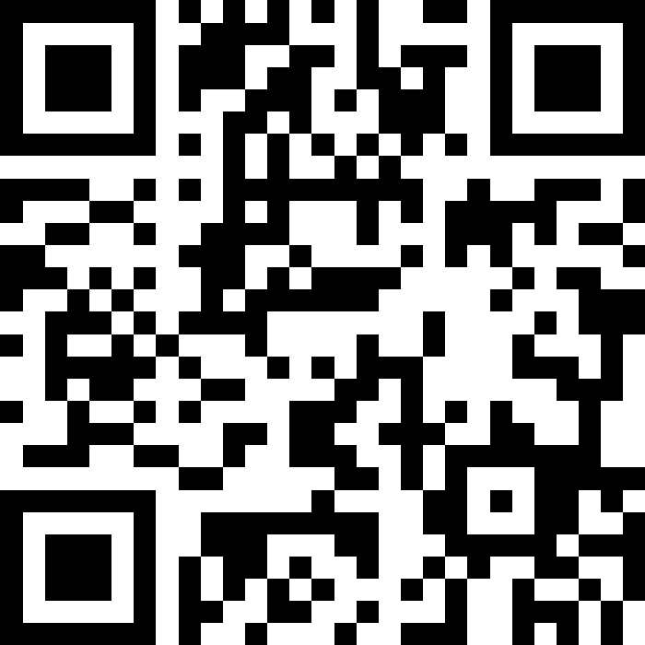
Scan Here to Submit a Question
Scan Here to Submit a Question Online.

Slide 2
51st FW Hot Topics
Osan AB Townhall
14 January 2026

Slide 3
Agenda
51st FW Lines of Effort
Super Squadron Update
Upcoming Exercises
Tour Normalization
Infrastructure Development
Housing Update
Child & Youth Program Update
AAFES Exchange Taxi Service
51 FSS Upcoming Events
Open Forum Q&A

Slide 4
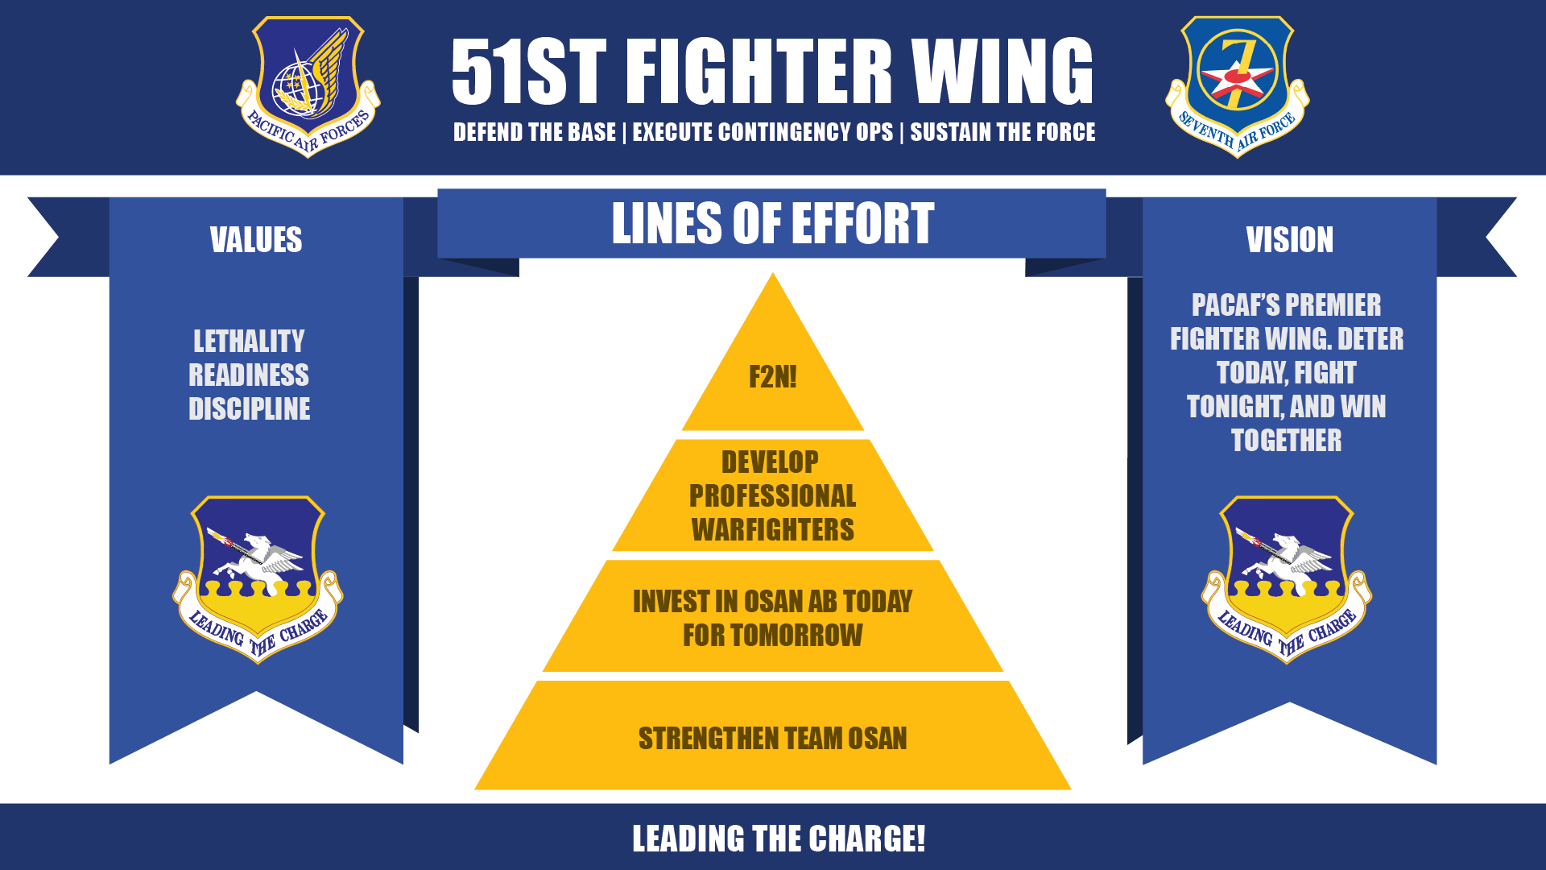
51 FW Lines of Effort

Slide 5
Super Squadron
7AF initiative (USAF and 7AF only)
Phase 1: Summer 2024 – Oct 2025 (36 FS)
Phase 2: Nov 2025 – July 2026 (35 FS)
Experimental test – Primary Aircraft Assigned Super Squadrons at Osan AB
Maximize efficiencies in one location to increase sortie generation
(LOEs: F2N!, Invest in Osan AB, Strengthen Team Osan)

Slide 6
CY 26 Calendar
51 FW Unit Effectiveness Inspection (Feb)
Freedom Shield (Mar)
Red Flag Alaska 26-1/Distant Frontier 26-1 (Apr~May)
Distant Frontier 26-2/Red Flag-Alaska 26-2 (May~Jun)
Freedom Flag (Apr)
Mustang Rodeo 26-2 (May)
Ulchi Freedom Shield (Aug)
Freedom Flag (Oct)
Mustang Rodeo 26-2 (Dec)
Buddy Squadrons/ACE (4/yr – 2x host, 2x guest)
HHQ taskings (as req’d)
Legend:
>MAJCOM PACAF USFK/7AF 51FW

Slide 7
Beverly Herd vs. Mustang Rodeo
The only exercise series controlled at the 51 FW level
Twice a year (May/Dec), between USFK exercises
Mustang Rodeo: 3 days of Focused Part-Task Training
Exercise and validate TTPs between Freedom Shield
Lethal, Ready, Disciplined

Slide 8
Tour Normalization
USFK initiative (All US Mil Services in Korea)
JTR – Jul ‘25 update, 3-2-1 construct
51 FW controls CSP Billets for Osan
Additional 2k-4k dependents over next 10 yrs
Relatively small increase in ADSMs
Increases continuity, increases readiness
Subject to worldwide manning/deployments
(All 51 FW LOEs)

Slide 9
Tour Normalization Project Updates
Youth Center Floor
Complete
Pet Boarding Kennel
Spring 2026

Slide 10
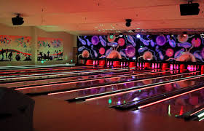
Tour Normalization Project Updates
Temporary Softball Field
Summer 2026
Bowling Alley HVAC
Winter 2026
MFH Playground on Hill 180
Spring 2026

Slide 11
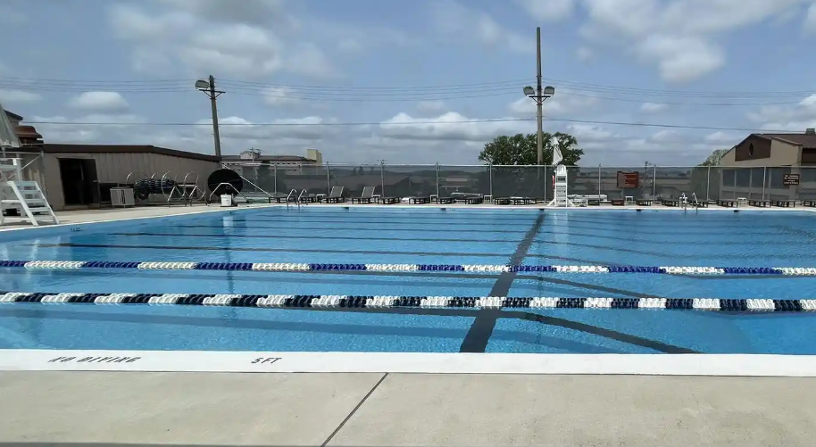

Tour Normalization Project Updates
Osan Pool Improvements
Summer 2026
BX Roof Repair
Fall 2026

Slide 12
Tour Normalization Project Updates
Repair Airman Dorms B383 & B1458
Winter 2027

Slide 13
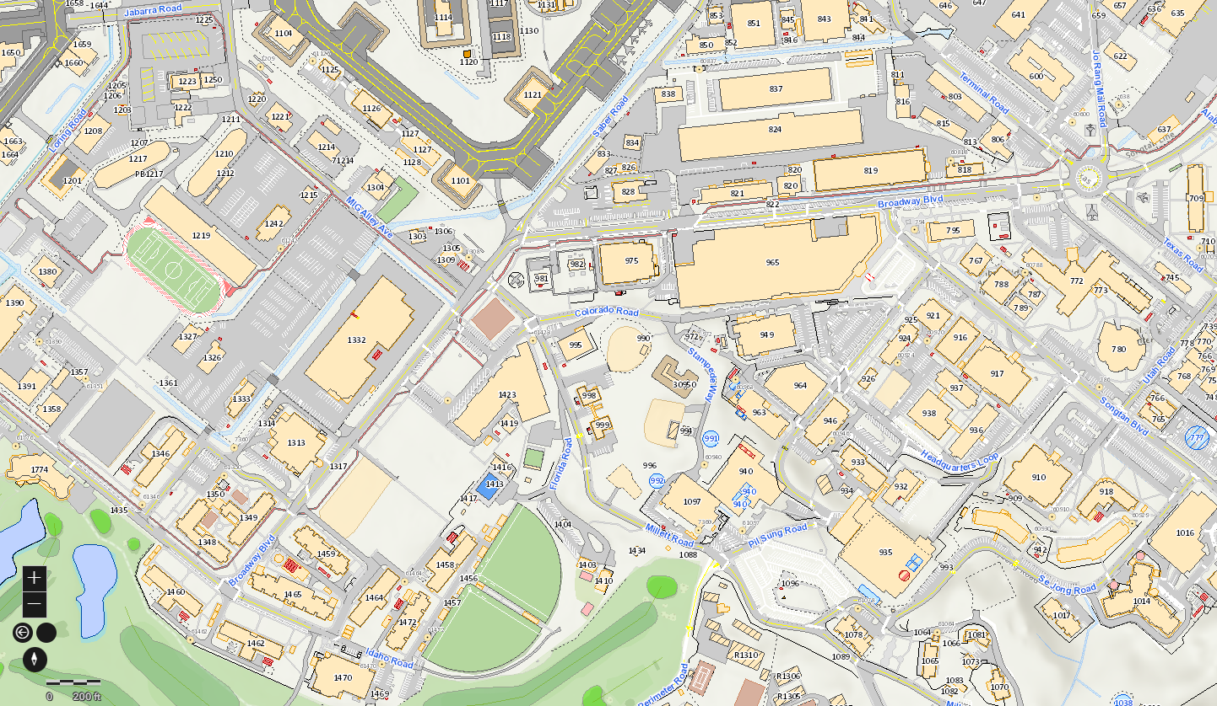
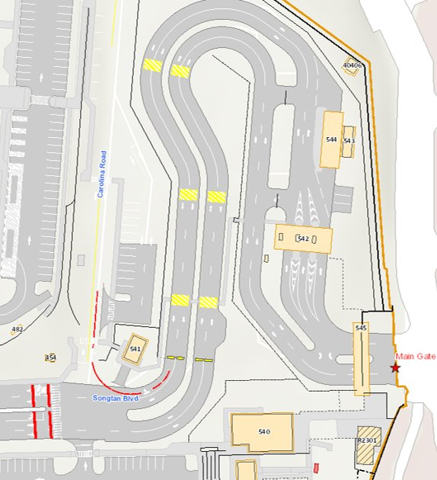
Parking Additions Now - 2027
Behind 1348: ~30 spots, end of Jan 2026
Near fitness center: ~250 spots, Mid Jan 2026
Behind 918: ~50 spots, Spring 2026
Main Gate: ~8-10 spots, Spring 2026
Demo B918: ~40 spots, Mid 2027
Demo B1464: ~30 spots, Mid 2027
4
2
1
5
3
6

Slide 14
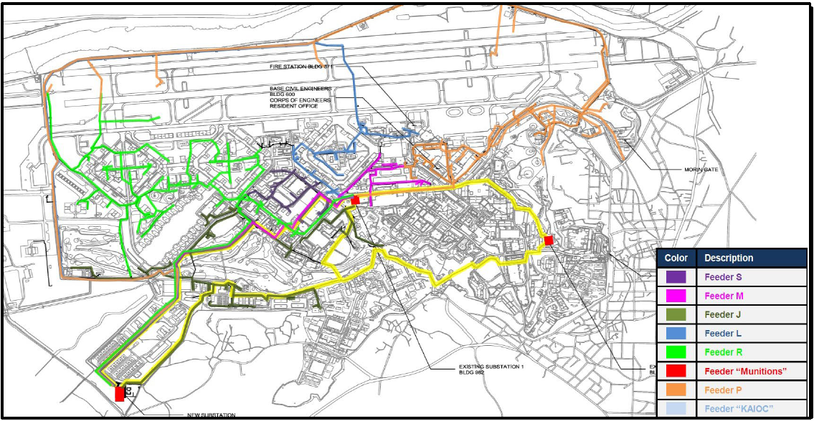
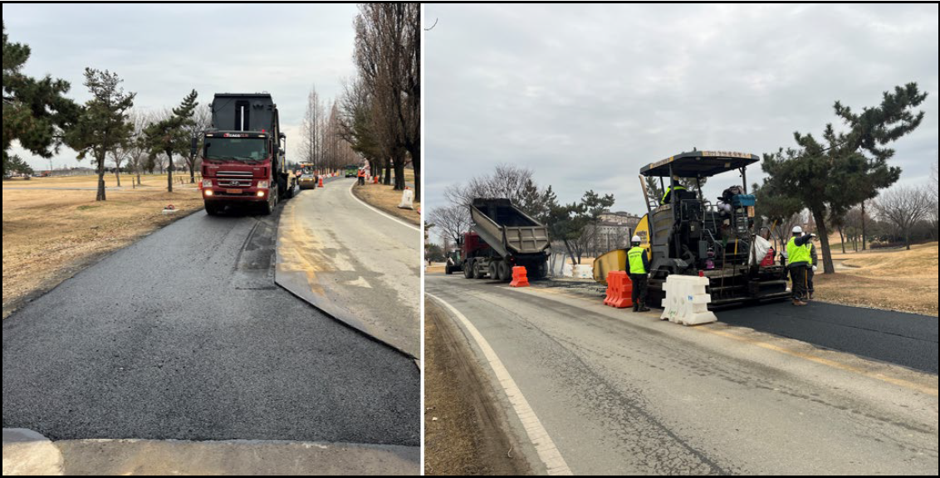
Upgrade Electrical Distribution (UED) Project
Q1 Impacts
Current
Golf Course parking lot
LRS TMO & IPE yards
Upcoming
S Perimeter Rd
Alabama Rd in front of B499

Slide 15
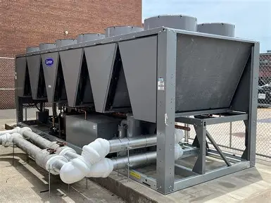
MHO's Proactive Approach to HVAC Readiness
Here’s how we’re preparing our HVAC systems
Performing Preventive Maintenance (PM): Inspecting and servicing HVAC systems to ensure they’re operating efficiently before the summer season
Purchasing New Equipment: Upgrading older systems and replacing outdated components to improve cooling performance.
Replacing filters
Coordinating Contractor Support
Portable AC Distro
Dehumidifiers in common areas

Slide 16

FY26 Tenant Satisfaction Survey
FY26 Tenant Satisfaction Survey Announcement
Dates: 02 Mar 26 – 01 May 26 (60 days)
Who: CEL and Associates
Method: Online - Questions are uniform across the DoD and housing types
Participation Goal: 20% for both FH and UH
Survey includes both UH and MFH residents; runs 01 Mar to 30 Jun 2026

Slide 17
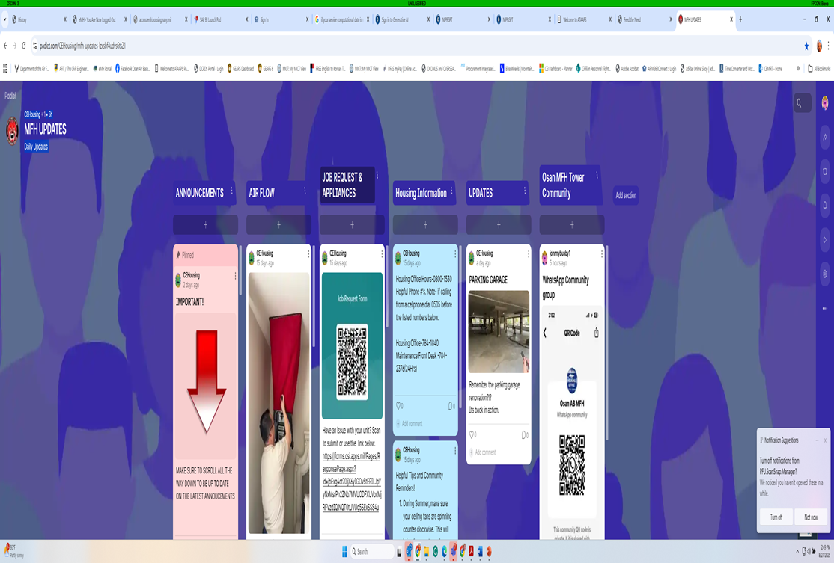

Communication Initiative

Slide 18
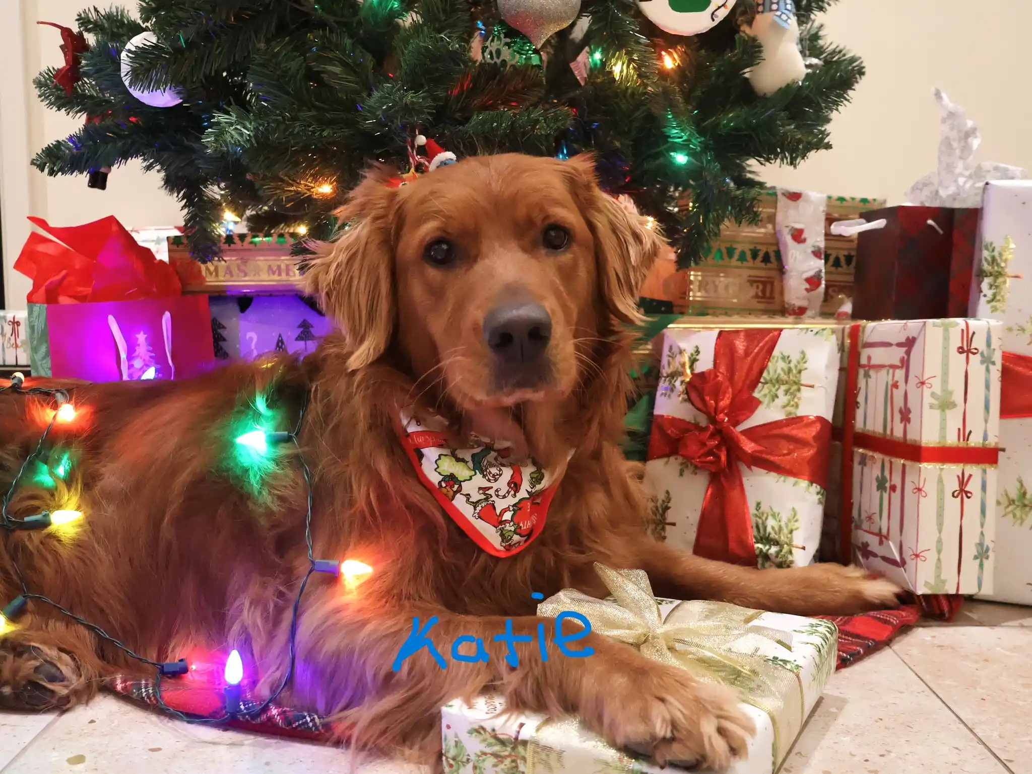
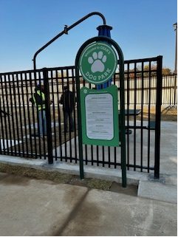
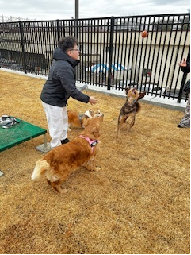
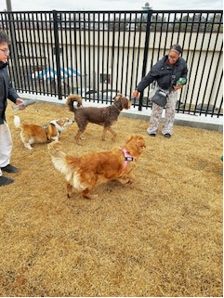
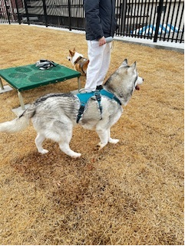
MFH Dog Park Grand Opening
Grand Opening Event
23 Dec 2025 Hug Success
XMAS Ugly/ Cute Sweater Winner *Katie*
Big Thank you: Participants & Resident Mayor Council
Assistance Request:
Keeping door closed
Keeping area clean
Proper use of trash receptacles

Slide 19

New Pet Policy
*Osan Vet Clinic*
Base Veterinarian Capt Woods
Pet registration required for MFH
Only dogs and cats are registerable
Giardia Incident

Slide 20
Child & Youth Programs
Youth Sports
Selected a NAF-III Youth Sports Coordinator in December 2025 with an expected start date of end of January 2026.
Began coordination / field reservation for upcoming Soccer Season.
Working on impromptu marketing for Soccer Registration to aid in a smooth transition for our new Youth Sports Coordinator (goal is to hit the ground running)
Registration for Soccer expected to begin Feb 2 – Feb 27.
Tentative Soccer Schedule April 6 – May 28.
Will need volunteer coaches! Please contact 51fss.fsyy.youthcenter@us.af.mil if interested in becoming a soccer coach! Will receive discounted registration price for your participating child!

Slide 21

Child & Youth Programs
Youth & Teen Membership Fee Increase
Increased fees support NAF staff labor expenses
Increased fees support the supply costs for our year-round clubs and daily activities
Youth Center Hours: Monday, Wednesday – Friday: 1430-1800 / Tuesday: 1330-1800, No School Days: 1300-1800 (72 hours monthly)
Teen Center Hours: Monday, Wednesday – Friday: 1500-1800 / Tuesday: 1400-1800, No School Days: 1300-1800 (64 hours monthly)

Slide 22

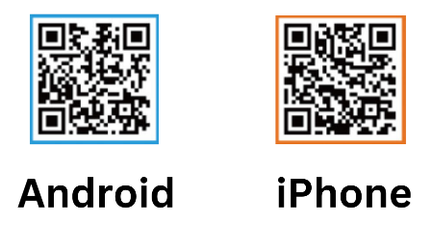

Exchange Taxi Services
EXCHANGE TAXI PLUS APP
Dispatching fee: ₩2,000
Search Exchange Taxi Plus on Apple App store or Google Play, or scan QR Code below
Create account on APP with ease
Trace your cab in real time on the map
Works with Korean and Overseas phone numbers
For Airport Pickup/Drop off service, please visit www.ftnholdings.com and select Regular Taxi or Van Taxi at top of screen, scroll down to see information needed for reservations, and send an email to taxi@usfktaxi.com
Or on the app, tap the 3 lines in top left corner to open the Exchange Taxi Service Menu
Dispatching Hours:
0500-0100, Mon-Sun
0100-0500, Auto-dispatch
Visit www.ftnholdings.com for further taxi information.
Download Here

Slide 23


Upcoming FSS Events

Slide 24


Upcoming FSS Events

Slide 25

A Taste of Opinion

Slide 26
Open Forum Q&A
Subject Matter Experts
51st Fighter Wing Leadership
MSG Leadership
Public Affairs
DoDEA Liaisons
Housing
Force Support Squadron
Medical Group
Scan Here to Submit a Question Online.

Slide 27
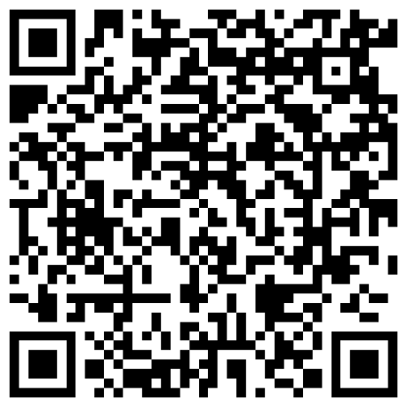
Join Us Next Time!
February Team Osan Town Hall
Date: 11 February
Time: 1700
Location: Officers’ Club
Town Hall Minutes and Slides are posted to the Mustang One Stop:

