Slide 1
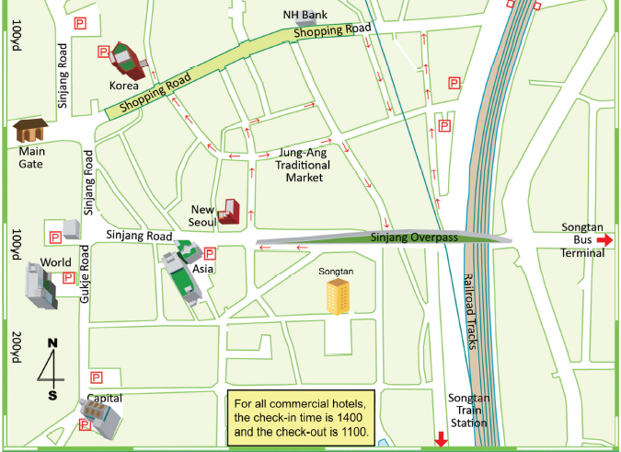
[Commercial Hotels]
Check-in time is 1400
Check-out time is 1100
Commercial Hotels List
Hotel Name | Phone Number | Room rate |  | Room Quantity |  |  | Pet Allowed |  | Email Address
 |  | Single | Double | SGL | DBL | FAM | Pet Size | Pet fee
Asia | 031-664-2367 | $74 | $100 | 72 | 10 | 6 | Small only | $10 | admin@aisahotel.kr
Capital | 031-611-7811 | $70 | $90 | 47 | 10 | - | Small only | $5 | capitalhotel7811@gmail.com
Korea | 031-662-3927 | $70 | $140 | 41 | - | 4 | No Pets Allowed |  | koreahotel3926@gmail.com
World | 031-667-5300 | $86 | $110 | 42 | 6 | 1 | No Pets Allowed |  | worldhotel21@naver.com
*Pick up service must coordinate in advance.
Air Force Inns is not authorized to recommend hotels that are not on our Commercial Hotels List. We highly recommend, if our Commercial Hotels are full to search "Pyeongtaek-si" online.
Prepared by Turumi Lodge, Osan Air Base, Korea (January 2026)

