Slide 1

Scan Here to Submit a Question
Scan Here to Submit a Question Online.

Slide 2
Military Family Housing
Osan AB Townhall
11 February 2026

Slide 3

Agenda
Seoraksan Tower Fire MNS Retrofit Temp Relocation
TSS Initiative
Elevator Assessment
Work Task Update
MFH Communication Initiative
FSS Upcoming Events
Open Forum Q&A

Slide 4
ST Temp Relocation * Fire MNS Retrofit
Background / Why
Our Commitment to Families:
  We recognize that our residents' homes are their safe havens, especially during the demands of military service. Any disruption to family life must be minimized whenever possible.
The Safety Imperative:
  Critical Safety Upgrade: Fire Mass Notification System (MNS) retrofit required to protect all residents • Contract The Dilemma:
  Operational Constraints: • Peak PCS season affecting families in transition • Tour normalization increasing on-base housing demand • Limited temporary quarters availability • Competing mission priorities • Requirement: 10 units per month completion rate
Our Family-Centered Solution:
  Pursued contract modification to protect our families: ✓ Household goods remain safely in place ✓ Contractor assumes full liability during work ✓ Families stay on-base in temporary quarters ✓ No financial burden or off-base relocation required
  Bottom Line: We prioritized both safety AND family well-being—ensuring critical fire safety upgrades while keeping disruption and hardship to an absolute minimum.

Slide 5
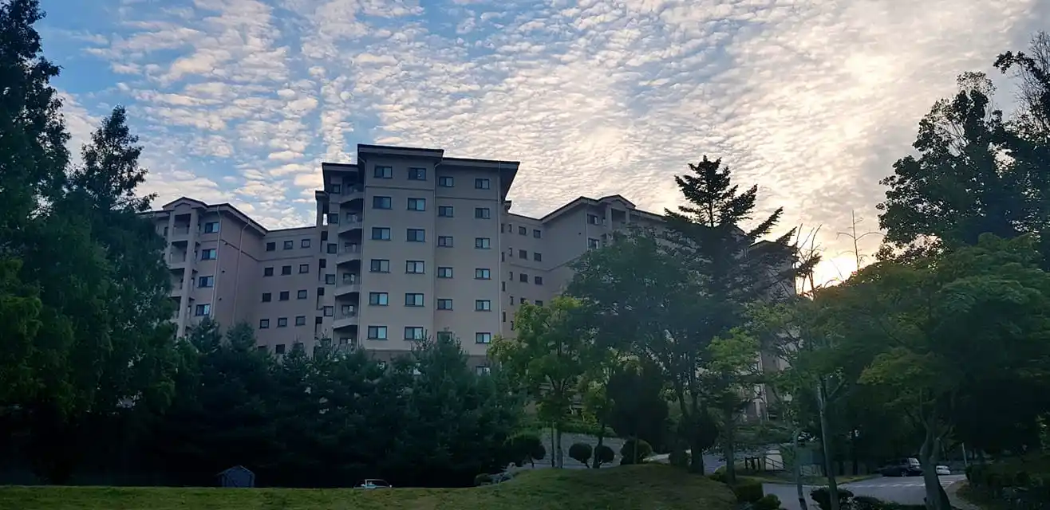
Fire MNS Retrofit Temp Relocation
Seoraksan Tower: 44 Units affected
  Residents will be notified: Military Emails
  Lodging reimbursement: MHO processed
  Renovation timeline: 30 Mar – 30 Jul
  # of days families will be relocated: 6
  Contractor Work Process:
  Entry facilitate by Housing Inspector
  Photograph unit to document existing condition & relocate furniture to non- work areas
  Furniture: covered with heavy cotton fabric
  Kitchen: fully enclosed with dust covers
  Windows & curtains: covered with vinyl sheets
  Toilets: locked (not for worker use)
  After work completion: remove all protective
  covers, return furniture to original positions
  followed by GOV inspection

Slide 6
Resident Action Items
REMOVE from Unit:
Cash, securities, valuables, and important documents
Secure in Wardrobes:
Place items inside wardrobes wherever possible • Seal doors with tape and sign across seal
Consolidate in Kitchen/Storage Room/EBS Room:
Small & decorative items | Consumables & cleaning supplies | Home appliances | Floor coverings, rugs & carpets | Miscellaneous household items
Leave in place: Tables, desks, chairs, sofas, beds
Heavy/Wall-Mounted Items (TVs, etc.):
Contractor will photograph and either relocate to non-work areas or protect in place

Slide 7

FY26 Tenant Satisfaction Survey
FY26 Tenant Satisfaction Survey Announcement
  Dates: 02 Mar - 01 May (60 days)
  Who: CEL and Associates
  Method: Online - Questions are uniform across the DoD and housing types
  Participation Goal: 20% for both FH and UH
  Survey includes both UH and MFH residents; runs 01 Mar to 30 Jun 2026

Slide 8

Tower Elevator Assessment
KOREA ELEVATOR SAFETY AGENCY (KoELSA)
Inspection Quote
About
KoELSA was established on July 1, 2016, as a government organization under the ministry of the Interior and Safety. KoELSA has been dedicated to statutory inspection, education of inspectors and other elevator personnel, safety campaign, training and assistance in technological development to maintain elevator safety according to Law on the Manufacture and Management of Elevators.
Responsibilities
Safety Inspection, Accident Investigation, Standardization, Technical Services (Diagnosis, Supervision, Consulting, Appraisal), Statutory Education, Publications
Notes:
Agenda:
-B1380 Fire Suppression expansion
-B2418 Bathroom Renovation f/Rush Park

Slide 9
Scope
Machine Room
  Motor insulation & deterioration → detect internal faults
  Brake condition → verify braking force & operation
  Main sheave wear & installation → check grooves & surface defects
  Hoisting device (main rope) → inspect wear & defects
  Lifting machine base → measure inclination for safety
  Ground resistance & leakage current → prevent electric shock (if control panel outside hoist way)
  Heat generation of main parts → assess durability of motor, brake, control panel
Hoist way
  Car frame installation → measure floor level accuracy
  Elevator landing precision → check leveling differences at each floor
Performance Evaluation
  Vibration analysis → ride comfort during acceleration/deceleration
  Noise analysis → detect abnormal sounds in car & machine room
  Control panel waveform analysis → verify operating condition of key devices
  Load test & traction force → confirm hoisting capability & balance ratio
  Other defects → inspect safety devices & component conditions
No. | Equipment | Main Measurement
1 | Vibration/Noise Meter (EVA-625) | Elevator vibration measurement
2 | Level Difference Gauge | Landing level error
3 | Laser Level | Level measurement
4 | Tachometer | Speed measurement
5 | Digital Vernier Caliper | Thickness & depth measurement
6 | Digital Protractor | Level measurement
7 | Sheave Wear Gauge | Sheave wear measurement
8 | Earth Resistance Meter | Ground resistance & leakage current
9 | Memory HiCorder | Control panel operation diagnosis
10 | Motor Deterioration Tester (MAT-5 / MI3210) | Motor insulation & deterioration diagnosis
11 | Sound Level Meter (NA-27) | Noise measurement
12 | Thermal Imaging Camera | Thermal condition measurement

Slide 10
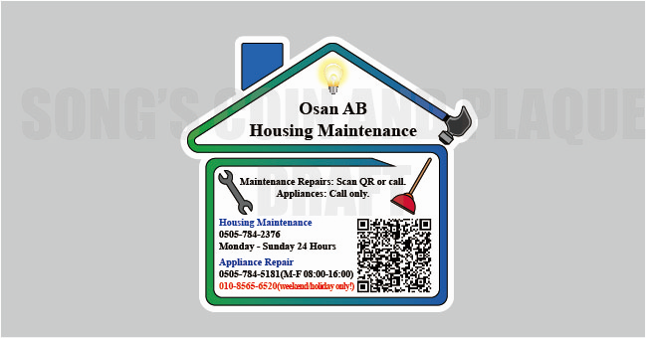
Work Task Magnet

Slide 11
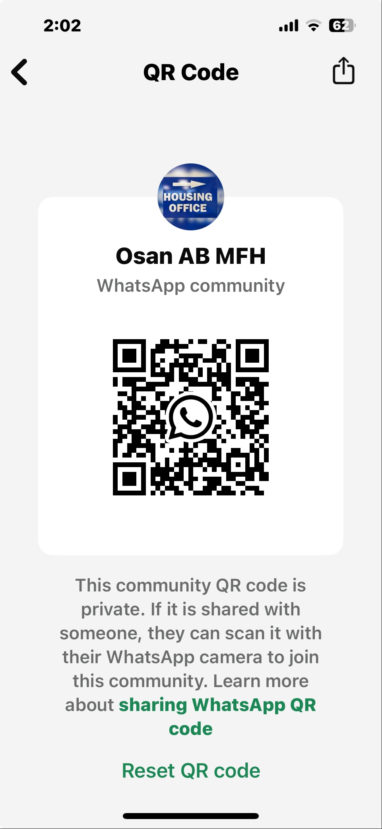

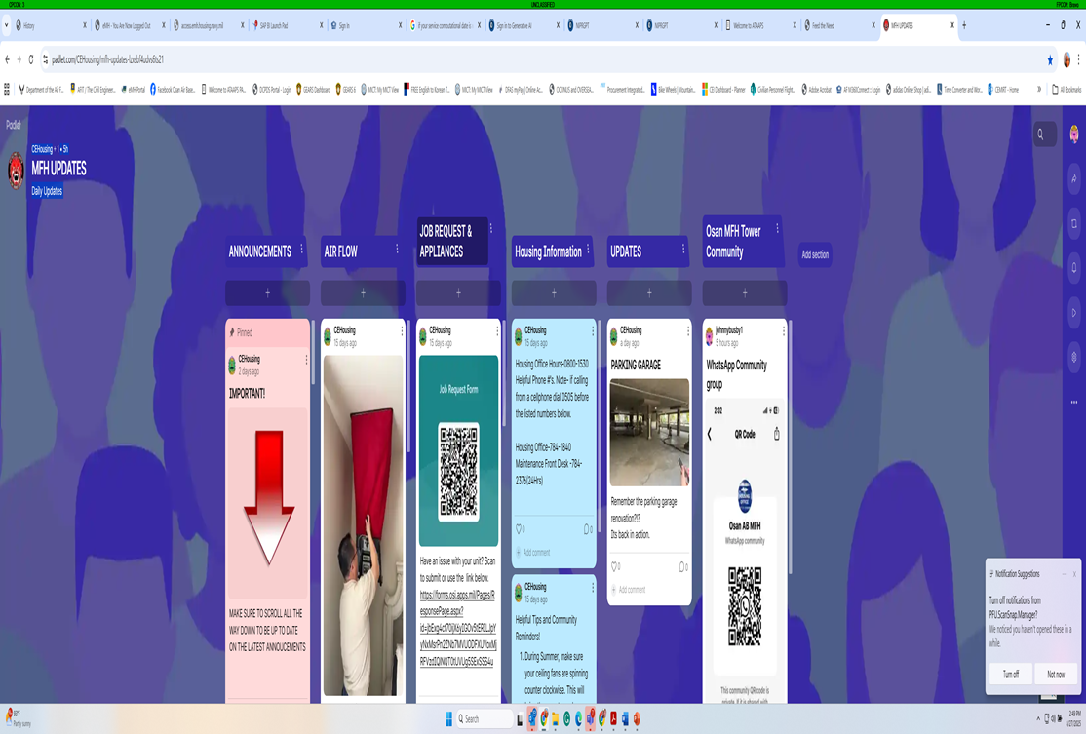
MFH Communication Initiative

Slide 12


Upcoming FSS Events

Slide 13


Upcoming FSS Events

Slide 14
Open Forum Q&A
Subject Matter Experts
  51st Fighter Wing Leadership
  MSG Leadership
  Public Affairs
  DoDEA Liaisons
  Housing
  Force Support Squadron
  Medical Group
Scan Here to Submit a Question Online.

Slide 15

Join Us Next Time!
Month Team Osan Town Hall
Date: 18 March
Time: 1700
Location: Officers’ Club
Town Hall Minutes and Slides are posted to the Mustang One Stop:

