Slide 1
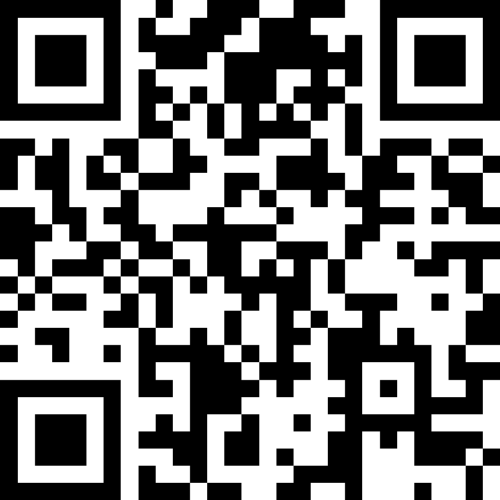
Scan Here to Submit a Question
Scan Here to Submit a Question Online.

Slide 2
51st Medical Group
Osan AB Townhall
April 2026

Slide 3
Agenda
General Clinic Information
MHS GENESIS Patient Portal
Patient and Family Partnership Council
TRICARE (Referrals, Displaced Beneficiaries, HNH)
EFMP
Access (Primary Care, Specialty Care & Networks)
Booking FAQs
Mental Health Services
Dental Care for Dependents
Tour Norm Updates & Recognitions
USO Entertainment
Open Forum Q&A

Slide 4
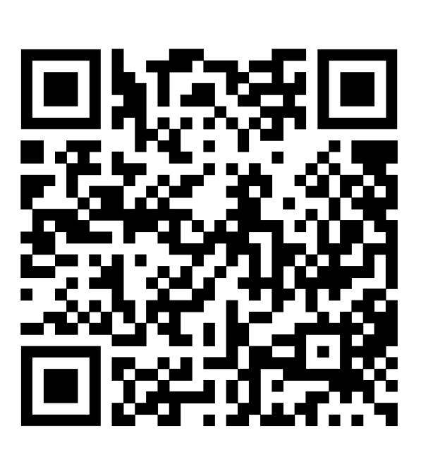

Medical Group QR Codes
51st Medical Group Facebook
MTF hours, announcements, updates, etc.
ISOS MyCare
Overseas App
Track referrals & appointments
Submit claims, find network providers, etc.

Slide 5
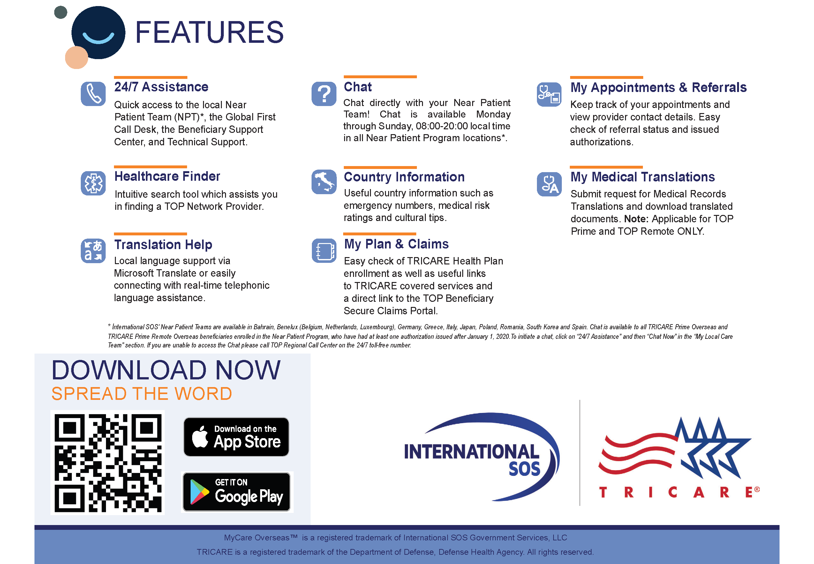

Slide 6
Medical Care
General Clinic Information
Appointment Line
Mon - Fri 0700-1600
COMM: 0505-784-DOCS (3627)
DSN: 784-DOCS (3627)
Reoccurring Closures
Clinic closed for medical readiness training on
the 3rd Thursday of each month.
Closed for federal holidays and limited services on FW Down Days.
(UPDATED) Pharmacy Hours
Mon - Fri 0730-1630

Slide 7
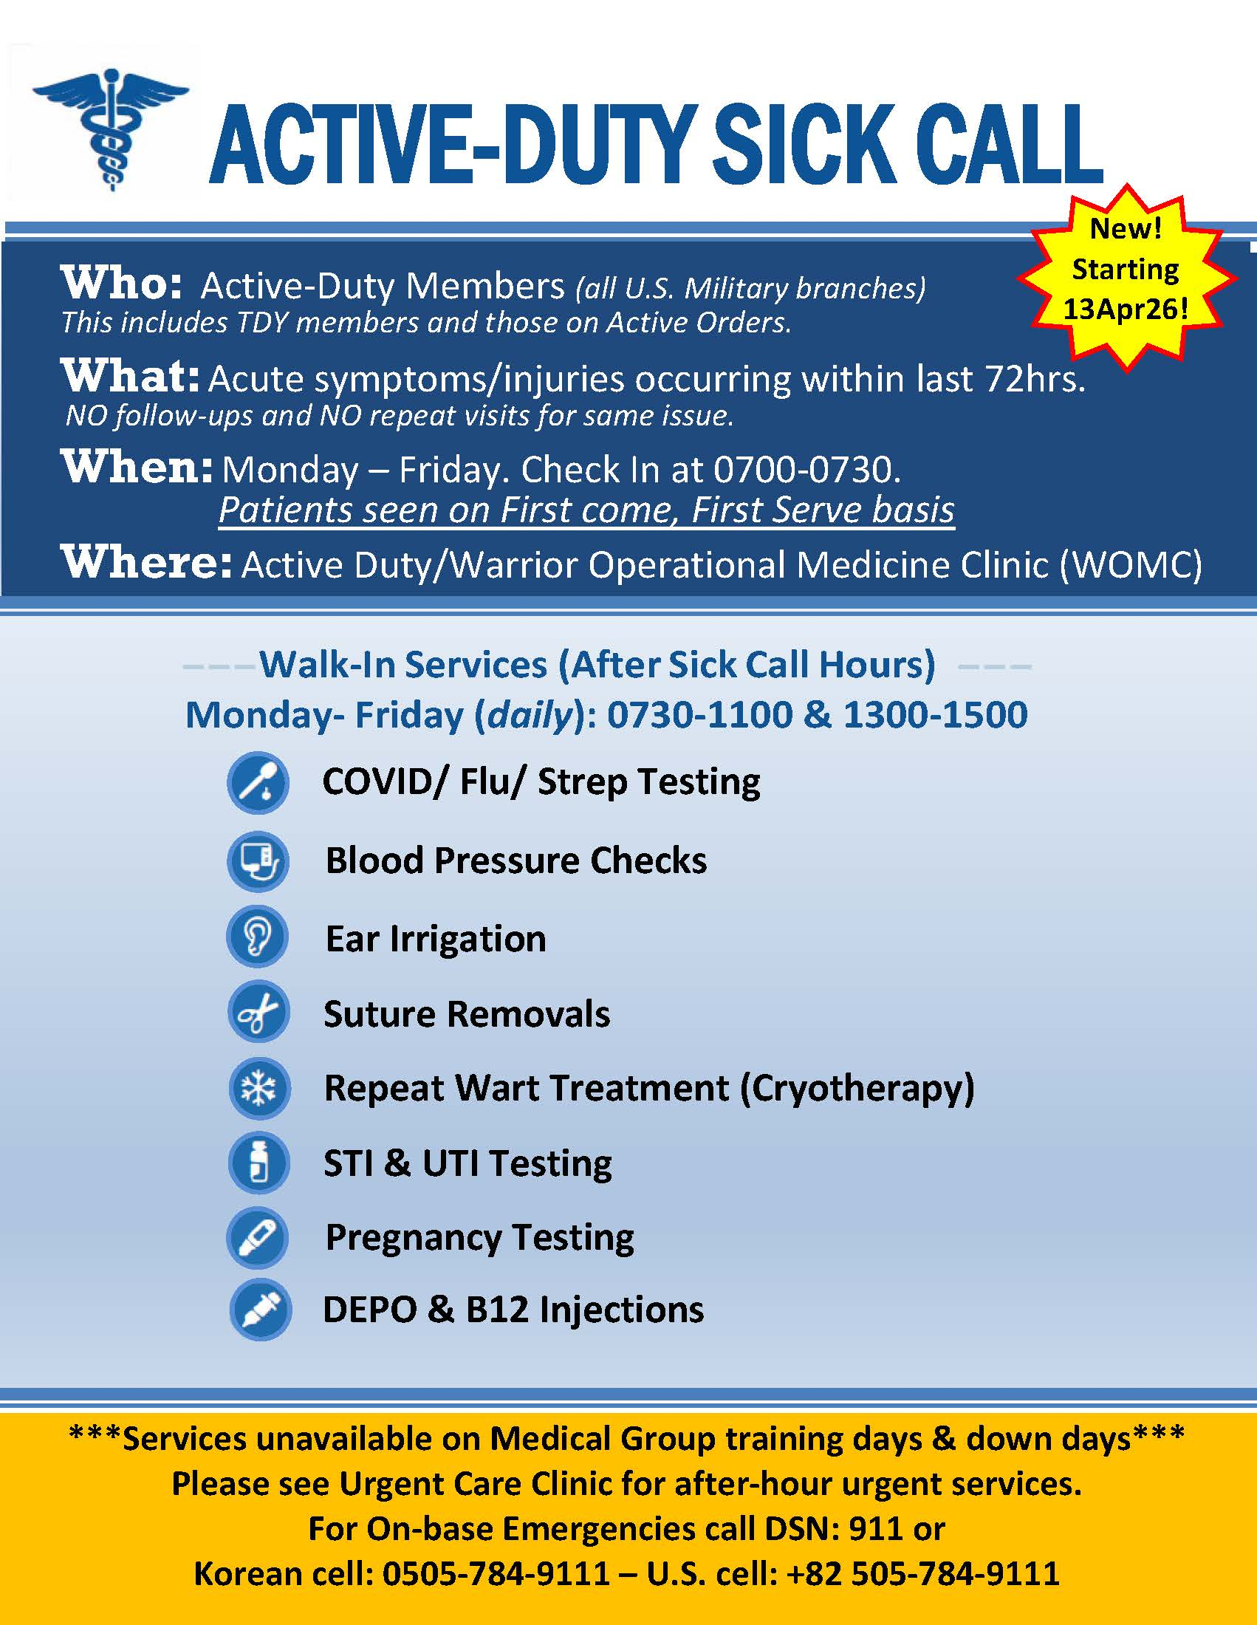
Medical Care

Slide 8
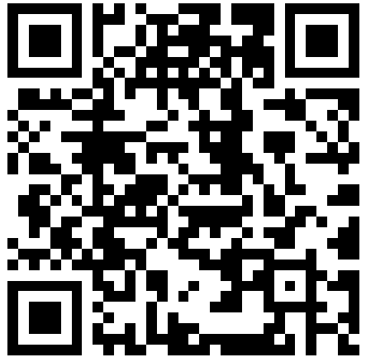
Medical Care
Patient Handbook
Scroll down to the 51 MDG Patient Handbook

Slide 9
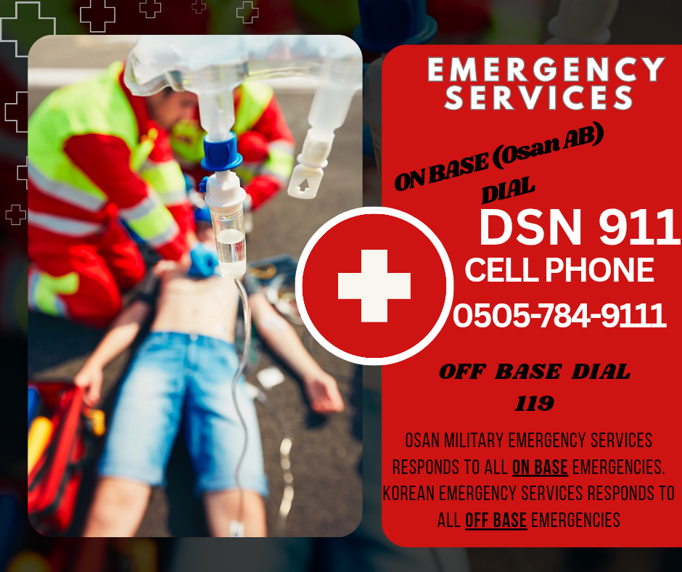
Emergencies
ON-BASE EMERGENCIES:
  Dial 911 from any DSN line.
  If using a Korean cell phone, dial 0505-784-9111.
OFF-BASE EMERGENCIES:
  Dial 119 (Korean Emergency Services)
  Go off-base for stroke, cardiac arrest, severe trauma, etc.

Slide 10
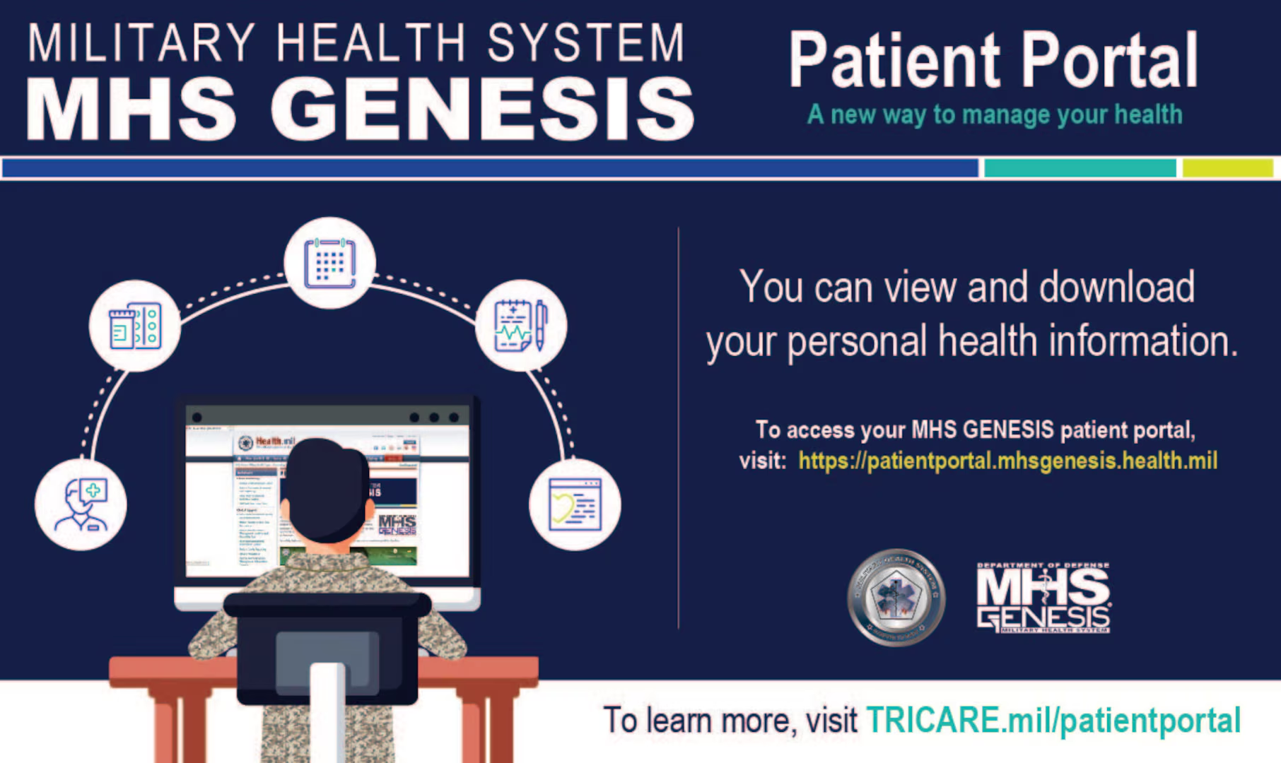
MHS GENESIS Patient Portal
View Health Record
  (clinic visits and test results)
Message your PCM Team
Pharmacy Refill Requests
To access the MHS GENESIS
Patient Portal visit:
https://my.mhsgenesis.health.mil
Notes:
GPM: Add MHS appointments online

Slide 11

Patient and Family Partnership Council (PFPC)
Patient and Family Partnership Council
If interested, please send us your contact information (Name, Phone Number, Email) to the Patient Advocacy Org Box
usaf.osan.51-mdg.mbx.mdg-patient-advocacy@health.mil

Slide 12
TRICARE In-Processing & ISOS
Mandatory TRICARE Briefing for AD Members
  Tuesdays, Wednesdays, and Thursdays
    (excluding federal holidays & exercise weeks)
  From 1300-1400
  Mustang Community Center – Ballroom
International SOS (ISOS) is responsible for coordination of medical benefit of the TRICARE Overseas Program
  Management of referrals for TRICARE Prime members
  International medical claim dispute for ALL TRICARE members
  Translation services for TRICARE Prime members stationed overseas
Questions on enrollment or benefits?
  Visit the TOPA office on the Main Floor

Slide 13
Medical Referrals
TRICARE Prime:
  Requires referrals for specialist visits & some diagnostic services
  Beneficiaries must get a referral from their Primary Care Manager (PCM) before seeing a specialist
TRICARE Select:
  Generally, does not require referrals for most health care services
  Out-of-pocket costs (Co-pays)
  Beneficiaries can choose any TRICARE-authorized provider without a referral, although some services may require pre-authorizations.

Slide 14
Displaced Beneficiaries
Are you a displaced beneficiary?
  If you were recently displaced from an overseas duty station or your home abroad, you’re still covered by TRICARE. This displacement counts as a qualifying life event, which opens a 90-day window for you to update your TRICARE region or make enrollment changes.
  Accessible: ER, Urgent Care, Routine Care, Nurse Advice Line (NAL), Mental Health, and Prescriptions
Key Phone Numbers
MHS Nurse Advice Line | International SOS (Routine Care)
800-TRICARE (874-2273), opt 1 Available 24/7 – advice, care finder, virtual urgent car | 877-451-8659 Call before getting care or making payments

Slide 15
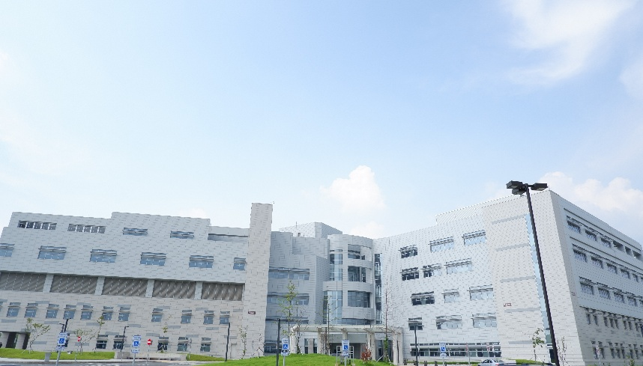

Host Nation Hospital Support
Brian D. Allgood Army Community Hospital (BDAACH) accepts a significant portion of the 51 MDG’s medical referrals.
When BDAACH is unable to accept medical referrals, ISOS sends them to Ajou University Hospital, Pyeongtaek St. Mary’s Hospital, Hallym University Hospital or Yongin Severance Hospital.
Level 1 trauma center nearby:
ROK Armed Forces Trauma Center & Ajou Trauma center

Slide 16
Exceptional Family Member Program (EFMP)
Members PCSing (CONUS or OCONUS) with dependents:
You are REQUIRED to complete an ITSQ (Initial Travel Screening Questionnaire). This will populate in MyVector within 15 days of receiving your RIP and no sooner than within 8 months of your RNLTD.
If you are PCSing to an OCONUS location, it is REQUIRED to complete the FMTS (Family Member Travel Screening). If you are PCSing to a CONUS location, it is ONLY REQUIRED if dependents are enrolled in EFMP or have an ongoing medical condition.
EFMP Contact Info: usaf.osan.51-mdg.mbx.osan-efmpm@health.mil and 784-5241

Slide 17
Exceptional Family Member Program (EFMP)
What we will need to process the FMTS application:
Finalize ALL outstanding medical, dental, or educational referrals and ensure that records are provided to the losing base SNC (Special Needs Coordinator) at your local EFMP-Medical office.
Ensure that all Adult dependents have a Physical Exam documented within the last 24 months and it is on file and current Wellness check for children.
DD Form 2792 (Medical Summary): For dependents who are enrolled, want to be disenrolled, or have an ongoing medical condition.
AF Form 1466D (Dental): for dependents 2years old or older. *ONLY if gaining base requires it”
DD Form 2792-1(Education): For all school-age dependents going to OCONUS. Only required for CONUS if the child has an IEP.
***If you are seen off base for care, we request up to 2 years of medical records. This could include discharge notes, progress notes, or treatment summaries for each specialty provider.
EFMP Contact Info: usaf.osan.51-mdg.mbx.osan-efmpm@health.mil and 784-5241

Slide 18
Clinic Access
Dependent Care (Family Medicine, Internal Medicine, Pediatrics, Women’s Health)
  Non Command-sponsored patients can be seen on a Space Available appointment.
  Call the Appointment Line after 0900 to make a same-day Space Available appointment.
Appointment Line
Mon - Fri 0700-1600
COMM: 0505-784-DOCS (3627)
DSN: 784-DOCS (3627)

Slide 19
Booking FAQs
When should I book an in-person appt?
Acute symptoms that do not warrant Emergency Room or Urgent Care Center
Initial request for a profile/referral
Emergency Room follow-up
Conditions that require physical assessment (i.e. blood pressure, musculoskeletal, skin issues)
First Term Airmen PHA
EFMP Clearance for family members
When should I book a virtual appt (phone)?
Medication/Condition follow-up
Referral request for an existing condition (ex. Urology referral for vasectomy)
Profile extension
Lab/Radiology results
Medical clearance
What can be done over messaging my PCM (instead of an appt)?
Medication refill request
Referral renewals
Incidences when a patient sends an attachment (Convalescent leave requests, Urgent Care Center discharge paperwork, radiology reports, med clearance form, etc.,)

Slide 20
Mental Health
The Mental Health Clinic (MH) comprises of 3 different services:
  MH (0700-1630)
    Offers individual counseling & therapy services from licensed psychologists/social workers in addition to medication management by a psychiatrist
    AD only
  Alcohol & Drug Abuse Prevention & Treatment (ADAPT) (0700-1630)
    Provides substance abuse education, assessments, and outpatient rehabilitation
    AD only
  Family Advocacy Program (FAP) (0700-1630)
    Develops & provides programs/services to prevent, halt & treat child/spouse maltreatment.
    AD & Family Members

Slide 21
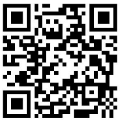
Dental Care For Dependents
Q: Where should I go for dental care?
  Any practice accepting United Concordia TRICARE Dental Program benefits
I thought Osan has a dental clinic?
  Yes, but routine care is not available for dependents
Q: Where can I find a provider?
  Use UCCI’s “Find a Dentist” tool
Q: Can I trust these providers?
  YES! They are credentialled through UCCI and must meet US standards of education and practice
Q: Who do I call for questions or complaints?
  First: Contact UCCI directly
  Second: CAPT Michael Flannery, the TRICARE Pacific Region Dental Director
  michael.b.flannery.mil@health.mil – 090-6652-9811 – DSN (315) 645-4849

Slide 22
Tour Normalization Updates
Medical Annex MILCON (2030 projected completion)
Working with AFMEDCOM, PACAF & DHA to right size manning
TRICARE Prime Remote for CSP dependents (Pilot)

Slide 23



Recognitions
National level win – Leapfrog Top General Hospital 2025,
Grade A for Surgical Safety
Air Force level win – Surgeon General Clinic of the Year award 2025
PACAF level win – Team Aerospace of the Year 2025
(Flight Medicine, Public Health, Bioenvironmental)
Society of Air Force Flight Surgeons

Slide 24

USO Entertainment

Slide 25
Summary
General Clinic Information
MHS GENESIS Patient Portal
Patient and Family Partnership Council
TRICARE (Referrals, Displaced Beneficiaries, HNH)
EFMP
Access (Primary Care, Specialty Care & Networks)
Booking FAQs
Mental Health Services
Dental Care for Dependents
Tour Norm Updates & Recognitions
USO Entertainment
Open Forum Q&A

Slide 26
Open Forum Q&A
Subject Matter Experts
  51st Fighter Wing Leadership
  MSG Leadership
  Public Affairs
  DoDEA Liaisons
  Housing
  Force Support Squadron
  Medical Group
Scan Here to Submit a Question Online.

Slide 27
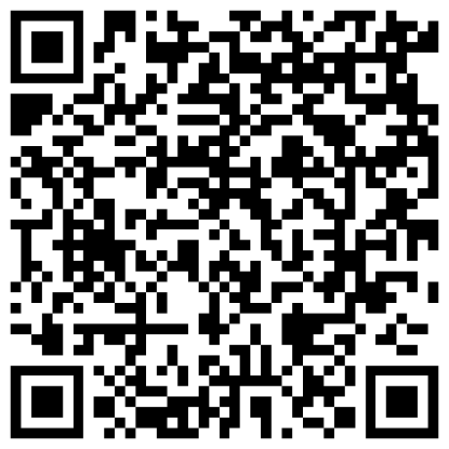
Join Us Next Time!
Month Team Osan Town Hall
Date: 20 May
Time: 1700
Location: Officers’ Club
Town Hall Minutes and Slides are posted to the Mustang One Stop:

