Slide 1
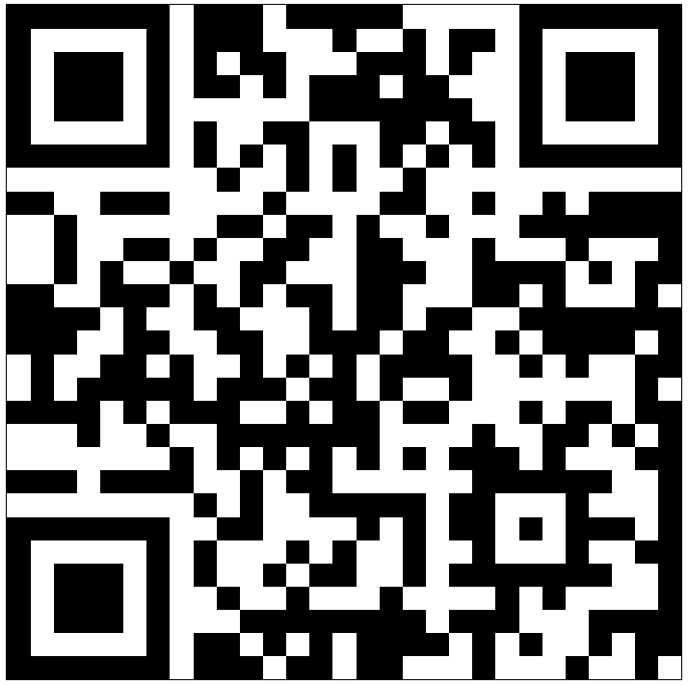
Scan Here to Submit a Question
Scan Here to Submit a Question Online.

Slide 2
51st FW Hot Topics & Updates
Osan AB Townhall
08 July 2026

Slide 3
Agenda
Tour Normalization
Community Calendar
Patriot Express Rotator Updates
Open Forum Q&A

Slide 4


Osan Tour Lengths
Accompanied Airmen with Command Sponsorship
36
1,650 CSP Authorizations
Increase 150 per year till 2,850
Tour Normalized by 2035
24
Single, Unaccompanied Airmen
12
Airmen denied Command Sponsorship
EFMP, Infrastructure or Community Services unable to support

Slide 5
Projected CSP Growth
FY26 - 35

Slide 6
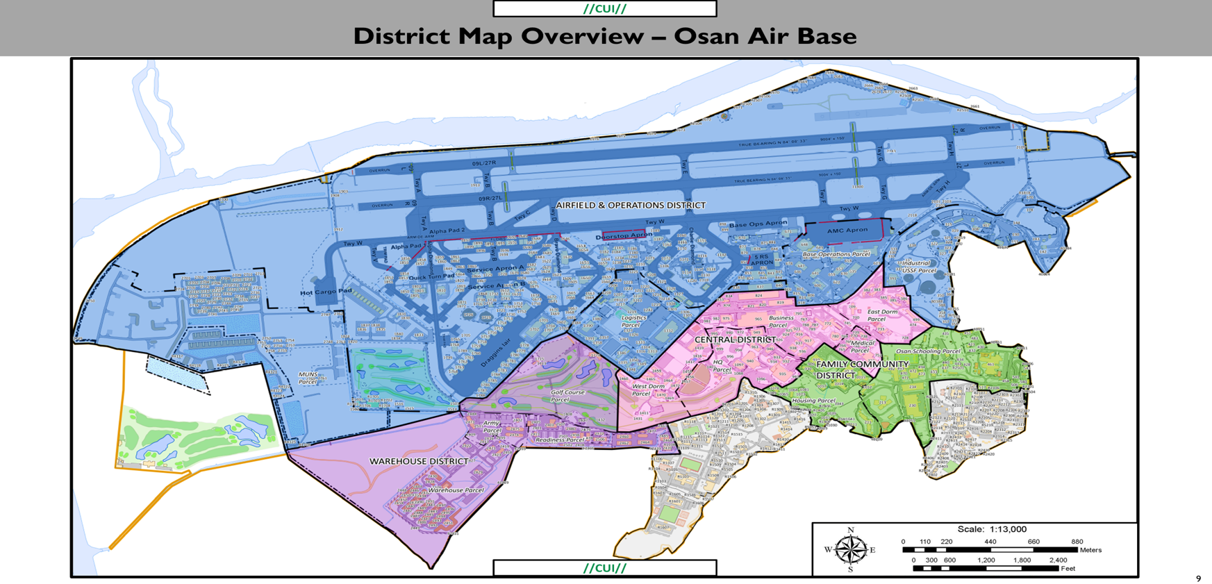
Osan 2035+ Plan

Slide 7
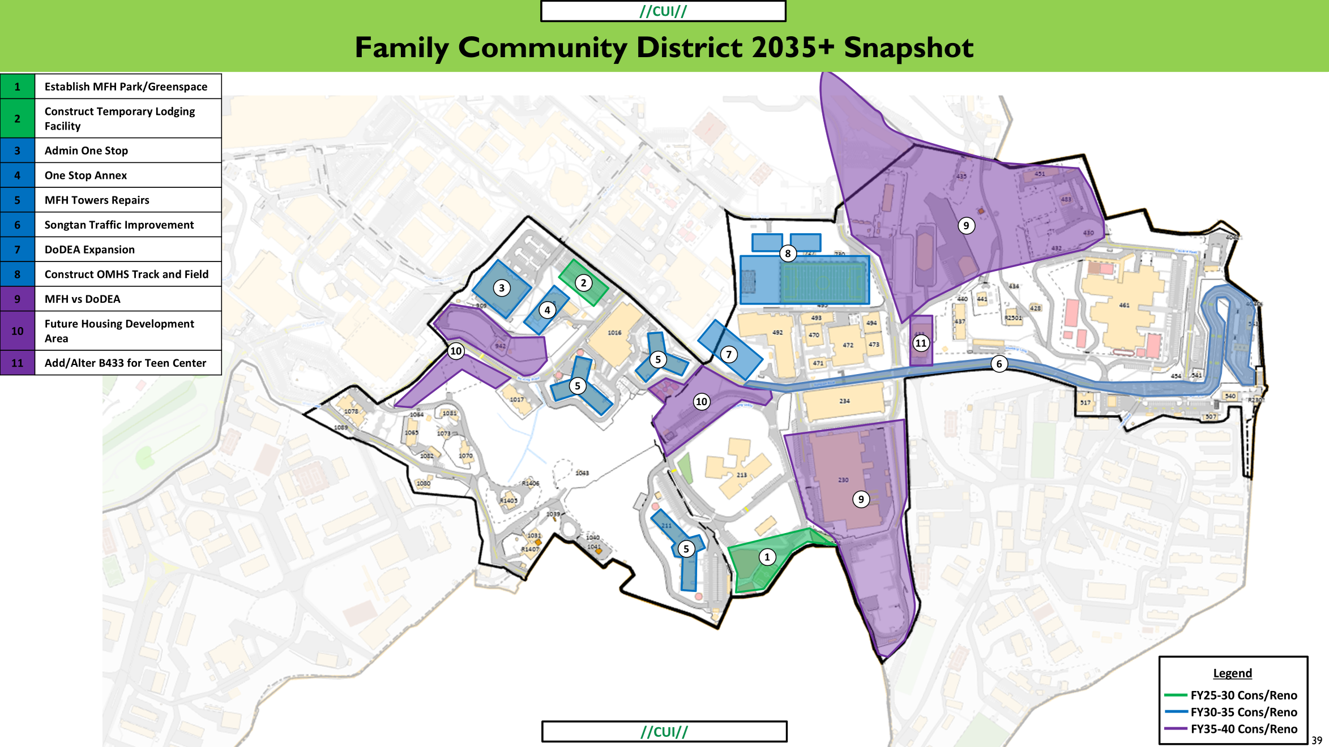
Family Community District - 2035+ Snapshot
Osan Middle / High School
OMHS
Osan Elementary
OES

Slide 8
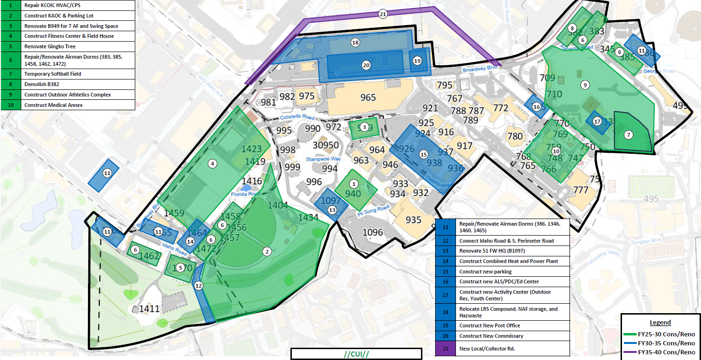
Central District - 2035+ Snapshot

Slide 9
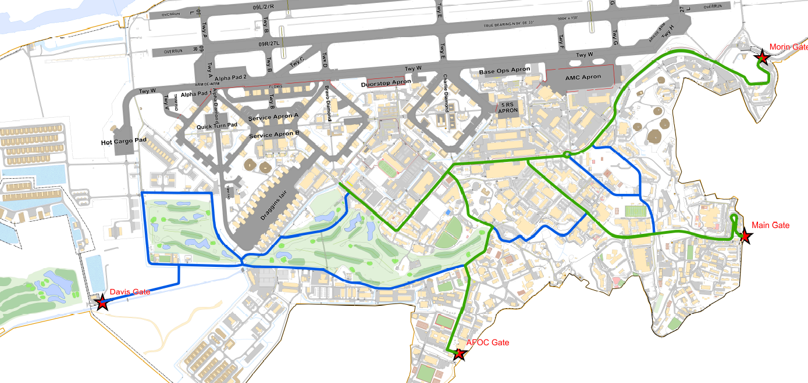
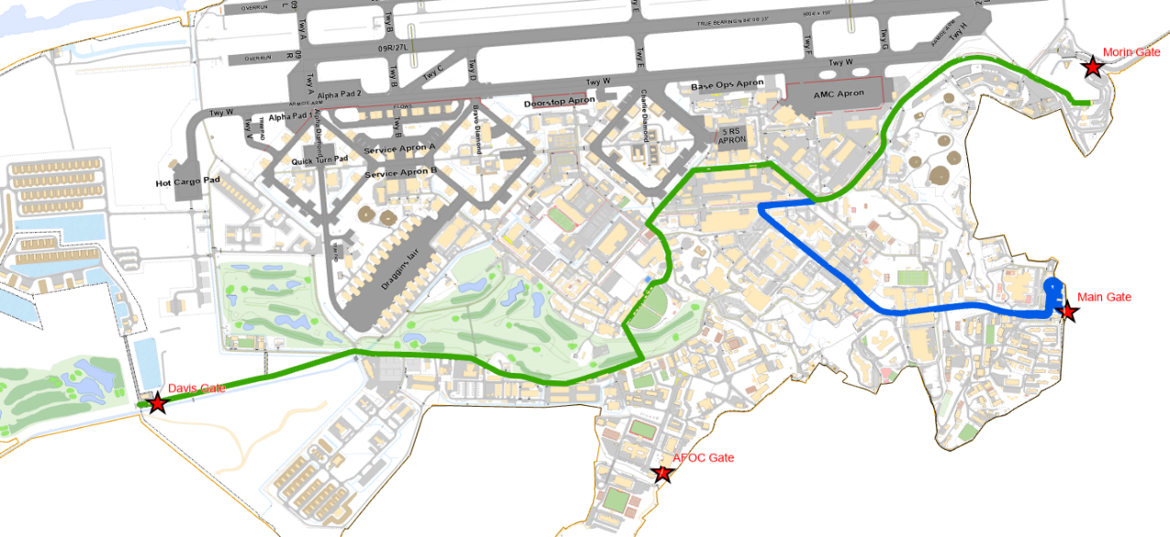
2035 Transportation Improvement Plan
Legend
Primary Route
Secondary Route
Future Traffic Flow
Main traffic route connecting West to East.
Creation of West Gate will alleviate congested traffic created by Godeok City Commuters coming on/off base.
Current Traffic Flow
Traffic flow focused on east side

Slide 10
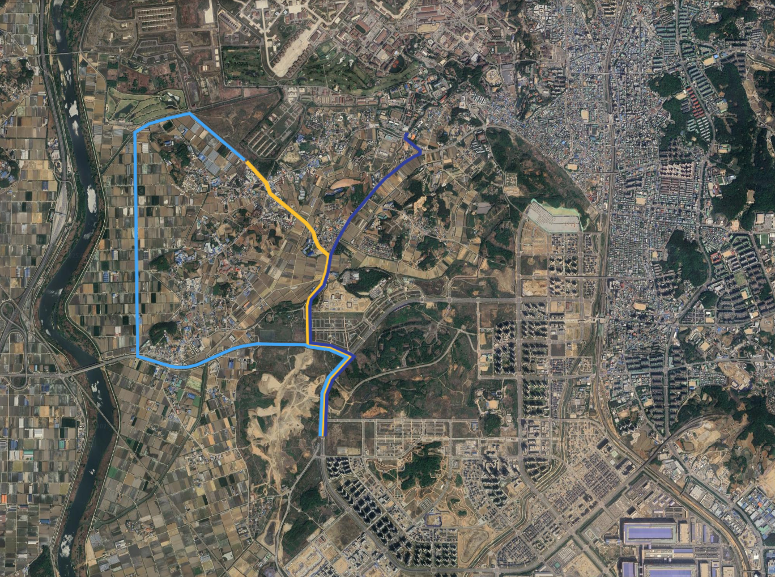
Davis Gate
ROKAF Gate
New West Gate
British Godeok
Samsung
Factory

Slide 11
Last 6-months…
Osan Teen Survey (On-going)
Base Pool Improvements (May ‘26)
Fitness Center Annex (April ‘26)
Fitness Center Locker Room Refresh (Apr ‘26)
New MFH Dog Park (Nov’ 25)
OMHS Crosswalk Light
Main Gate – 3 lanes open in a.m.
Commander & SEL Dashboard
Mustang Center Paint Refresh (Mar ’26)
Ready Families & NEO Event
Airmen Leadership School Re-opening (Feb ‘26)
U.S./ROKAF Single-Entry Control Procedures
Off-base Community Sports/STEM Trifold
Soccer/Basketball Court Project at MFH (May ‘26)
Dinosaur Park Renovation (Oct ‘25)
  4th of July
  New MFH Pet Policy (May 26)
  All Paws Pet Boarding (June ‘26)
  Main Gate Parking Redesign (Mar '26)
  Chili's AC improvements (Apr '26)
  Checkpoint at Checkertails (May ’26)
  Pass & ID Refresh (Apr ‘26)
  B1810 Bathroom Renovation (Apr '26)
  New Jirisan Chiller (May ’26)
  New Chillers Dorms 499, 1460, 1462 (May ‘26)
  Hill 180 Playground Renovation (Jun 26)
  Renovate B671 Kitchen and B1185 & B1214 Bathrooms (April ‘26)
  Military Housing Office Extended Operation Hours 0745-1600 (May ’26)
  American Red Cross Volunteer Opportunities
  Parking Improvements
  New Housing Policy (Sum ‘26)

Slide 12
Near-Term…next 12-months
Summer ‘26 – Summer ‘27
Community Calendar
Commissary Parking Garage Lighting (Sep ’26)
Songtan Road Retaining Wall Project – larger sidewalks! (Oct ‘26)
Softball Field Construction
Back-to-School Bash
Ready Families (Sept ‘26)
Checkertails Renovation (Winter ‘26)
Softball Field Construction (June ’26)
Repaint MFH Parking Structure Floors (June ‘26)
New LED Lighting in Military Family Housing (July ‘26)
Renovated Dorms B382 & B1458 (Spring ‘27)
BX Roof Repair (Sum ‘27)
Housing Fair Market Value Analysis (Sum ‘26)
Red Cross Dental Assistant Program (Fall ‘26)
Red Cross VolnTEEN Program (Sum ‘27)
Parking Improvements (Next Slide)

Slide 13

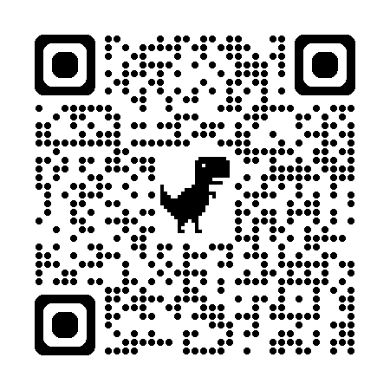
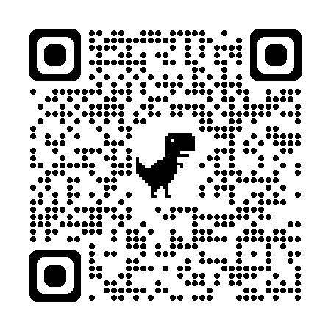
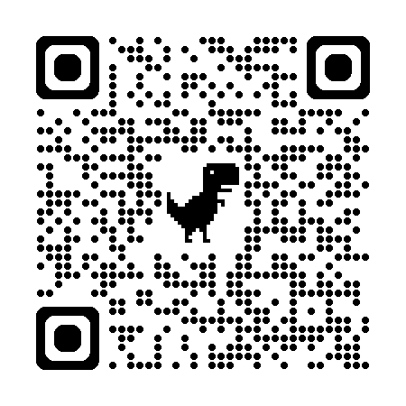
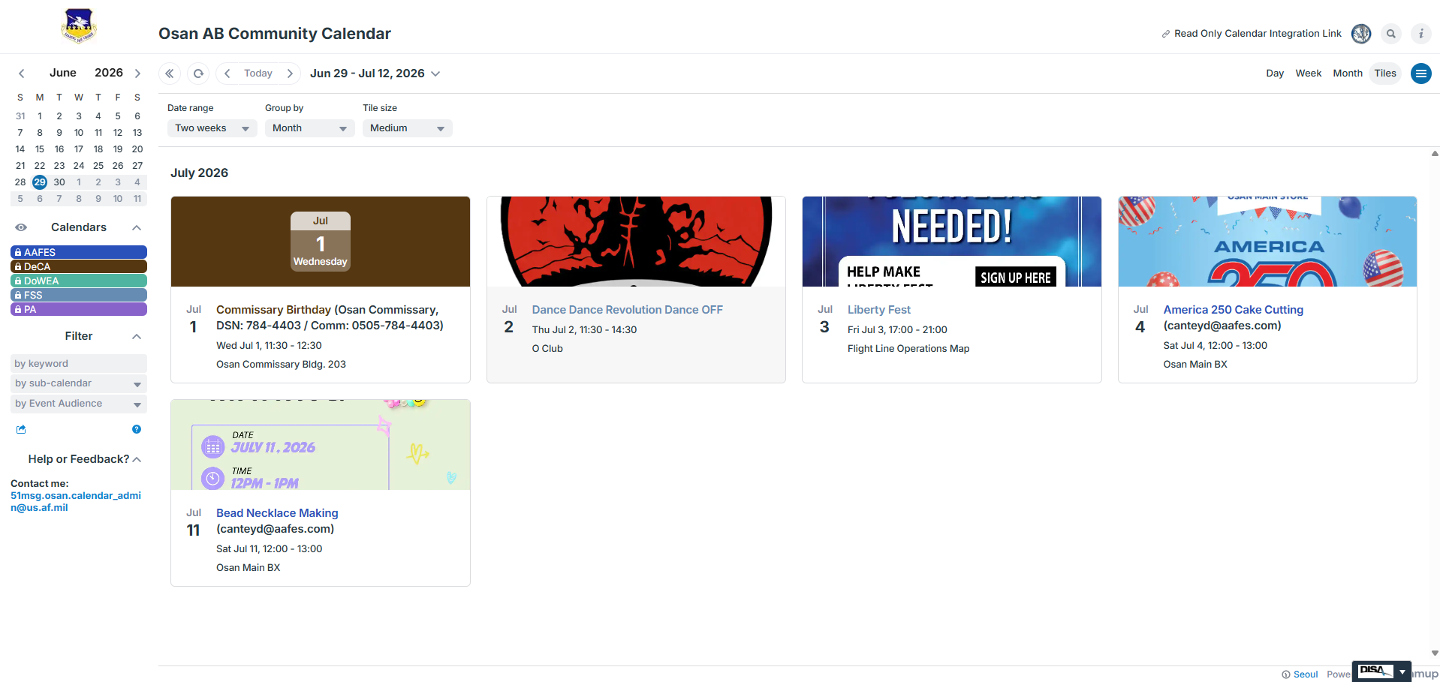
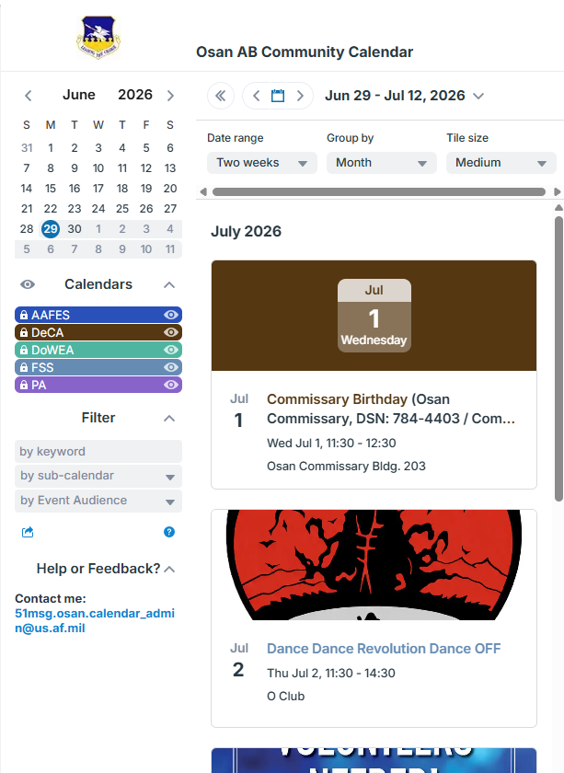
Osan AB Community Calendar
Hosted on the Osan AB Homepage!
Coming soon… On the 51st Force Support Squadron App
- Download now on the Google Play Store
- Also available on the Apple App Store
Notes:
The FSS App developer is Straxis, and they reside stateside. The embed URL has been provided to FSS and the expected ETA would be 3~5 business days for implementation.
FSS Marketing will not be the POC for updating the Osan AB Community Calendar with events. SrA Peloquin is standing by for 51st FSS POC’s.

Slide 14
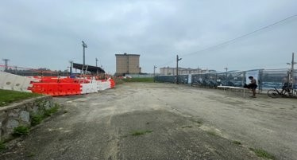
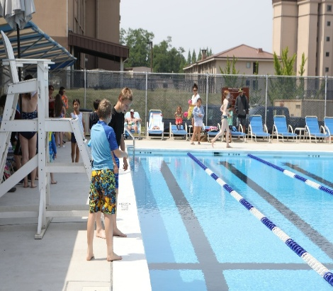
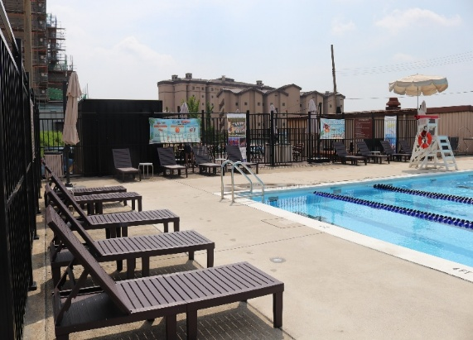
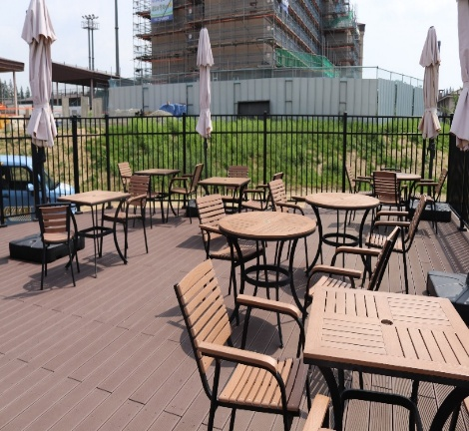
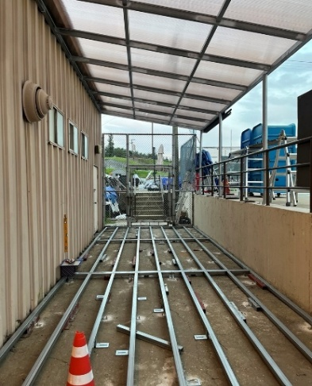
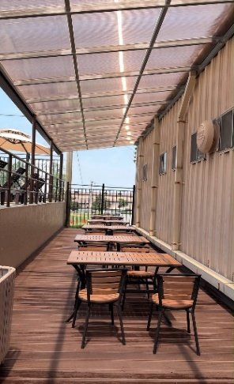
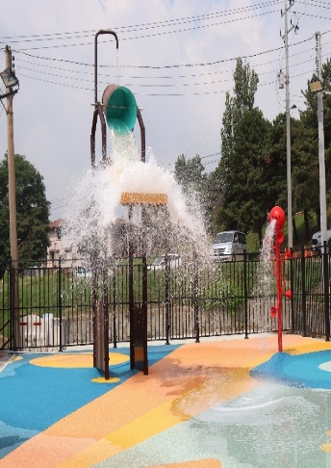
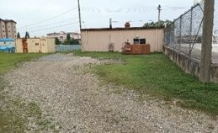
Base Pool Improvements

Slide 15
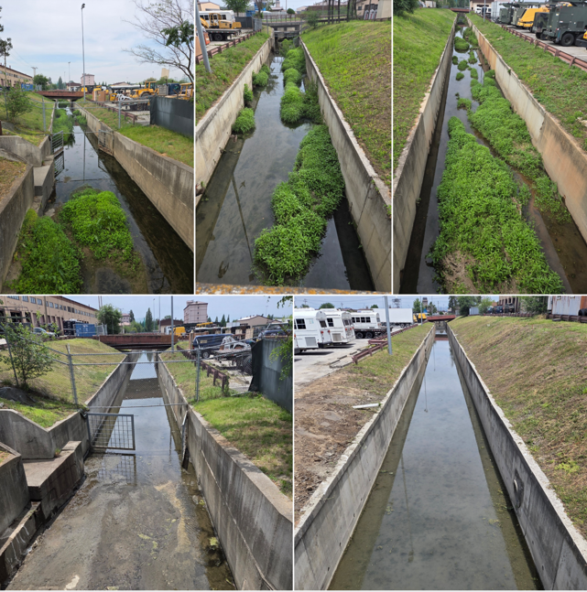
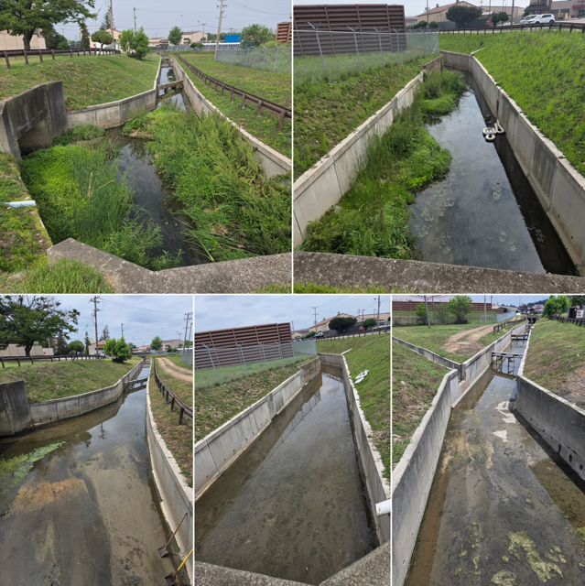
Behind the Scenes…
We’re always working

Slide 16

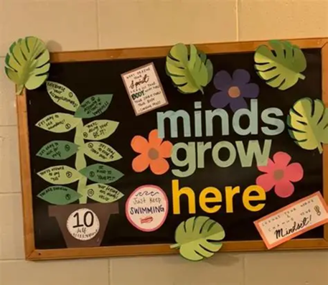
Ready Set Grow, Back to School Expo!
Description: Join the IRO team and FSS for an interactive resilience event that teaches practical skills and shows how we put the F in FSS for fun. This event offers short workshops, hands‑on “Growing With Me” activities, and community games designed to boost confidence, coping skills, and connection as you begin the new year. Snacks and take‑home resources provided.
When: 11 Aug
Where: OMHS Gymnasium/Endurance Field
Time: 1630 – 1830 (1530 EFMP early access)
Events: Library will have balloon activities, magic show and bubble man appearance, bouncy houses and more

Slide 17


Upcoming Fitness Center Improvements!
Exciting improvements coming to the Fitness Center this summer:
  Delivery of $305K in fitness equipment from AFSVC
  New Aerobics Room flooring, new workout mats
  Replacements of Men/Women bathroom sinks, faucets & shower fixtures
  Weight room improvements
  AC tower in small weight & conditioning rooms
  LED HAMR run pacer tool

Slide 18
Osan AMC Passenger Terminal
Patriot Express Changes FY27
  Route Update: Direct flight to SEATAC
  How does this impact PCS/Space-A travel?
Aircraft upgrade from B767 to B747
What does this mean for the terminal?
  Flight schedule adjustments to shift two flights per month
EARLY BIRD check-in: (HIGHLY ENCOURAGED)
  Pet Screening for New World Screw worm (NWS)
  Pet Carrier/Kennel requirement(s)
  Limited Pet Spaces – Caution! The belly can "Bulk out" before accommodating all pet spaces

Slide 19
Open Forum Q&A
Subject Matter Experts
  51st Fighter Wing Leadership
  MSG Leadership
  Public Affairs
  Housing
  Force Support Squadron
Scan Here to Submit a Question Online.

Slide 20
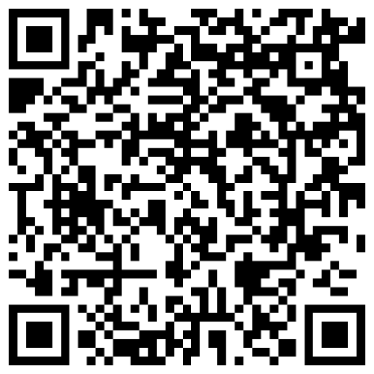
Join Us Next Time!
August Housing Osan Town Hall
Date: 12 Aug
Time: 1700
Location: Officers’ Club
Town Hall Minutes and Slides are posted to the Mustang One Stop:

