Slide 1
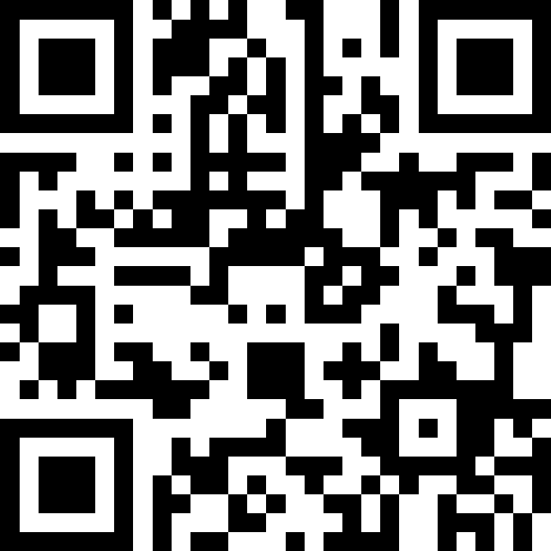
Scan Here to Submit a Question
Scan Here to Submit a Question Online.

Slide 2
Medical
Osan AB Townhall
14 October 2026

Slide 3
Agenda
AAFES Medical Contracted Services Update
Open Items from Last Medical Town Hall
General Clinic Information
MHS GENESIS Patient Portal
Patient and Family Partnership Council
Flu & Smallpox
Sports Physicals
TRICARE (Referrals, Displaced Beneficiaries, HNH, TRICARE Prime Remote Overseas)
EFMP
Access (Primary Care, Specialty Care & Networks)
Booking FAQs
Mental Health Services
Dental Care for Dependents
Open Forum Q&A

Slide 4
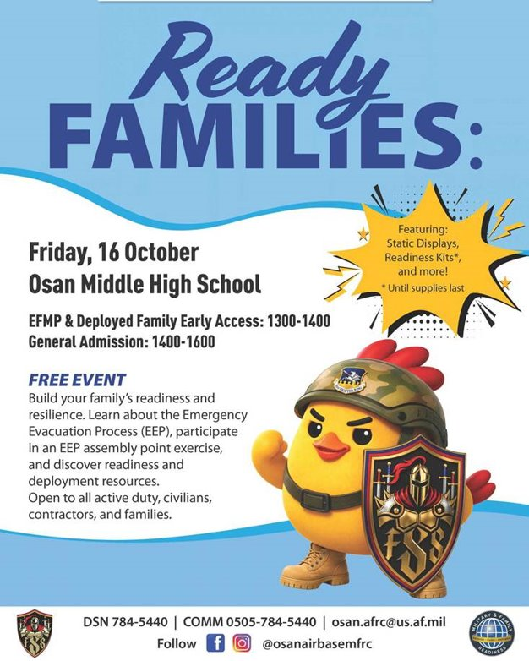
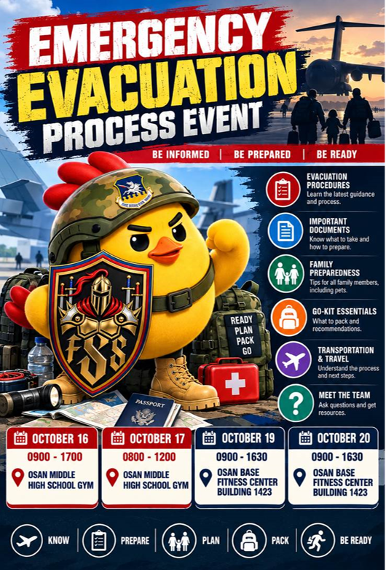
Ready Families & Emergency Evacuation Event ​

Slide 5
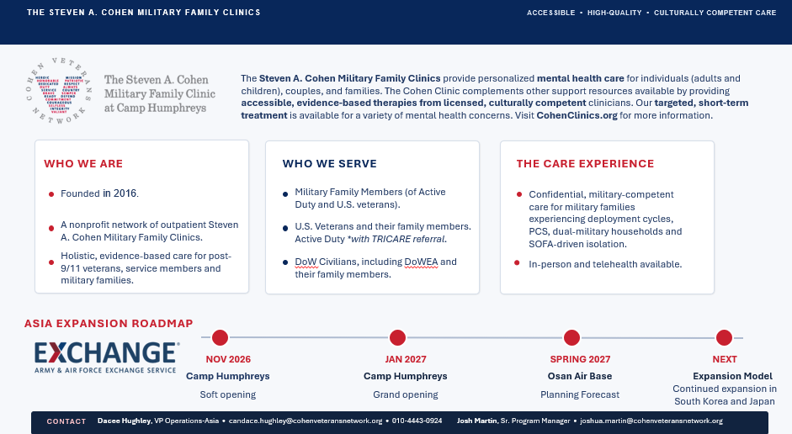
AAFES
Dental Services – Target opening spring/summer 2027.
Notes:
7AF initiative (USAF and 7AF only)
Phase 1: July 2024 – Oct 2025 (36 FS)
Phase 2: Nov 2025 – July 2026 (35 FS)
Experimental test – 2 x ~30-31 Primary Aircraft Assigned Super Squadrons at Osan AB
Korean Basing Action = permanent (TBD)
Maximize efficiencies in one location to increase sortie generation
(LOEs: F2N!, Invest in Osan AB)

Slide 6
Open Items from April Town Hall
Can the base get pharmacy boxes for after-hours pickup?
  Currently there is no plan to add this capability due to cost and time required to maintain.
  Access Initiatives:
    More robust electronic inventory management system with the goal of reducing wait times for out-of-stock medications.
    Q-flow systems, to include Q-Anywhere, the text to pharmacy system that BDAACH and many CONUS sites use
    Testing email prescription reminders (limited to out of stocks currently) as an additional patient communication tool for when prescriptions are ready to be picked up.

Slide 7
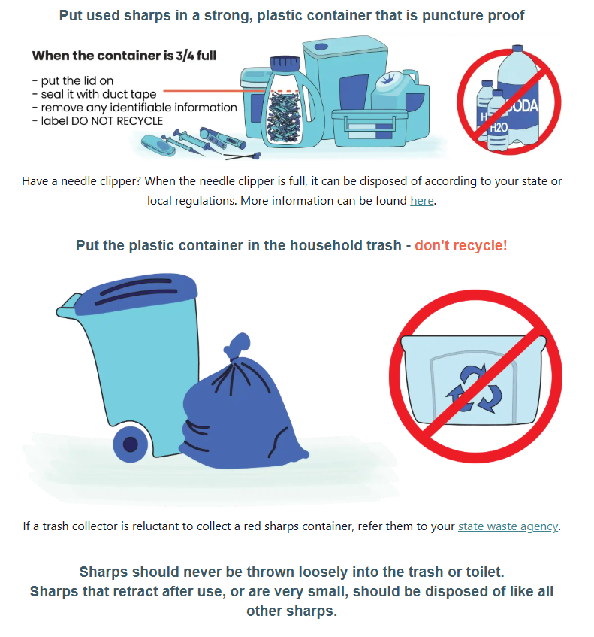
Open Items from April Town Hall
How can patients dispose of used medical sharps/needles?
  The Pharmacy & 51 MDG DO NOT take these back
  Pharmacy has sharps containers that patients can request
  ON BASE
    Use any leak-proof heavy-duty plastic container with a lid (i.e. laundry detergent) dispose in normal trash (NOT RECYCLING)
  OFF BASE
    Patients are encouraged to ask their realtors questions regarding waste disposal.

Slide 8
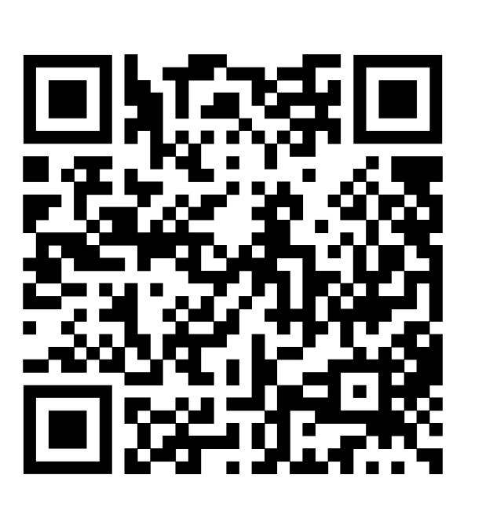

Medical Group QR Codes
51st Medical Group Facebook
MTF hours, announcements, updates, etc.
ISOS MyCare
Overseas App
Track referrals & appointments
Submit claims, find network providers, etc.

Slide 9
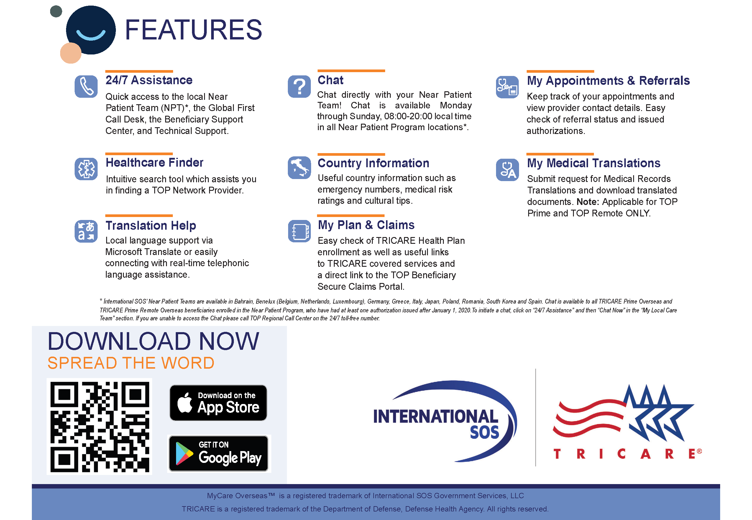

Slide 10
Medical Care
General Clinic Information
Appointment Line
Mon - Fri 0700-1600
COMM: 0505-784-DOCS (3627)
DSN: 784-DOCS (3627)
Reoccurring Closures
Clinic closed for medical readiness training on
the 3rd Thursday of each month.
Closed for federal holidays and some FW Down Days.
(UPDATED) Pharmacy Hours
Mon - Fri 0730-1630

Slide 11
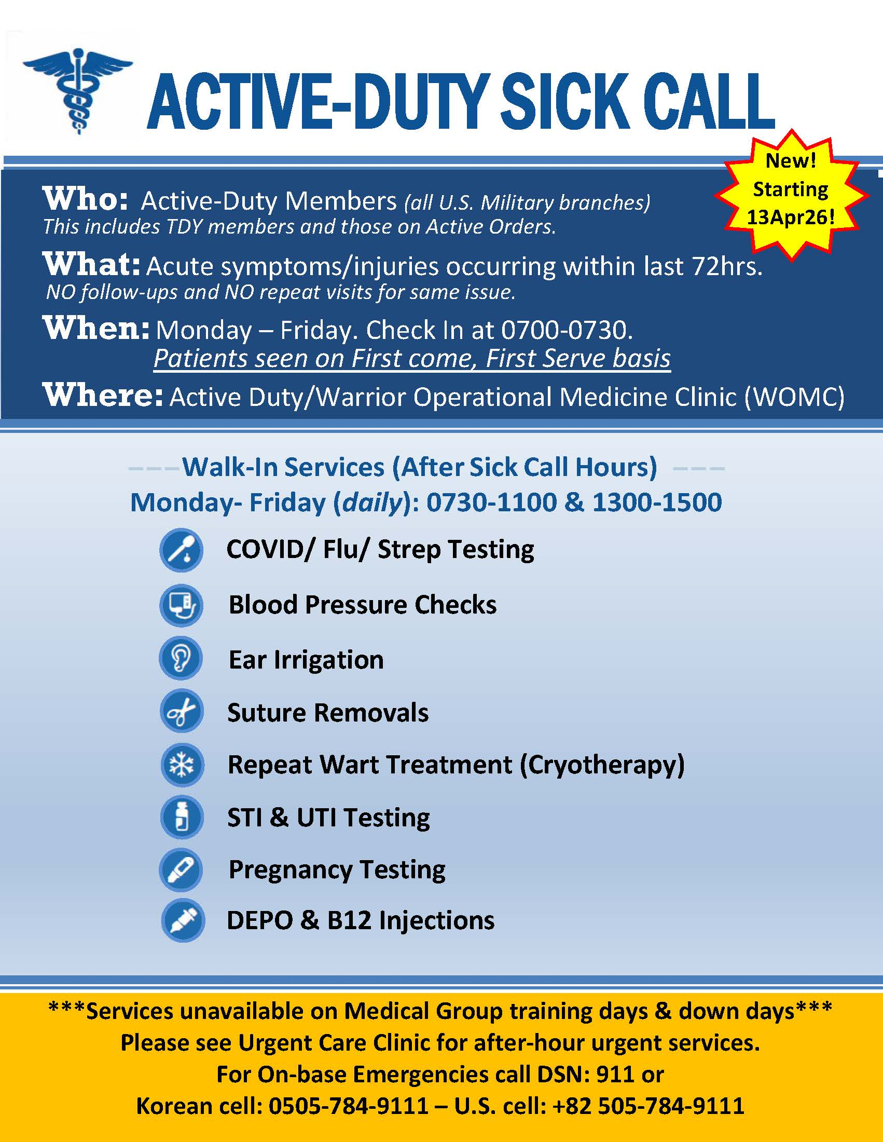
Medical Care

Slide 12
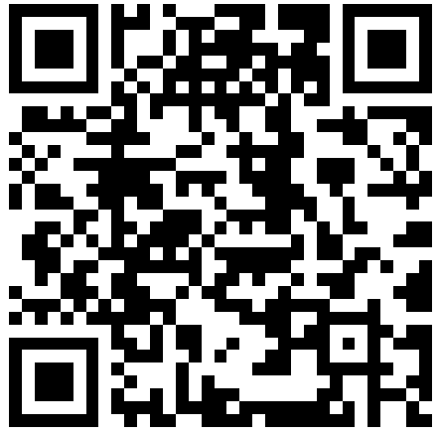
Medical Care
Patient Handbook
Scroll down to the 51 MDG Patient Handbook

Slide 13
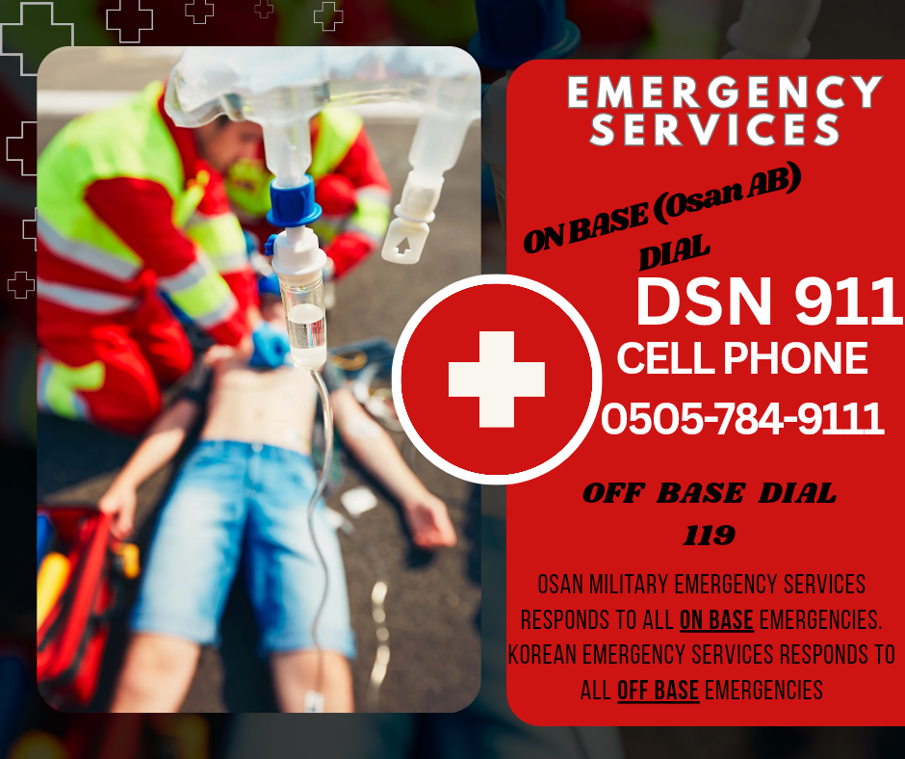
Emergencies
ON-BASE EMERGENCIES:
  Dial 911 from any DSN line.
  If using a Korean cell phone, dial 0505-784-9111.
OFF-BASE EMERGENCIES:
  Dial 119 (Korean Emergency Services)
  Go to closest ER for stroke, cardiac arrest, severe trauma, etc.

Slide 14
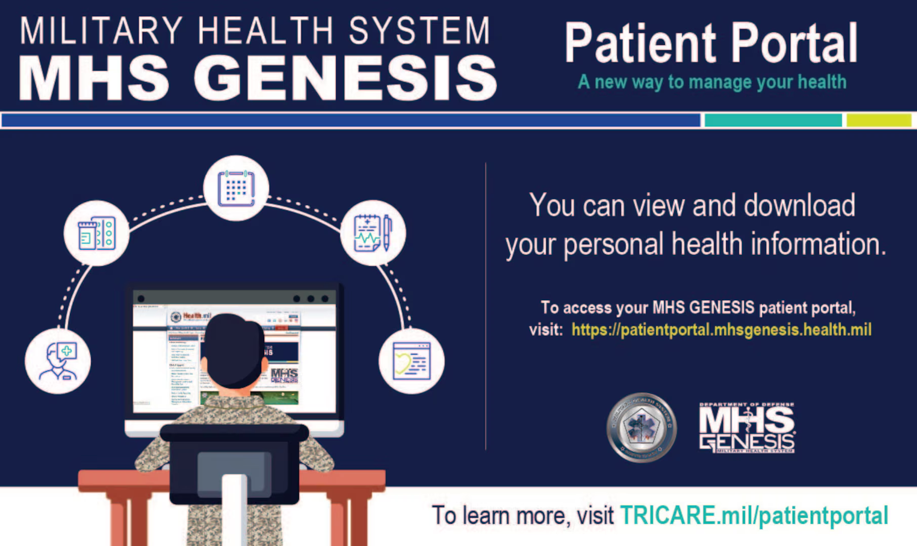
MHS GENESIS Patient Portal
View Health Record
  (clinic visits and test results)
Message your PCM Team
Pharmacy Refill Requests
To access the MHS GENESIS
Patient Portal visit:
https://my.mhsgenesis.health.mil
Notes:
GPM: Add MHS appointments online

Slide 15

Patient and Family Partnership Council (PFPC)
Patient and Family Partnership Council
If interested, please send us your contact information (Name, Phone Number, Email) to the Patient Advocacy Org Box
usaf.osan.51-mdg.mbx.mdg-patient-advocacy@health.mil

Slide 16
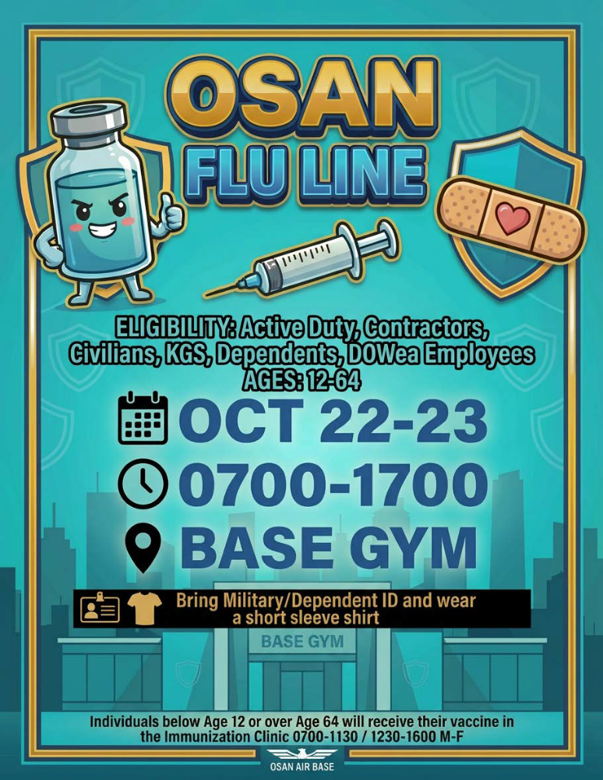
Flu & Smallpox
Flu Vaccine
  Available at the MDG!
  Flu Line 22-23 Oct at the Base Gym
Smallpox Vaccine
  Currently unavailable

Slide 17

Sports Physicals
Offered twice annually
  Fall (before school starts)
  Spring
Outside of these times members need to schedule an appointment with their provider.

Slide 18
TRICARE In-Processing & ISOS
Mandatory TRICARE Briefing for AD Members
  Tuesdays, Wednesdays, and Thursdays
    (excluding federal holidays & exercise weeks)
  From 1300-1400
  Mustang Community Center – Ballroom
International SOS (ISOS) is responsible for coordination of medical benefit of the TRICARE Overseas Program
  Management of referrals for TRICARE Prime members
  International medical claim dispute for ALL TRICARE members
  Translation services for TRICARE Prime members stationed overseas
Questions on enrollment or benefits?
  Visit the TOPA office on the Main Floor

Slide 19
Medical Referrals
TRICARE Prime:
  Requires referrals for specialist visits & some diagnostic services
  Beneficiaries must get a referral from their Primary Care Manager (PCM) before seeing a specialist
TRICARE Select:
  Generally, does not require referrals for most health care services
  Out-of-pocket costs (Co-pays)
  Beneficiaries can choose any TRICARE-authorized provider without a referral, although some services may require pre-authorizations.

Slide 20
Displaced Beneficiaries
Are you a displaced beneficiary?
  If you were recently displaced from an overseas duty station or your home abroad, you’re still covered by TRICARE. This displacement counts as a qualifying life event, which opens a 90-day window for you to update your TRICARE region or make enrollment changes.
  Accessible: ER, Urgent Care, Routine Care, Nurse Advice Line (NAL), Mental Health, and Prescriptions
Key Phone Numbers
MHS Nurse Advice Line | International SOS (Routine Care)
800-TRICARE (874-2273), opt 1 Available 24/7 – advice, care finder, virtual urgent car | 877-451-8659 Call before getting care or making payments

Slide 21
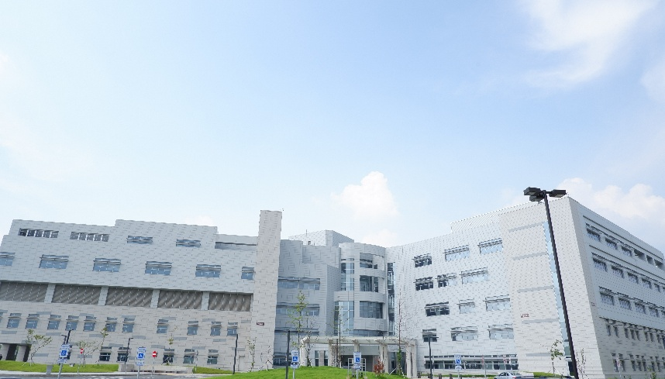

Host Nation Hospital Support
Brian D. Allgood Army Community Hospital (BDAACH) accepts a significant portion of the 51 MDG’s medical referrals.
When BDAACH is unable to accept medical referrals, ISOS sends them to Ajou University Hospital, Pyeongtaek St. Mary’s Hospital, Hallym University Hospital or Yongin Severance Hospital.
Level 1 trauma center nearby:
ROK Armed Forces Trauma Center & Ajou Trauma center

Slide 22
TRICARE Prime Remote Overseas
Survey trends
  Pros
    High overall satisfaction with Care and Access
    Improvements to Timeliness of Care
    Efficiency
      "Testing was done the same day with no wait time and care was extremely thorough.“
    International Offices
  Areas for Improvement
    Lack of communication between TRICARE and off base providers
      Led to some patients being asked to pay out-of-pocket unexpectedly.
    Referral Issues
    Hospital Assignment

Slide 23
Exceptional Family Member Program (EFMP)
Members PCSing (CONUS or OCONUS) with dependents:
You are REQUIRED to complete an ITSQ (Initial Travel Screening Questionnaire). This will populate in MyVector within 15 days of receiving your RIP and no sooner than within 8 months of your RNLTD.
If you are PCSing to an OCONUS location, it is REQUIRED to complete the FMTS (Family Member Travel Screening). If you are PCSing to a CONUS location, it is ONLY REQUIRED if dependents are enrolled in EFMP or have an ongoing medical condition.
EFMP Contact Info: usaf.osan.51-mdg.mbx.osan-efmpm@health.mil and 784-5241

Slide 24
Exceptional Family Member Program (EFMP)
What we will need to process the FMTS application:
Finalize ALL outstanding medical, dental, or educational referrals and ensure that records are provided to the losing base SNC (Special Needs Coordinator) at your local EFMP-Medical office.
Ensure that all Adult dependents have a Physical Exam documented within the last 24 months and it is on file and current Wellness check for children.
DD Form 2792 (Medical Summary): For dependents who are enrolled, want to be disenrolled, or have an ongoing medical condition.
AF Form 1466D (Dental): for dependents 2years old or older. *ONLY if gaining base requires it”
DD Form 2792-1(Education): For all school-age dependents going to OCONUS. Only required for CONUS if the child has an IEP.
***If you are seen off base for care, we request up to 2 years of medical records. This could include discharge notes, progress notes, or treatment summaries for each specialty provider.
EFMP Contact Info: usaf.osan.51-mdg.mbx.osan-efmpm@health.mil and 784-5241

Slide 25
Clinic Access
Dependent Care (Family Medicine, Internal Medicine, Pediatrics, Women’s Health)
  Non Command-sponsored patients & retirees can be seen for minor issues on a Space Available appointment.
  Call the Appointment Line after 0900 to make a same-day Space Available appointment.
Appointment Line
Mon - Fri 0700-1600
COMM: 0505-784-DOCS (3627)
DSN: 784-DOCS (3627)

Slide 26
Booking FAQs
When should I book an in-person appt?
Acute symptoms that do not warrant Emergency Room or Urgent Care Center
Initial request for a profile/referral
Emergency Room follow-up
Conditions that require physical assessment (i.e. blood pressure, musculoskeletal, skin issues)
First Term Airmen PHA
EFMP Clearance for family members
When should I book a virtual appt (phone)?
Medication/Condition follow-up
Referral request for an existing condition (ex. Urology referral for vasectomy)
Profile extension
Lab/Radiology results
Medical clearance
What can be done over messaging my PCM (instead of an appt)?
Medication refill request
Referral renewals
Incidences when a patient sends an attachment (Convalescent leave requests, Urgent Care Center discharge paperwork, radiology reports, med clearance form, etc.,)

Slide 27
Mental Health
The Mental Health Clinic (MH) comprises of 3 different services:
  MH (0700-1630)
    Offers individual counseling & therapy services from licensed psychologists/social workers in addition to medication management by a psychiatrist
    AD only
  Alcohol & Drug Abuse Prevention & Treatment (ADAPT) (0700-1630)
    Provides substance abuse education, assessments, and outpatient rehabilitation
    AD only
  Family Advocacy Program (FAP) (0700-1630)
    Develops & provides programs/services to prevent, halt & treat child/spouse maltreatment.
    AD & Family Members

Slide 28
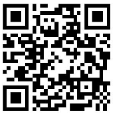
Dental Care For Dependents
Q: Where should I go for dental care?
  Any practice accepting United Concordia TRICARE Dental Program benefits
I thought Osan has a dental clinic?
  Yes, but routine care is not available for dependents
Q: Where can I find a provider?
  Use UCCI’s “Find a Dentist” tool
Q: Can I trust these providers?
  YES! They are credentialled through UCCI and must meet US standards of education and practice
Q: Who do I call for questions or complaints?
  First: Contact UCCI directly
  Second: CAPT Michael Flannery, the TRICARE Pacific Region Dental Director
  michael.b.flannery.mil@health.mil – 090-6652-9811 – DSN (315) 645-4849

Slide 29
Open Forum Q&A
Subject Matter Experts
  51st Fighter Wing Leadership
  MSG Leadership
  Public Affairs
  DoDEA Liaisons
  Housing
  Force Support Squadron
  Medical Group
Scan Here to Submit a Question Online.

Slide 30
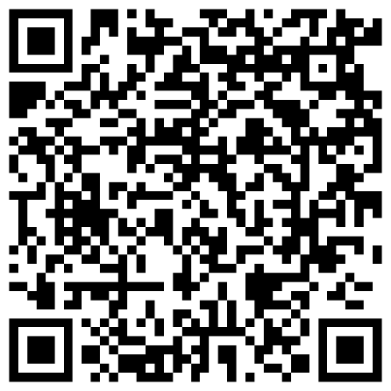
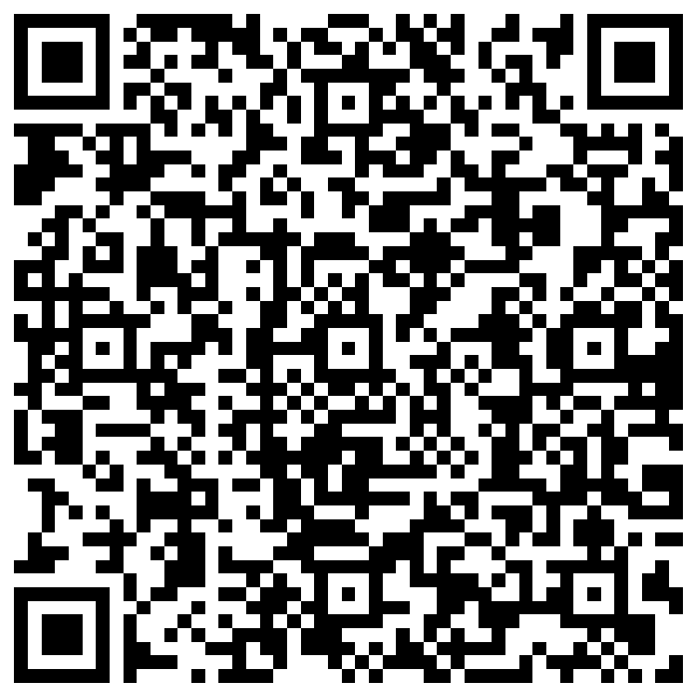
Join Us Next Time!
November Team Osan Town Hall
Date: 11 November
Time: 1700
Location: Officers’ Club
Town Hall Minutes and Slides are posted to the Mustang One Stop:
We're always looking to improve, please participate in our survey:

